Slide 1
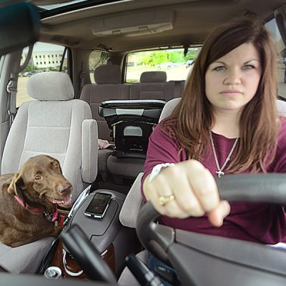
Vehicle Occupants and Driver Behavior: An Assessment of Vulnerable User Groups
Texas a&m transportation institute
Safe-D project 02-009
Learning module-educational transfer

Slide 2
overview
Project Objectives
Introducing the Dataset
Data Cleaning & Processing
Model Development Process
Creating a Model: Example in R
Interpreting Model Results

Slide 3
Project objectives

Slide 4
Speeding & occupancy
Determine whether speeding is more prevalent while traveling with occupants for:
Teenagers
Drivers (age ≥ 25 & <50) Traveling with Children
Seniors (Age 65+)
Use data traditionally used for transportation planning purposes for safety research
Based on results obtained from models, recommend safety countermeasures

Slide 5
Introducing the dataset

Slide 6
Texas Department of Transportation Travel Survey Program
Performed on a rotational basis for study areas across Texas
Traditionally used in developing rates for planning and travel demand modeling
Sample sizes range from 2,000 to 6,000 households
GPS Data of approx. 10% of the HH

Slide 7
Data Study Areas
Abilene
Bryan-College Station
Corpus Christi
El Paso
Houston
Midland-Odessa
San Angelo
Sherman-Denison
Texarkana
Victoria
Wichita Falls

Slide 8
HERE Network data
Highly detailed roadway network
Posted speed limits
Example Variables:
LinkID
Functional class
Number lanes
Lane type (e.g., bike lanes)
Pavement markings
Direction of travel
Z-levels (grade separated)

Slide 9
Data cleaning & processing

Slide 10
Travel Diary / GPS Data Linking
Original purpose
Spatial link of origin & destination locations
Temporal link of departure and arrival times
Imperfections between observed and revealed responses
Various kinds of linkages based on different parameters
D
O
Lat/Long Coordinates
Arrived: 10:45 AM
Lat/Long Coordinates
Departed: 10:00 AM

Slide 11
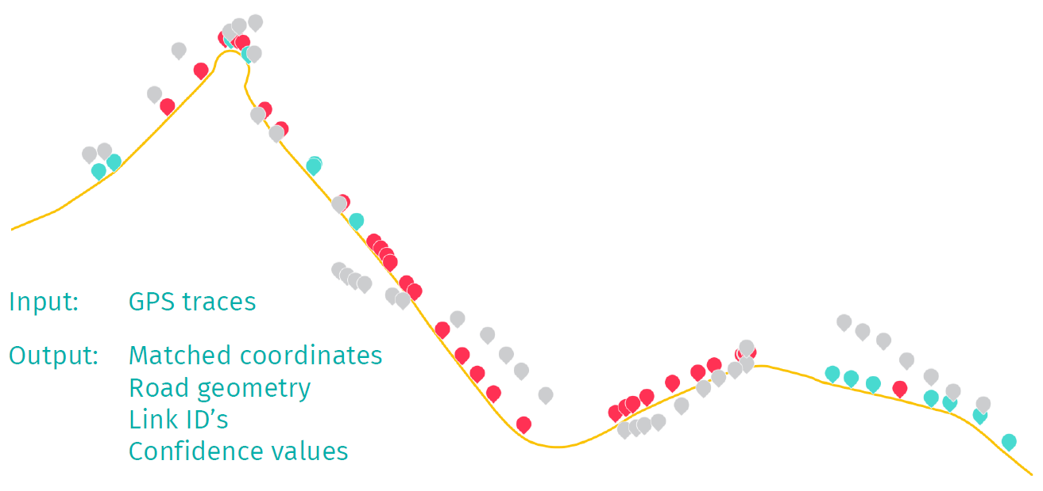
Map matching

Slide 12
Creating a Model: Example in r
Install and load libraries
Set up working directory
Load input files
Prepare tables for analysis
Perform binomial logistic regression

Slide 13
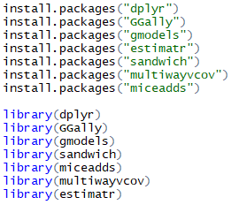
1. Install and load libraries
Move the cursor to install.packages(“dpylr”) and run the lines one by one until all the packages are installed and loaded.
Note : While installing packages, it is advised to run the install statements one by one rather than selecting multiple and running them all at once.
Useful Shortcuts for the exercise:
Description | Windows & Linux | Mac
Run current line/ selection | Ctrl+Enter | Command+Enter
Comment/ uncomment current line/ selection | Ctrl+Shift+C | Command+Shift+C

Slide 14
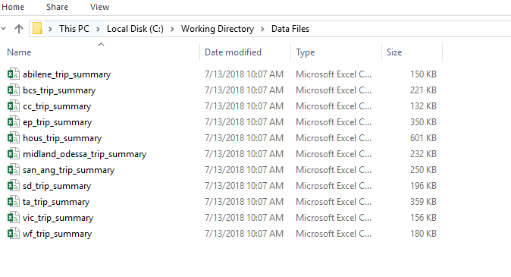
2. Set up working directory
Set the working directory as your folder where you have saved the data files. Using setwd(“C:/Working Directory/Data Files”) statement.
Note: If you are using Windows, make sure you swap the slashes to forward slash(/) after copying the address from file explorer.

Slide 15
3. Load input files
To run the model, samples from various study areas need to be merged and split into age groups.
Merge all the rows using ‘rbind’ to create one dataframe called ‘myMergedData’

Slide 16
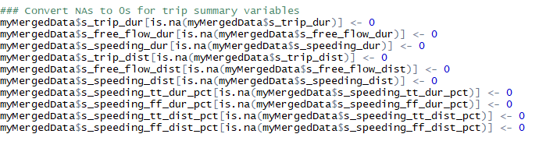
4. Prepare tables for analysis
Replace NAs with zeroes.
Note : While working on R, always replace or remove NAs in a columns if you intend to perform a calculation. Columns containing NAs always return NAs while performing calculations.

Slide 17
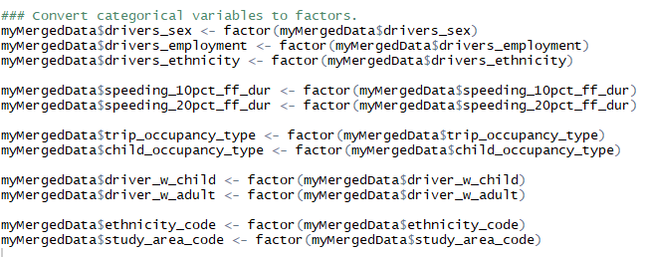
4. Prepare tables for analysis (contd.)
For the purpose of modeling, the following new variables are needed. Some of these are converted to referent groups and are identified by the value of ‘0’. A referent group is a group to which another group is compared.
unique_driver_id:
speeding_10pct_ff_dur: Speeding 10% of the trip duration. 1: true; 0: false

Slide 18
4. Prepare tables for analysis (contd.)
speeding_20pct_ff_dur: Speeding 20% of the trip duration. 1: true; 0: false
trip_occupancy_type: Number of passengers
child_occupancy_type: Number of children
trash_flag: a flag to exclude entries with zero trips
ethnicity_code: White is the referent group
study_area_code: Sherman Dennison is the referent group

Slide 19
4. Prepare tables for analysis (contd.)
Covert existing variables to referent group: Driver’s sex and employment status
Convert the above variables to factors (categorical variables in R)
female was 2 now 0
unemployed (i.e. no) was 2 now 0

Slide 20
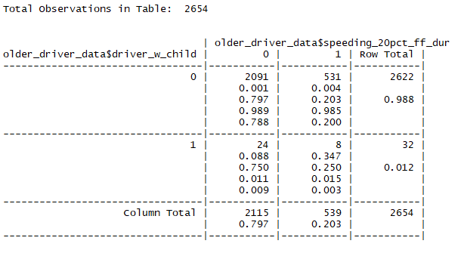
4. Prepare tables for analysis (contd.)
Create Data Subsets:
Older drivers 65+ years old
Younger drivers between 16 to 24 years old
All drivers 16+ years old
Create a cross table to assess the sample sizes in each group.

Slide 21
5. Perform binomial logistic regression
Use ‘glm.cluster’ function on various variables to calculate robust standard errors
Older Drivers: 20% Speeding drivers ->ethnicity, study area, employment, age, sex, adult passengers
Younger Drivers: 20% Speeding drivers -> study area, adult passenger, child passenger
All Drivers with Child: 20% Speeding drivers -> adult passengers, child passenger, ethnicity, study area, employment, age, sex, adult passengers
Calculate Odds Ratio and 95% Confidence Interval using the robust standard errors calculated above

Slide 22
5. Perform binomial logistic regression
NOTES:
Binomial logistic regression was selected because the outcome was dichotomous (yes/no)
Robust standard errors were used since data were clustered by driver (e.g., multiple trips per driver) thus violating the assumption of independence of observations
The terms for study areas were forced (i.e., allowed to remain in the model regardless of their statistical significance) into the model since data also were sampled by study area.

Slide 23
5. Perform binomial logistic regression
NOTES continued:
Prior to the model building process, determine the approach (e.g., forward selection, backward elimination)
Set your level of statistical significance or alpha (α). A level of 0.05 which corresponds to a confidence interval of 95% is common

Slide 24
Interpreting Model ResultS

Slide 25
Odds Ratios
Logistic regression models produce coefficients that can transformed into odds ratios (ORs). ORs can be easier and more intuitive to interpret. Odds ratios range from 0 to infinity.
The null value of an OR is 1.00. This value means that there is no indication of a relationship between an independent and dependent variable
Positive relationship: OR greater than 1.00
Negative or inverse relationship: OR less than 1.00
If the 95% CI includes 1.00, the result is not statistical significant at the α=0.05 level

Slide 26
Odds Ratios Examples
The odds ratio below was produced from a model (with more than one independent variable) constructed to estimate the association between having a child passenger in the vehicle and speeding among drivers ages 16-55 years old.
Presence of child passenger: _{adj}OR=0.73; 95% CI=0.60-0.87
0.73 is less than 1.00; speeding is less common when a child passenger is present
This is called a protective effect since speeding is less when a child passenger is present
The odds of speeding were 27% lower (1-0.73=0.27) among drivers with a child passenger present compared to drivers without a child passenger present
Said another way, the odds of speeding among those with a child passenger are .73 times the odds of speeding among those without a child passenger
This estimate is statistically significant because the 95% CI does not include 1.00

Slide 27
Odds Ratios Examples
The odds ratio below was produced from a model (with more than one independent variable) constructed to estimate the association between having a child passenger in the vehicle and speeding among drivers ages 16-55 years old.
Employed driver: _{adj}OR=1.77; 95% CI=1.48-2.12
1.77 is greater than 1.00; speeding is more common among employed drivers versus unemployed drivers
The odds of speeding were 77% higher (1.77=1.00=0.77) among employed drivers compared to unemployed drivers
Said another way, the odds of speeding among employed drivers are 1.77 times the odds of speeding among unemployed drivers
This estimate is statistically significant because the 95% CI does not include 1.00

Slide 28
Odds Ratios
A thorough and accessible discussion of the interpretation of odds ratio in logistic regression can be found at the UCLA Institute for Digital Research and Education website: https://stats.idre.ucla.edu/other/mult-pkg/faq/general/faq-how-do-i-interpret-odds-ratios-in-logistic-regression/

