Slide 1
Using a Transportation Network Company (TNC)

Slide 2
What Is a Transportation Network Company?
Car-for-hire service
Pre-arranged ride between drivers and passengers
Matches riders and drivers through Smartphone app
Examples
Other regional and local companies
Notes:
A transportation network company, or TNC, is a car-for-hire service that matches drivers and customers online, usually through a smartphone application, which is commonly called an “app.” Examples include Uber and Lyft. There are also some regional and local TNCs.
More readily available in urban or suburban areas, although there are some providers that serve rural areas. Check with local AAA for options in your area!

Slide 3
How Are TNCs Different from Taxis?
TNC versus… | Taxi
Drivers use their own vehicles | Drivers generally lease vehicles from Taxi companies. Some companies use “owner drivers”.
Rides are scheduled through an app | Rides are scheduled by phone or by “hailing” on the street
Fare is calculated prior to trip (distance, time of day) and paid through app | Fare is calculated at end of trip (by minute, by mile) and paid in person
Background check requirements vary by state | Fingerprint-based background checks required
Passenger and driver reviews through app | Passenger call company with complaints or comments
Notes:
Contacting a TNC for a ride is a little like using a taxi, but there are some differences in how TNCs operate compared to taxis. TNC drivers usually drive their own vehicles rather than company-owned vehicles. The fare for a TNC trip is determined based on the trip’s origin and destination and on the time of day, and the total is presented to the rider before the rider agrees to the ride.
But the biggest difference between TNCs and traditional taxi service is that for most TNCs, every part of the trip request, fare payment, and other communication happens through an app. The ride is requested via app, the fare is paid via app, and the passenger and driver can each review each other via the app.
For people who are not used to smartphone applications and online business, this can be intimidating at first. We are going to walk through the process step by step to show you how it works.

Slide 4
Benefits of TNCs
Flexibility
Safety
No need to…
Rely on goodwill of family or friends for rides
Drive yourself to an unfamiliar place while navigating
Drive yourself at night
Park and walk to your final destination
Notes:
TNCs can offer a number of benefits for people who don’t drive at all, but also to people who can drive but do not always want to.
Because they don’t require an advance reservation, TNCs are a flexible, as-needed transportation option.
TNC drivers tend to have safer-than-average driving records.
Finally, if you’re using a TNC for a trip, you don’t need to worry about finding your way to an unfamiliar location, driving at night or in poor weather conditions, or finding a place to park at your destination.

Slide 5
Safety Benefits
Background checks
Insurance
Driver/vehicle information and picture available
Trip monitoring
Share your location with a friend
App payment system
Notes:
Many people have understandable concerns about riding in a vehicle with a person that they do not know. These are some of the ways that TNCs promote the safety of their customers:
Before a person can become a TNC driver, he or she must pass a criminal background check as well as a check of his or her driving record. The vehicle must be in good condition, and the driver must carry insurance. In addition to the driver’s own insurance, the TNC typically adds its own insurance to cover additional liability.
The driver’s performance is also monitored during TNC trips. For instance, the Uber app reports real-time driving performance and will warn the driver about fast stops and starts and other unsafe driving maneuvers.
Being able to share your trip information with a friend provides another measure of security.
Finally, the app-based payment system means that you do not have to have money or credit cards visible during or at the end of your trip.

Slide 6
How Does a TNC Work?
Notes:
A rider requests a ride with a TNC driver using the smartphone app for that TNC. The entire trip, from the initial request for a ride to paying and tipping the driver, is transacted through this app. Next, we’ll look at this process step by step.

Slide 7
How Does a TNC Work?
Notes:
A rider requests a ride with a TNC driver using the smartphone app for that TNC. The entire trip, from the initial request for a ride to paying and tipping the driver, is transacted through this app. Next, we’ll look at this process step by step.

Slide 8
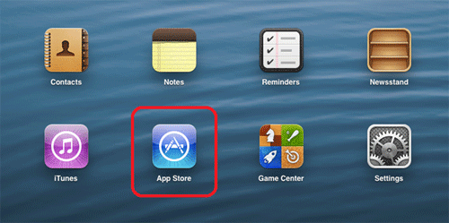
Find your phone’s online store for applications
Notes:
The first step to being able to use most TNCs is to download an app to a smartphone. Later we’ll cover some services that assist people who don’t own smartphones or are not comfortable with using smartphone apps to book TNC rides.
All smartphones connect to an online store. To download any app to your phone, you must find your phone’s online store. On iPhones, you will look for the blue “App Store” icon. On Android phones, look for the “Play Store” icon.

Slide 9
Download the Smartphone Application
Tap “Get” to download the app to your phone.
Notes:
Most apps for TNC services are free. Type the name of the TNC you want in the App store’s search window. Once the app you want is shown on the screen, tap the button next to it marked “Get” to start downloading the app to your phone.
You may be asked for your app store account name and password. If you have never downloaded an app before, you may need to establish a username (usually your email address) and a password for your phone’s app store.

Slide 10
How Does a TNC Work?
Notes:
Set Up your account
Once the TNC application is downloaded and you open it for the first time, it will ask for your name, and contact information (generally a phone number and an email address).

Slide 11
Set Up Your Account
Enter your info
Name
Phone number
Email address
Password
Notes:
It will also ask you to choose a password to protect your account information. This information will be saved and you shouldn’t have to enter it again, unless you need to change any information later.

Slide 12
Set Up Your Account
Credit or debit card number
Notes:
You will need to enter a credit card or debit card number, which will be saved to pay for future rides. You may be able to enter more than card, if you want to have more than one payment method available to you.

Slide 13
Set Up Your Account
Menu Button
Change your account information
Go to other screens
Notes:
To change your account information or get to other screens in the app, tap the menu symbol in the upper left corner of the screen. It may look like the outline of a person’s head, or it may look like three short horizontal lines, depending on the specific app.

Slide 14
How Does a TNC Work?
Notes:
Once you have your account set up, you’re ready to ride!

Slide 15
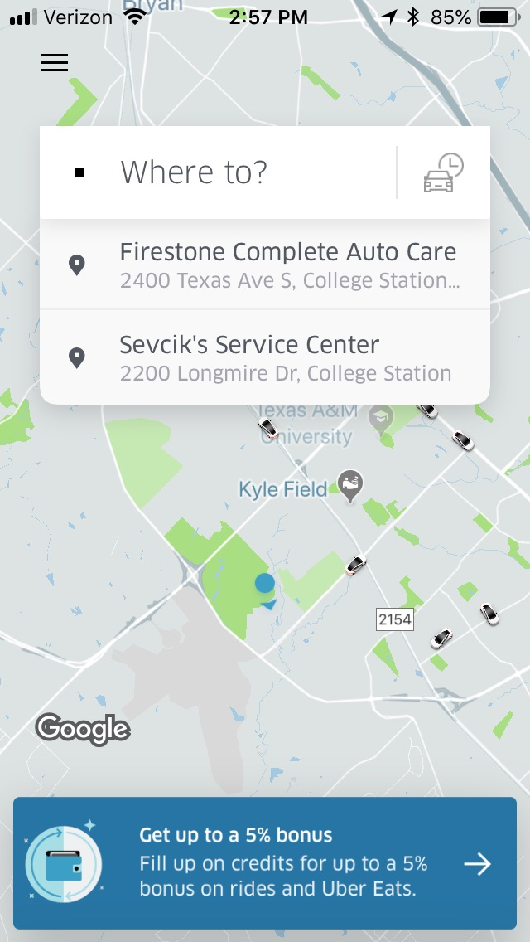
REQUEST A TRIP – Set Pickup Location
Your location
Notes:
When you open the app on your phone, it will find your current location using the Global Positioning System (GPS).

Slide 16
REQUEST A TRIP – Set Pickup Location
Type in destination
Notes:
The app will ask you to type in your trip destination. You can type in a street address, or you can try typing in the name of the place you want to go, such as the name of a restaurant or business, and see if the address automatically fills in.

Slide 17
REQUEST A TRIP – Set Pickup Location
Select ride option.
Then touch “confirm.”
Notes:
The app will display a route between your current location and the destination you entered, and show you the ride options available in your area. Tap the option you want and choose ‘confirm.’ Later in this presentation we will review some of the ride options that you may see, depending on where you live.

Slide 18
How Does a TNC Work?
Notes:
Pick up

Slide 19
Pick Up
Your driver and car shown here.
Share your trip information with a friend or relative.
Notes:
Once you have selected and confirmed your trip, the app will display a picture of your driver and the type of car they’re driving. If you want to let someone else know about your trip and when you will be arriving at your destination, some TNCs let you send that information through the app to one or more people that you select . On the Uber app, there is a “send ETA” button (for “estimated time of arrival”) at the bottom of the screen that will share your trip information with the person your choose.

Slide 20
Pick Up
Map shows your driver’s progress toward your location.
Notes:
The app’s map will let you track your driver’s progress towards your location.

Slide 21
Pick Up – Ride Arrives
Pick Up
Ride Arrives
**Need to possibly get a picture of a driver actually showing up live in an app (just a pic showing what to check for/ask when the driver does arrive.) (can stage with an actual Uber driver if need be)**
Notes:
The app will notify you when your driver has arrived. In general, drivers will wait no more than about 5 minutes after they have arrived, so be ready to walk out of the door and to the curb. Check that the make, model, and color of the car that is waiting at the curb is the same as the one pictured on the app. You can also check that the license plate number is the same as the one listed on the app’s screen. You can also ask the driver “who are you here for?”
If you do not see the car but the app is showing you that it has arrived, you can call the driver by tapping the word “contact” on the screen.

Slide 22
How Does a TNC Work?
Notes:
During the ride, you can watch your progress toward your destination on the app’s map.

Slide 23
During the Trip
Track your location on the map
Exit the vehicle at your destination
**We need a picture of the GPS during a ‘current-ride’ displaying the geographic location, or we could use a picture of the location showing they have made it to their destination successfully (can stage with an actual uber driver if need be)**
Notes:
During the ride, you can watch your progress toward your destination on the app’s map.
Once you reach your destination, you simply thank the driver and exit the vehicle. You don’t pay or tip your driver in cash; all payment happens online.

Slide 24
How Does a TNC Work?

Slide 25
Rate or Tip Your Driver
Notes:
After you have left the vehicle at the end of your trip, the app will prompt you to rate your driver. This also gives you an opportunity to make a comment about your trip or to ask a question online. You also have the option to tip the driver if you wish, though this is not required.

Slide 26
Service Types
UberX | Standard service, up to 4 passengers
Lyft | Standard service, up to 3 passengers
UberPOOL/LyftSHARED | Shared ride with another customer
Uber XL/Lyft XL | Up to 6 passengers
UberSUV/LyftLUX | High-end vehicles
UberBlack/LyftLUXBLACK | High-end black vehicles
Notes:
The standard service for TNCs is a car that will carry 3 to 4 passengers who are all part of the same group. Some areas offer a lower-cost “carpool” version of this service, such as UberPOOL or LyftSHARED, that allow a rider to share a ride, if they wish, with another customer who is traveling the same direction.
Depending on what is available in your area, you may also be able to select a ride option such as Uber XL or Lyft XL for groups of up to 6 passengers. In some cities, luxury services such as UberSUV, LyftLUX, UberBlack, or Lyft LUX BLACK offer high-end vehicles for a premium price.

Slide 27
TNC Services for Older Adults | Wheelchair Accessible | Door-to-Door Assistance | No Smartphone Needed
Uber WAV | ✓
Uber ASSIST | ✓ | ✓
Uber ACCESS | ✓
SilverRide |  | ✓ | ✓
GreatCall Rides (Lyft) |  |  | ✓
Gogo Grandparent (Lyft, Uber, others) |  |  | ✓
RideWith24 (Uber) |  | ✓ | ✓
Lift Hero (California) |  | ✓ | ✓
Notes:
These are examples of TNC services that cater specifically to older adults. They are only available in some cities. Check online or with local area agency on aging.
Uber WAV accommodates riders who require wheelchair accessible vehicles with a ramp or hydraulic lift
Uber ASSIST provides trained drivers to assist riders into the vehicles; accessible to wheelchairs, scooters, walkers,etc.
Uber ACCESS offers wheelchair accessible vehicles
SilverRide is a TNC founded specifically to serve seniors
GreatCall Rides allows riders to make trip requests on Lyft using Jitterbug phones
Gogo Grandparent offers operator-assisted TNC reservations for Uber, Lyft, and other TNCS, and also can provide extra tracking during the trip.
RideWith24 trains Uber and taxi drivers to accommodate older passengers who have physical limitations.
Lift Hero, available in California, offers roundtrip availability, phone-based ride booking, specially trained drivers with careers in health care. Designed for people who can’t use conventional TNCs.
Some of these services, like Uber WAV and Gogo Grandparent, are available in many communities nationwide. Others, like Lift Hero, are local or regional services.
If your area offers Uber WAV, Uber ASSIST, or Uber ACCESS, that option should appear as one of the ride options when you enter your destination.
Your local Area Agency on Aging, hospital, or medical center may have information about specialized TNC services in your area.

Slide 28
What If You…
Notes:
While most trips that you take on TNCs should run smoothly, the following slides cover some potential questions and situations that could come up. For instance, what if you have to cancel a ride after you’ve requested it on the app?
Look at your app’s screen for a “cancel trip” button or for a “trip information” button that should then lead to a “cancel trip” option. Cancel the trip by tapping the “cancel trip” button. You may be charged a cancellation fee through the app.

Slide 29
What If You…
Notes:
If the app says that your driver has arrived at your location, but you cannot find the driver’s car, look for the driver’s contact information on the app. There should be an option there for you to telephone the driver so that you can find each other.

Slide 30
What If You…
Notes:
If for any reason you were not satisfied with your driver or the service that you received, the first step to take is to rate your driver. As part of the rating, you will have a chance to enter a comment or complaint. Many TNC apps include some built-in comment options that you can select from. Also be aware that if your rating of your driver is low, you will not be assigned that driver again.

Slide 31
What If You…
Notes:
Tap the menu icon on your TNC app (usually at the top left of your screen). The menu should include “your trips” or “trip history.” If you select that option, you should be able to see the last several trips you have taken on the TNC, listed by date. Select the trip for which you had a fare question or problem. On that trip’s information page, scroll down and select a question or other option such as “review my fare and fees” or “request review.”

Slide 32
What If You…
Notes:
On the same “your trips” or “trip history” page, select the trip during which you left an item in the driver’s car. There should be an option on that trip’s information page to select “I lost an item,” “find lost item,” or similar. If you left your phone in the car or need further assistance with a problem, visit the TNC’s website on a computer or tablet and select the “help” button on the website. This should provide you with a way to contact the company and report your problem.

Slide 33
Questions?

