Slide 1
Motorcycle Crash Data Analysis:
to Support Development of a Retrofit Concrete Barrier System for Freeway Ramps
Authors: Jonathon Wilson, Heather Sulaica, Marcie Perez, Chiara Silvestri Dobrovolny Ph.D.

Slide 2
Acknowledgements
This project was funded by the Safety through Disruption (Safe-D) National University Transportation Center, a grant from the U.S. Department of Transportation – Office of the Assistant Secretary for Research and Technology, University Transportation Centers Program, and, in part, with general revenue funds from the State of Texas.

Slide 3
Objective
To provide support in developing retrofit options for existing concrete barrier systems to contain motorcycle occupants during an impact by analyzing:
relevant national and international studies
protocols and standards developed for motorcycle safety
crash data to identify relevant factors involved in accidents

Slide 4
Methodology
Conducted through Texas Crash Records Information System (CRIS)
One-Motor-Vehicle (OMV) motorcycle crashes
Fatal and incapacitating (KA) motorcycle crashes in TX between 2014-2016
Two general cases
Flyovers and connectors
Curves

Slide 5
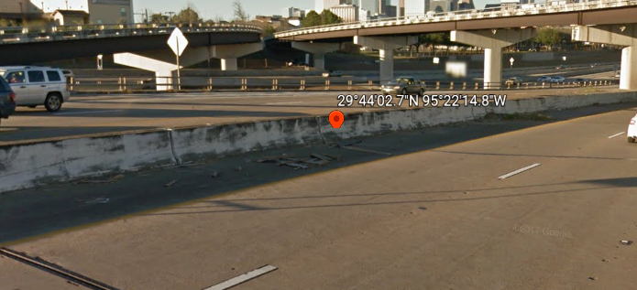
Crash Data Analysis Flyovers and Connectors
The distribution of fatal to incapacitating injuries recorded – 40% Fatal and 60% incapacitating.

Slide 6
All KA on flyovers/connectors for various roadway types
The highest number of incidents happened on interstates, followed by accidents occurring on state highways.

Slide 7
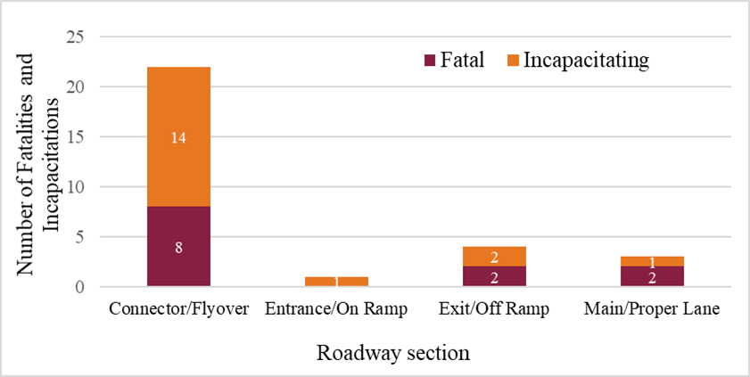
Type of Road Traveled Before First Harmful Event Resulting in KA (flyovers/connectors)
All KA on Flyovers/Connectors for Various Roadway Sections

Slide 8
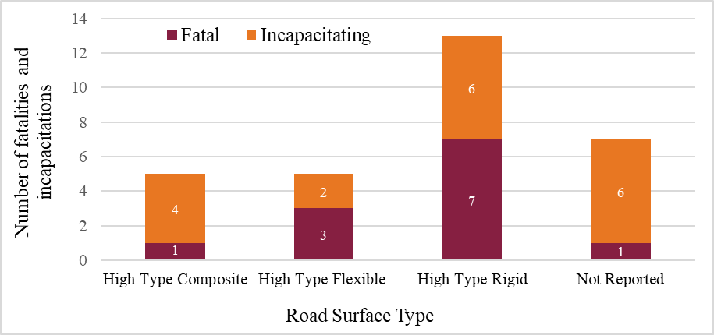
All KA on Flyovers/Connectors for Various Road Base Materials
Flex Base and Stabilized Earth had the highest number of fatalities, however Flex Base proved to have more incapacitating injuries.
All KA on Flyovers/Connectors for Various Road Surfaces
The highest number of KA injuries occurred on High Type Rigid road surfaces.

Slide 9
Distribution of all Harmful Object Struck Resulting in KA on Flyovers/Connectors
For cases where no object was struck, many of the times the bike was overturned.

Slide 10
All KA for Flyovers/Connectors with Various Median Widths
The data sample appears to indicate a higher risk to riders when the median width is not optimal, however no conclusion can be drawn due to limiting sample size.

Slide 11
Variation of Contributing Factors Resulting in KA on Flyovers/Connectors
The leading contributing factor according to the crash data was Speeding.

Slide 12
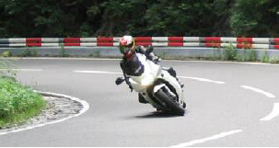
Crash Data Analysis Curves
The distribution of fatal to incapacitating injuries recorded – 26% Fatal and 74% incapacitating
The distribution of accidents on curves with varying locations
35% U.S. and state highways
18% Interstates
47% Farm to Market roads

Slide 13
All Fatal and Incapacitating Injuries on Curves from 2014 to 2016
Incapacitating injuries experienced a downward slope between 2014-2015, but steadied out between 2015-2016.

Slide 14
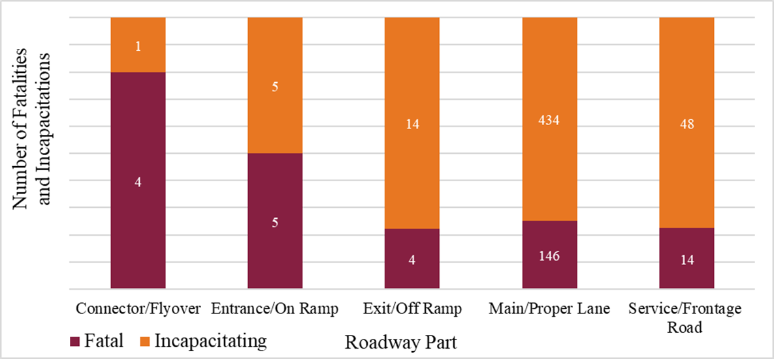
All KA on Curves for Various Road Alignment Configurations
The Curve Level configuration reached a high of 167 incapacitating and 65 fatal injuries.
All KA on Curves for Various Roadway Functional Classifications
Main/Proper Lane crashes yielded the highest number of KA injuries by an overwhelming amount.

Slide 15
All Fatal and Incapacitating Injuries for Various Curve Types
N – Normal Curve P – PI Curve S – Spiral Curve
The vast majority of injuries that happened on curves were type N.

Slide 16
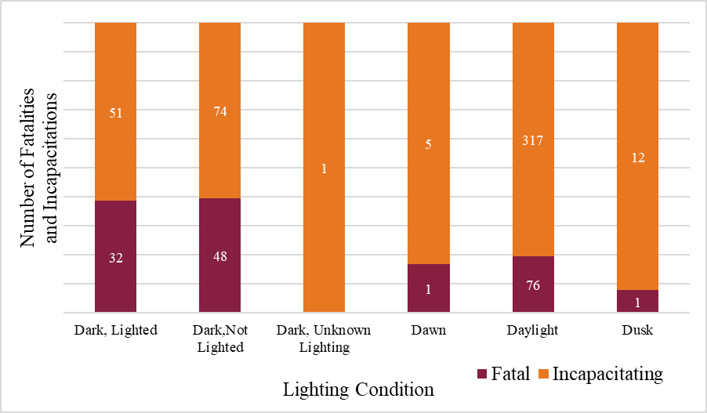
All KA on Curves for Various Weather Conditions
The most common weather condition for accidents is Clear with 131 fatal cases and 367 incapacitating cases.
All KA on Curves for Various Lighting Conditions
Daylight conditions proved to have the most incapacitating injuries. Dark, Not Lighted had a large number of motorcyclist injuries.

Slide 17
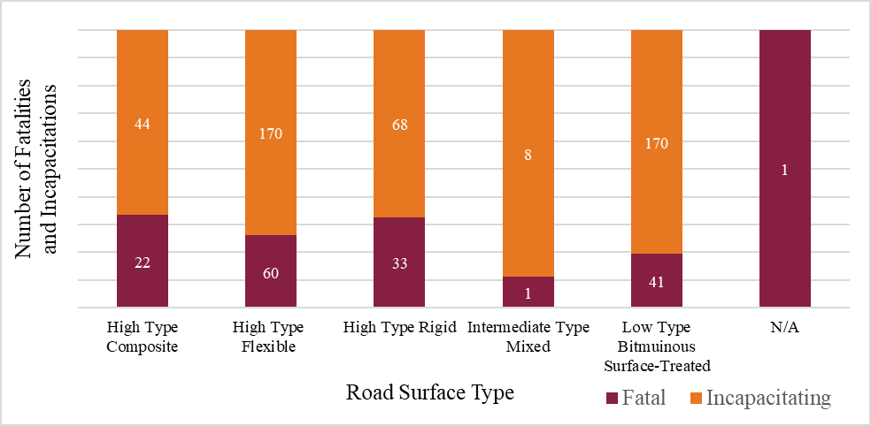
All KA on Curves for Various Road Base Material
Flex Base proves to be the most dangerous road base type.
All KA on Curves for Various Road Surface Types
Both High Type Flexible and Low Type Bituminous Surface-Treated produced the most incapacitating injuries.

Slide 18
All KA on Curves for Harmful Events
Excluding cases of overturning, Fixed Objects resulted in the most collisions. Fatal cases are more common when involving Fixed Objects rather than any other event.

Slide 19
All KA on Curves for Objects Struck
A large majority of accidents occurred as a result of overturning. The remaining collisions had a tendency to involve fixed objects.

Slide 20
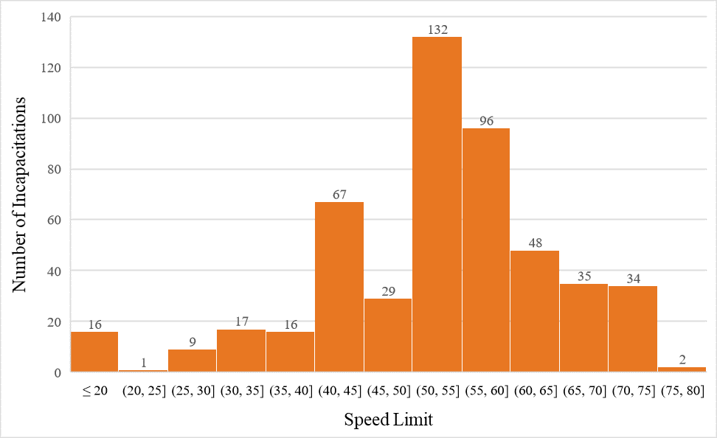
Distribution of Fatalities for Different Speed Limits
For both fatal and incapacitating cases, the highest amount of accidents occurred between speed limit ranges 50 to 60 mph.
Distribution of Incapacitations for Different Speed Limits

Slide 21
Various Primary Contributing Factors Resulting in KA on Curves
The leading contributing factor according to the crash data was Excessive Speed followed by Mishandling.

Slide 22
Distribution of Secondary Contributing Factors for Primary Factor “Under the Influence”
Collisions regarding drivers Under the Influence have a high correlation to Excessive Speed as well as Unsafe Maneuvering

Slide 23
Distribution of Secondary Contributing Factors for Primary Factor “Faulty/Unsafe Maneuvering”
Following Unsafe Maneuvering as the primary factor, Excessive Speed is a frequent secondary factor

Slide 24
Distribution of Secondary Contributing Factors for Primary Factor “Involved Excessive Speed”
In addition to Excessive Speed, Unsafe Maneuvering is a supplementary contributor for collisions.

Slide 25
Distribution of Secondary Contributing Factors for Primary Factor “Other”
Unsafe Maneuvering reached the highest number of incapacitating injuries. All contributing factors had a small number of fatalities.

Slide 26
Number of KA Victims of Different Age Groups on Curves
The maximums were found to occur from age 25 to 30 and from age 50 to 60.

Slide 27
Conclusions
Retrofit options for existing roadside safety systems are necessary to:
Contain the motorcycle user after impact
Reduce injury severity for the rider during the impact

Slide 28
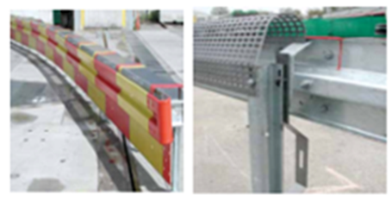
Further research is recommended to address the need for retrofitting existing barriers.
Other countries have developed standards to guide the design and evaluation of roadside safety systems during motorcycle impacts, very little has been done in the U.S. to address this issue.
As a result the already existing international systems will need research and modification to adhere to U.S. specifications.
System Euskirchen Plus Guardrail

Slide 29
Questions?
Chiara Silvestri Dobrovolny Ph.D.
Roadside Safety & Physical Security Division
Texas A&M Transportation Institute
(979)-317-2687
c-silvestri@tti.tamu.edu

