Slide 1
What do the Experts Do? Insights from Interviews & Literature to Deal with Bias in Big Data
Conversations about Counting: Big Data – Implications for Bicycle and Pedestrian Traffic Analysis
Jun 26, 2018
Greg P. Griffin, AICP

Slide 2
Disclaimer
The contents of this report reflect the views of the authors, who are responsible for the facts and the accuracy of the information presented herein. This document is disseminated in the interest of information exchange. The report is funded, partially or entirely, by a grant from the U.S. Department of Transportation’s University Transportation Centers Program. However, the U.S. Government assumes no liability for the contents or use thereof.

Slide 3
Approach
Synthesis of Literature
Interviews with Experts
135 studies
39 contacted
75
on bias in big data
10
participated
Sources & Mitigation
of Bias in Big Data

Slide 4
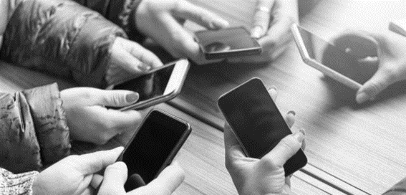
Sampling (or demographic) Bias
Sources
Mobile phone data
Census demographics ≠ mobile adoption
Mitigation
Local survey
Data fusion
Reference
Chen, C., et al. The Promises of Big Data and Small Data for Travel Behavior (Aka Human Mobility) Analysis. Transportation Research Part C: Emerging Technologies, Vol. 68, 2016, pp. 285–299.

Slide 5
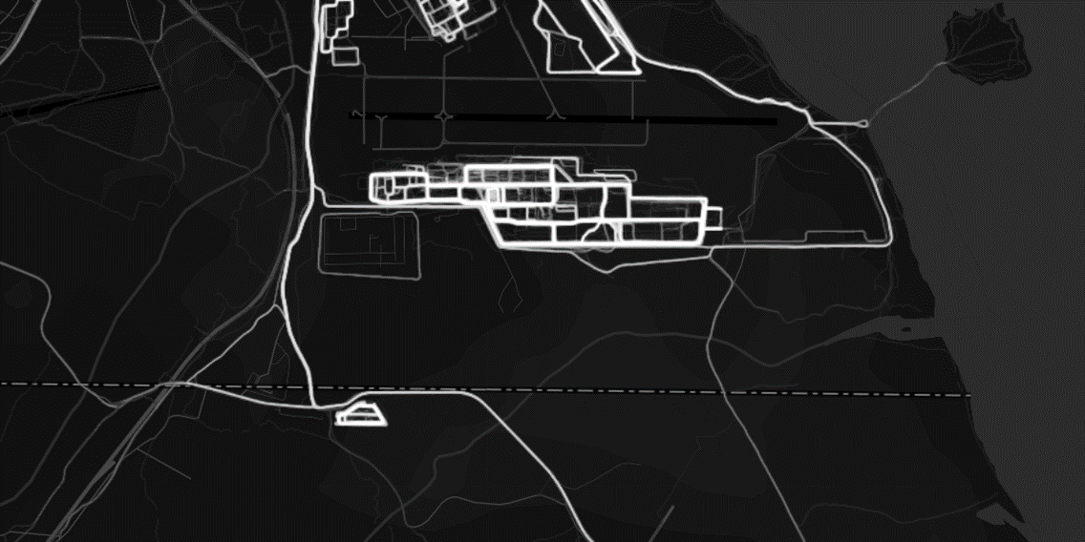
Aggregation Bias
Sources
Privacy protection changes travel counts
<threshold of trips usually removed
Mitigation
Data fusion
Maths ;-)
Markovian
Inverse Wernerization?
Reference
Mehmood, R., et al. Exploring the Influence of Big Data on City Transport Operations: A Markovian Approach. International Journal of Operations & Production Management, Vol. 37, No. 1, 2017, pp. 75–104.

Slide 6
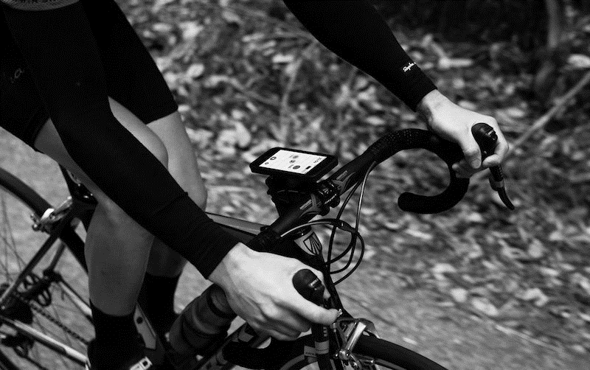
Social Desirability Bias
Sources
Social media or ‘athlete’ data
Fitness cyclists may post only ‘good’ or ‘fast’ trips
Mitigation
Explore platforms that record all trips
Sample weighting
Data fusion
Reference
Beecham, R., and J. Wood. Exploring Gendered Cycling Behaviours within a Large-Scale Behavioural Data-Set. Transportation Planning and Technology, Vol. 37, No. 1, 2013, pp. 83–97.

Slide 7
Coverage Bias
Sources
Mobile phone call data records
People do not make calls at every destination
Mitigation
Data providers that aggregate multiple networks?
Sample weighting
Reference
Toole, J. L., S. Colak, B. Sturt, L. P. Alexander, A. Evsukoff, and M. C. González. The Path Most Traveled: Travel Demand Estimation Using Big Data Resources. Transportation Research Part C, Vol. 58, 2015, pp. 162–177.

Slide 8
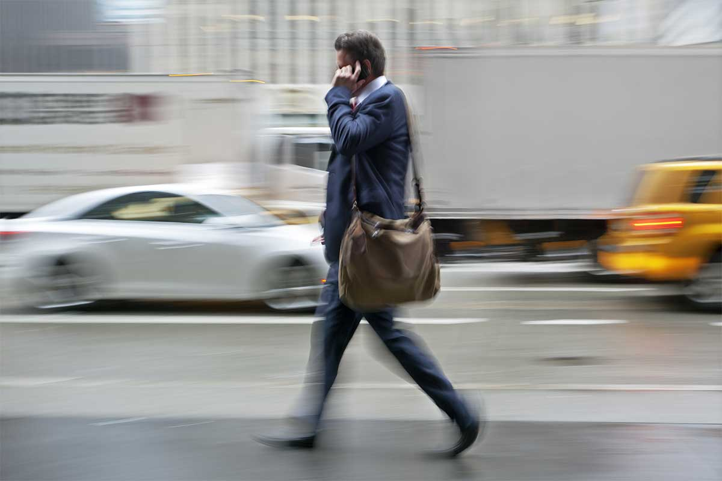
Perspective
big data from mobile devices probably under-represents older segments of the population and maybe lower income ... But it also does a better job of representing under-represented road users like bicyclists and pedestrians.
People (not cars) carry phones
Biased data > no data

Slide 9
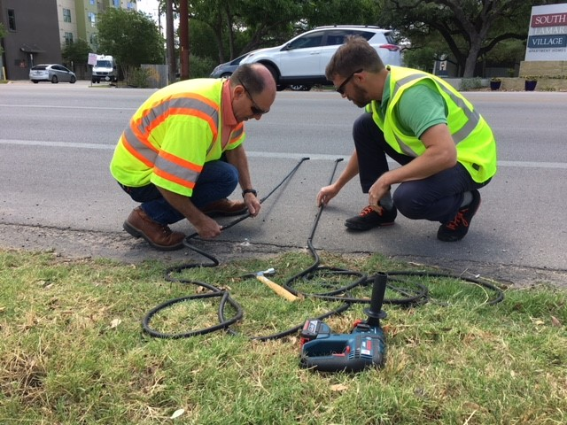
Lessons for Methods
Real counts remain critical!
Biases include aggregation, coverage, sampling, social desirability, and more
Mitigation techniques
Sample weighting with counts or local surveys
Data fusion
Maths ;-)

Slide 10
Recommendations & Next Steps
Keep transportation experts and public central in determining the right goals and metrics to evaluate transportation safety.
Develop new methods to relate big data to the total population needed for transportation safety.
Leverage big data to answer intractable questions.
Work ahead to transfer emerging knowledge to future problems.

Slide 11
Thanks!
Co-authors Meg Mulhall & Chris Simek
Interview coding support by TTI researcher Boya Dai, AICP.
Project report posted soon
“Sources and Mitigation of Bias in Big Data for Transportation Safety”
https://www.vtti.vt.edu/utc/safe-d/
This project was funded by the Safety through Disruption (Safe-D) National University Transportation Center, a grant from the U.S. Department of Transportation – Office of the Assistant Secretary for Research and Technology, University Transportation Centers Program.
g-griffin@tti.tamu.edu
@gregpgriffin

