Slide 1
Naturalistic Driving Studies for Automated Driving Systems
VTTI-00-029 Project Consequences
A Learning Module for Education & Workforce Development
Hy Kim
Sr. Research Associate, VTTI
6/30/2020

Slide 2
Table of Content
Driving Automation
Types of Studies on Transportation Human Factors
What are Naturalistic Driving Studies?
VCC 50 Elite NDS for Automated Driving Systems
Overview
Vehicles and Automated Driving Systems
Data Collection
Data Sampling
Data Reduction
Data Analysis
Results
Findings & Implications

Slide 3
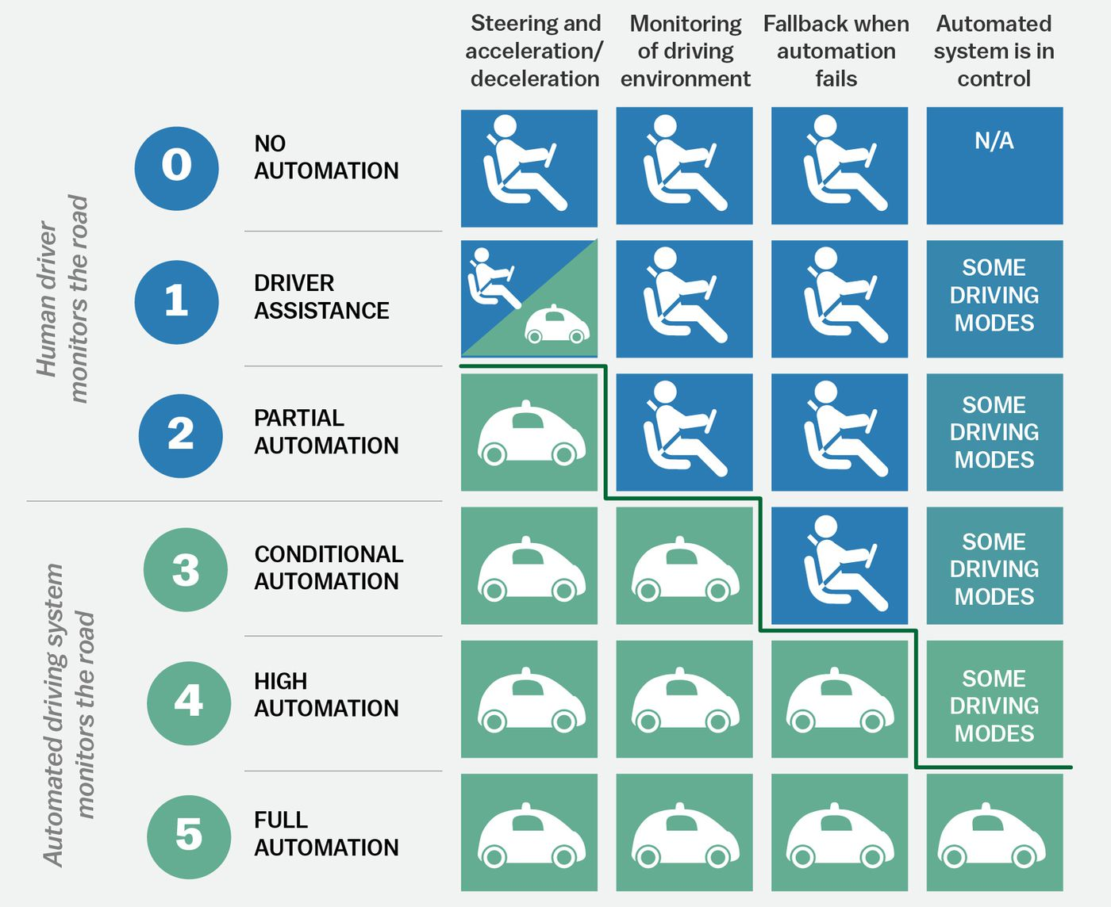
5 Levels of Driving Automation (SAE): L0 ~ L5

Slide 4
Types of Studies on Transportation Human Factors
Typical Study Approach
Driving simulator → Test Track → On-road (controlled testing) → Naturalistic (field operational tests)
Driving Simulator Studies
Test-track Studies
Naturalistic Studies

Slide 5
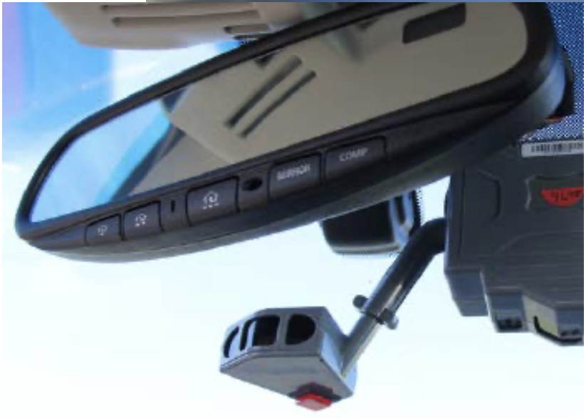
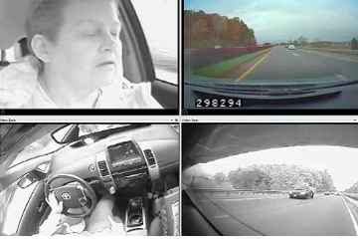
What are naturalistic driving studies (NDS)?
No experimenter present
Participants drive as they normally would
Collected (preferably) in privately owned vehicles
Unobtrusive instrumentation
Benefits: NDSs provide
Real-life behaviors
Detailed pre-crash information
Rich databases for subsequent mining

Slide 6
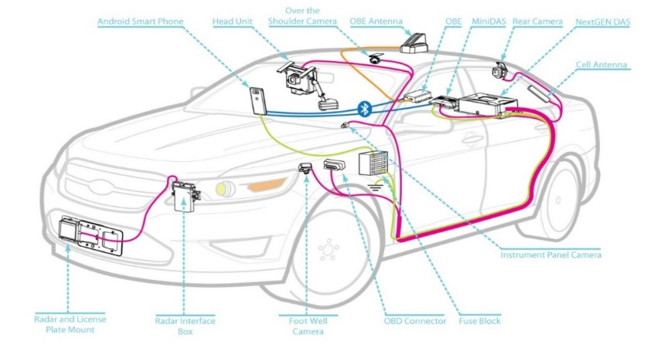
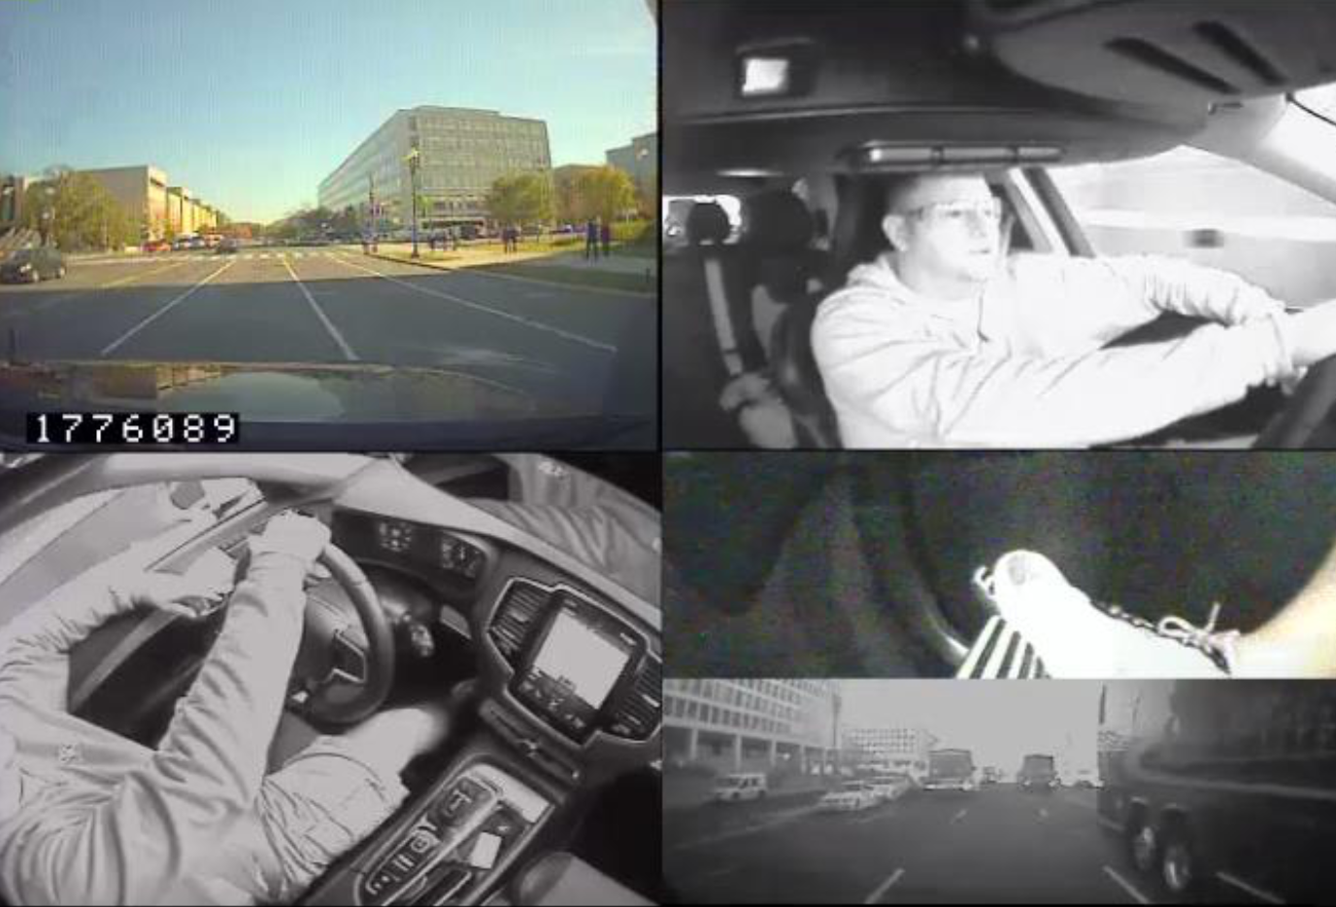
VCC 50 Elite NDS: Overview
Purpose: Build naturalistic dataset to assess behavior with early production SAE Level 2 vehicles
Method:
Participants: 50 drivers in Washington D.C. metro area, aged 24 o 76
Vehicles: personally owned vehicles with SAE Level 2 automation (longitudinal and lateral control, ACC & LKA)
Duration: 12 months of data collection
Mileage: 684,931 miles driven across all participants
Data collection: VTTI’s data acquisition system
Data reduction: VTTI’s trained reductionists
Variables: Driver behavior, vehicle movement, traffic conditions

Slide 7
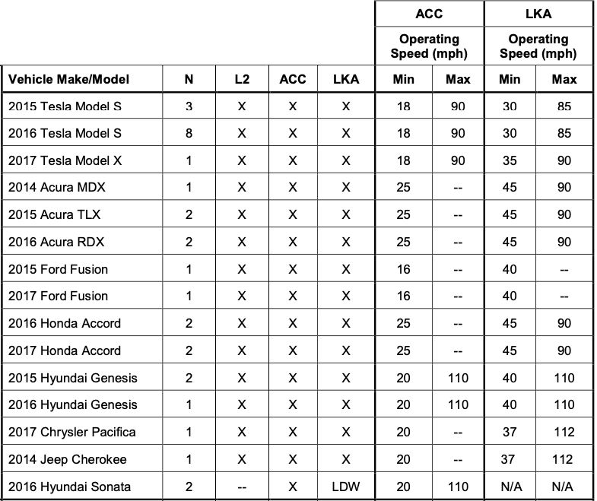
VCC 50 Elite NDS: 50 Vehicles and Equipped ADS

Slide 8
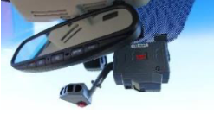
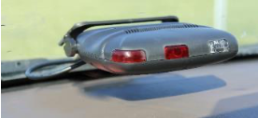
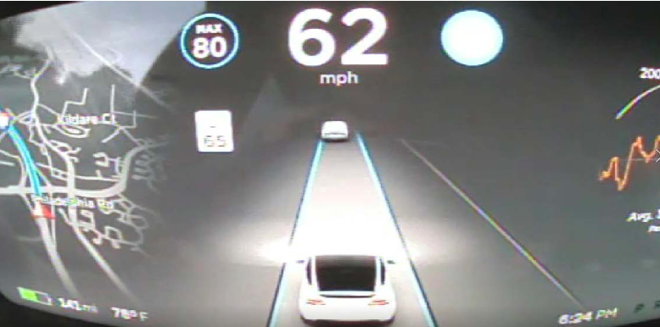
VCC 50 Elite NDS: Data Collection
MiniDAS and NextGEN DAS
Vehicle dynamics
Throttle position
Brake application
GPS
Constant video collected
Face
Forward roadway
Over-the-shoulder view
Foot pedals
Instrument cluster

Slide 9
Project Consequences: Overview
Objectives
Understand real-world use of automated driving systems (ADS)
Understand prevalence of unintended use of ADSs and safety consequences
Understand driver acceptance of ADSs
Research Questions
Q1. Of the safety critical events (SCEs*) identified, what proportion involved ADS use?
Q2. Of the SCEs with ADS engaged, what proportion involved human at fault?
Q3. Of the SCEs with ADS engaged, what proportion involved machine at fault?
Q4. How did the participants rate the usefulness and usability of ADSs?
Method
Analysis of the VCC 50 Elite NDS dataset

Slide 10
Project Consequences: Data Sampling
Safety critical events & matched baseline epochs
Safety Critical Events (SCEs)
235 SECs captured from 44 vehicles (excluding poor quality data from 5 vehicles)
Baseline Epochs Selection
Vehicle – same vehicles
reach about 4:1 ratio (baseline events vs. SCEs)
Over 800 baseline events from 44 vehicles
Equally sampled from each of the vehicles
One event per trip
Random point within a trip
3-sec duration

Slide 11
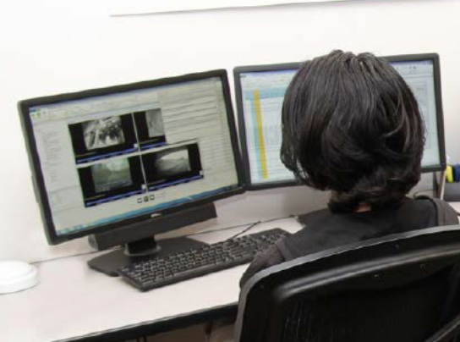
Project Consequences: Data Reduction
Tool: Hawkeye (VTTI NDS database viewer)
Variables
ADS feature activation: ACC & LKA
Hands on wheel
Driver has at least one hand (fingers) touching the steering wheel
Adverse weather condition
There is/are adverse weather condition(s) that impact visibility (rain, snow, fog)
Highway
The vehicle is on freeway/highway (vs business or residential)
Secondary Task
Driver engages in any form of non-driving related tasks, 5 seconds prior to event start till event end

Slide 12
Project Consequences: Data Reduction
Procedure
Load trip ID
Load camera views
Load speed time series
Move to start time point
View videos/data and answer questions

Slide 13
Results: Real-world Use of ADSs (Safety Critical Events)
VCC L2 NDS captured 237 safety critical events (including 7 crashes)
20% of SCEs (= 47) involved the use of driving automation
Human: unintended uses account for 57.4% of SCEs (not on highways, rain, secondary task)
Machine: silent failure account for 27.7% of the SCEs (no alerts; drivers may not expect)
Both human and machine failed 10.7% of the time
 |  | Machine |  | Sub Total
 |  | Appropriate Response | Inappropriate Response
Human | Intended Use | 25.5% (12) | 17.1% (8) | 42.6% (20)
 | Unintended Use* | 46.8% (22) | 10.7% (5) | 57.4% (27)
Sub Total |  | 72.3% (34) | 27.7% (13) | 100% (47)
Out of operational boundaries (14.9%)
Sys did not respond (12.8%)
Not on highway (12.8%)
Rain/fog (2.1%)
Hands-off-wheel (10.6%)
Secondary task (51.1%)
Percentage %
(Number of SECs)
* Some events involved multiple types of unintended use and thus may be reflected in more than one category
Notes:
Out of 47 SCEs with ADS features in use, in 14 of them (29.8%) the ADS issued an alert and/or controlled the vehicle. On the other hand, no alert of any kind was identified in over 70% of events. However, in seven of these events (14.9%), ADSs were not intended to address the direction of the threat (e.g., rear-end with the lead with only LKA activated, or crossed the line with only ACC); there was no alert in 20 events due to manual system deactivation.

Slide 14
Results: Real-world Use of ADSs (Case-Control Study)
Case-control study: an observational epidemiological study of events with the case (safety critical events) of interest and a suitable control group of events (baseline events)
Odds ratio (OR): a statistic that quantifies the strength of the association between two events
Safety Critical Events
(cases)
Baseline Events
(controls)
Exposed
Hands off wheel
Adverse weather
Not on highway
Secondary task
S_{E}
B_{E}
S_{N}
B_{N}
Nonexposed
S_{E}/S_{N}
OR =
Odd = S_{E}/S_{N}
Odd = B_{E}/B_{N}
B_{E}/B_{N}
Odds Ratio (OR)

Slide 15
Results: Real-world Use of ADSs (Case-Control Study)
Secondary task engagement increased the odds of SCEs
 | Total | Hands off Wheel | Adverse Weather Condition | Not on Highway | Secondary Task | Unintended (Combined not sum)
Case | 47 | 5 | 1 | 6 | 24 | 26
Control | 215 | 20 | 13 | 65 | 52 | 113
 |  | Hands off Wheel | Adverse Weather Condition | Not on Highway | Secondary Task | Unintended (Combined not sum)
 | Odds Ratio | 1.161 | 0.338 | 0.338* | 3.271* | 1.118
 | .95lower | 0.412 | 0.043 | 0.137 | 1.705 | 0.593
 | .95higher | 3.268 | 2.648 | 0.835 | 6.275 | 2.107
 | Chi-square (Pearson) | NA | NA | 5.960 | 13.530 | 0.120
 | p-value | NA | NA | 0.015 | 0.000 | 0.729
Fisher Exact | p (one-tailed) | 0.477 | 0.247 | 0.009 | 0.000 | 0.429
 | p (two-tailed) | 0.785 | 0.331 | 0.018 | 0.000 | 0.750

Slide 16
Results: Usability & Usefulness
Adaptive Cruise Controls are more acceptable than Lane Keep Assists
People thought ACCs are more usable and useful than LKA
Many (49% with ACCs) felt more comfortable engaging in secondary tasks
Adaptive Cruise Control (ACC)
49%
0%
28%
2%
2%
9%
95%
47%
93%
86%
Secondary Task Engagement
Usability: Easy to use
Usefulness: Takeover needed
Reliability: Performed as expected
Usefulness: Prevent crashes
Lane Keep Assist (LKA)
35%
0%
23%
12%
23%
31%
81%
50%
65%
42%
Secondary Task Engagement
Usability: Easy to use
Usefulness: Takeover needed
Reliability: Performed as expected
Usefulness: Prevent crashes
Negative
Positive

Slide 17
Project Consequences: Findings & Implications
Key Findings
People were using driving automation 20% of the time during safety critical events (SCEs)
Human accounts for ~57% of SCEs (unintended use of driving automation)
Machine accounts for ~28% of SCEs (silent failure which drivers may not expect)
The more people felt driving automation usable, the more they felt comfortable
engaging in secondary tasks
Implications
Many people may not use driving automation as intended
New driver training programs for automated vehicles may be required
Human-machine interfaces should make the system limitations salient to the driver
Human-machine interfaces should be adaptive to the driver state (e.g., secondary task)

