Slide 1
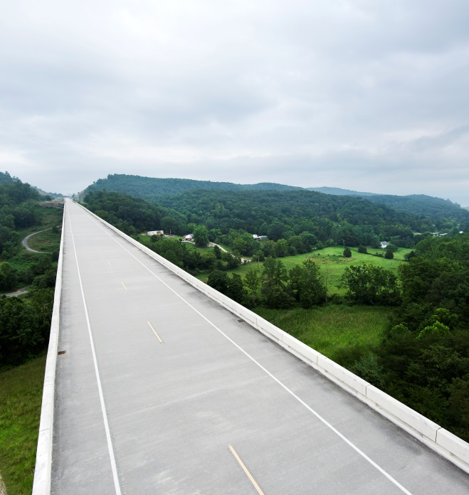
Aging and Driving

Slide 2
Seniors & Driving

Slide 3
Seniors: Population Projection in US
U.S. Population Aged 65 and Older from 2016-2060 (in thousands)
U.S. Population Aged 65 and Older Composition from 2016-2060 (in percent)
Data source from US Census Bureau, Projections for the United States: 2017 to 2060

Slide 4
Senior: Licensed Driver Projection in US
Average Percentage of Senior Licensed Drivers aged 65 and over
Average Number of Licensed Senior Drivers aged 65 and over

Slide 5
Seniors: Crash Rate
The rate of passenger vehicle fatal crashes per 100 million miles driven began to increase at the age group of 65-69. Drivers aged 85 and older had the highest rate of fatal crash involvement.
(Rate=No. of crash involvement/ miles driven*100000000)
Data source is from IIHS, retrieved from
http://www.iihs.org/iihs/topics/t/older-drivers/fatalityfacts/older-people#cite-text-0-2 )

Slide 6
Seniors: Vehicle Crash Trend
Motor Vehicle Crash Deaths and Deaths per 100,000 people 70 and older from 1975 to 2016
Retrieved from IIHS: http://www.iihs.org/iihs/topics/t/older-drivers/fatalityfacts/older-people#cite-text-0-2
Notes:
A total of 4,792 people ages 70 and older died in motor vehicle crashes in 2016. This is 18 percent fewer than in 1997, when deaths peaked, but a 27 percent increase since 1975. Deaths of older people increased 8 percent from 2015 to 2016. The rate of fatalities per capita among older people has decreased 43 percent since 1975.

Slide 7
Age-related Declines: Vision
Age-related Declines | Driving problems
Declines in night vision, declines in dark adaptation ability and needs longer glare recovery time. | Have difficulty seeing other road users or traffic signs while driving at night, and difficulty seeing after having on-coming cars’ headlights flashed at night.
Reduced motion perception and difficulty in perceiving motion in depth, including judging speed and distance of other road user. | Difficulty in judging relative speeds of other road users and perceiving the traffic situation.
Declines in visual acuity | Hard to read the road signs in the moving vehicle
Declines in eye movements ability, also declines the maximum extent of gaze without head movement | Difficulty in locating objects and resolving the details of objects that are in motion; Hard to read the dashboard and simultaneously look on the road without a head movement.
Reduced Useful Field View (UFOV) | Difficulty in detecting objects or other road uses in peripheral visual field.

Slide 8
Age-related Declines: Cognition
Age-related Declines | Driving problems
Decreased attentional ability | Higher crash risk when engaging in non-driving secondary tasks, difficulty in identifying hazards when driving.
The duration of short term memory(STM) is shorter and STM processing speeds are significantly longer. | Driving slowly and hesitantly, with unexpected maneuvers, longer time to deal with potential hazard situations.
Difficulty in transmitting and retrieving information from long term memory (LTM) | Difficulty in remembering what to do in certain driving situations and recalling and complying with driving laws. Easier to get lost. Difficulty in navigating and finding locations.
Declines in spatial cognition ability, including cognitive mapping ability and navigation ability. | Difficulty in navigating and finding locations.
Increased reaction time | Late response to changing driving conditions, slow to respond to road and traffic signs, slow to respond to hazards

Slide 9
Age-related Declines: Psychomotor Skills
Age-related Declines | Driving problems
Less joint flexibility and limited range of motion, declined ability to rotate the head | Failure to scan the rear, back up, and turn the head to observe blind spots. Reverse parking can be difficult
Declines in strength | Failure to brake
Increased frailty | Reduced tolerance to injury in the event of a crash
Increased susceptibility to fatigue | Easy to be fatigued on long journeys

Slide 10
Summary
U.S. population is aging
U.S. senior drivers are increasing
Crash rate increases for those over 70 years old
Age-related decline may contribute to higher driving risks
Vision
Cognition
Motor control

Slide 11
Advanced Driver Assistance System (ADAS)
Notes:
Nathan, I think we should stick w/ “ADAS” to avoid confusion w/ our data acquisition system (DAS) – I’ve made this correction throughout the deck – thx.

Slide 12
Advanced Driver Assistance System (ADAS)
Warning and crash mitigation
Blind Spot Detection
Forward Collision Warning and Braking
Lane Departure Warning
Lane Keeping Assistance
Visibility
Advanced Forward Lighting Systems
Backing Aids
Night Vision Systems
Pedestrian Detection
Vehicle Control
Roll Stability Control
Traction Control
Other driver assistance
Adaptive Cruise Control
Brake Assist
Driver Monitoring
Speed Alert
Tire Pressure Monitors
The category is based on Transport Canada (2013), retrieved from https://www.tc.gc.ca/eng/motorvehiclesafety/safevehicles-vehicle-safety-related-technologies-1068.htm

Slide 13
Advanced Driver Assistance System (ADAS)
 | Functionality
Adaptive Cruise Control | Keeps a set speed or a set following distance relative to a leading vehicle
Lane Keep Assist | Steers back into the lane when detects drifting out of it
Lane Departure Alert | Sends alert when detects drift
Blind Spot Warning | Indication that vehicles are located in the blind spot; warning if collision is imminent

Slide 14
Function | Description
Adaptive Cruise Control (ACC) | ACC is designed to assist the driver by maintaining a set speed or a set distance to the vehicle ahead. ACC uses radar sensors to monitor the distance between the head vehicle, and drivers can take over anytime through braking. ACC stops the vehicle at a comfortable distance from the head vehicle with no extra alerts provided.
Blind Spot alert | Blind spot alert system is designed to warn drivers when it detects other road users present at the areas directly alongside and behind the car (blind spot area). Blind spot alert system uses seniors monitoring blind spot areas, once activated, it alerts drivers through visual, acoustic or tactical signals.
Lane Keeping Assist (LKA) | Lane keeping assist is designed to assist drivers return to their lanes if it detects the vehicle drifting from their lane. LKA shares the information provided by the camera with the lane departure warning (LDW) system to determine the lateral location of the vehicle with respect to the lane boundary, once activated, LKA steers the vehicle back to the lane, at the same time, it alerts drivers through visual, acoustic or tactical signals.
Lane Departure Warning (LDW) | LDW is designed to alert drivers when it detects the vehicle unintentionally drifting out of its lane without a turn signal. Not like LKA, LDW does not control the vehicle. Instead of warning the driver to steer the vehicle back to the lane. LDW uses a camera to monitor the distance between the vehicle and the clear lane markings, once it detects the drifting, it informs drivers through visual, acoustic, or/and tactical warnings.

Slide 15
Research to Reduce Driving Risks
ADAS has potential to assist senior drivers by compensating for age-related declines
Two key questions:
Will seniors improve their driving with ADAS?
Driving performance and safety may be different from the design expectation
Will seniors accept and thus use new technology/ADAS?
Less interest in the vehicle technologies than youngers
Less willingness to spend on these technologies than youngers
Less likely to embrace the concept of driverless cars
Showed concerns about riding in self-driving vehicles

Slide 16
Senior Mixec Level of Automation Experiment (SMX)
18 participants (70-79) drove study vehicles with mixed-level automated vehicle systems and equipped with DAS for six weeks
Driving behavior recorded by camera
Driving data and vehicle data recorded by sensors
Driving with the loaner vehicle with mixed level automated features and DAS
Pre-study survey on automated features
Vehicle orientation and vehicle training
After-study survey on automated features
Focus group
Weekly phone interview
Initial attitudes towards automated features
Usage and attitudes
towards automated features each week
Experienced attitudes towards automated features
Discussion on attitudes, perception and experience

Slide 17
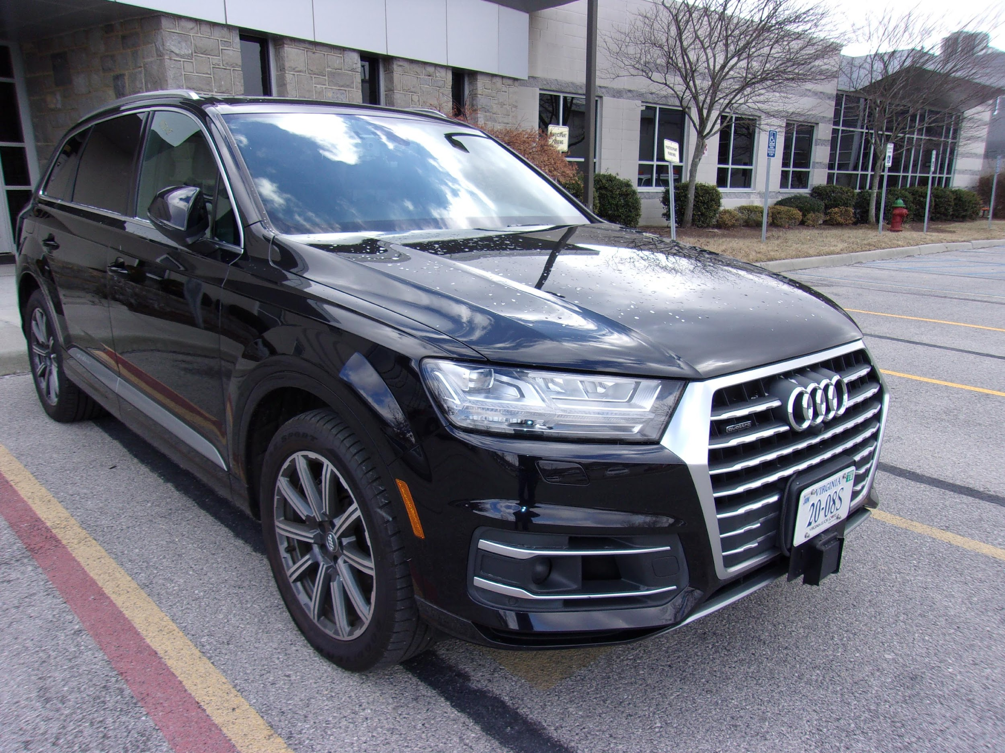
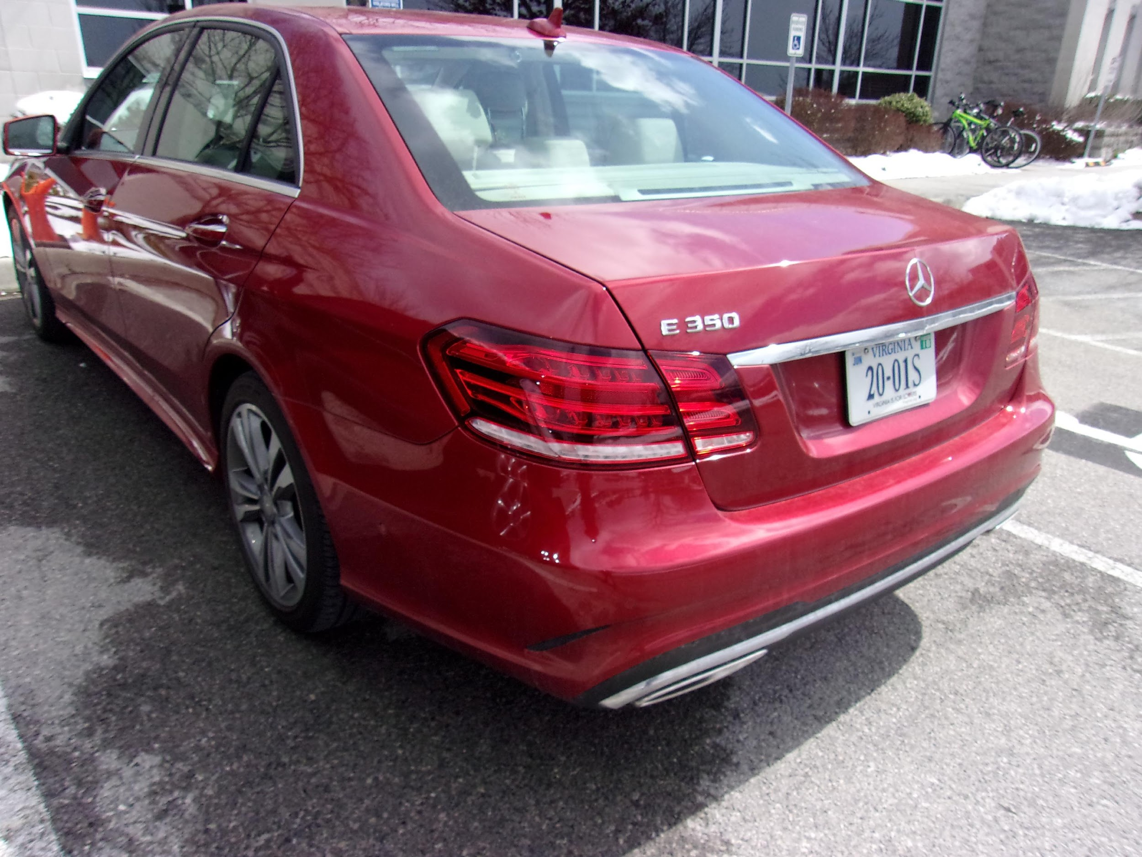
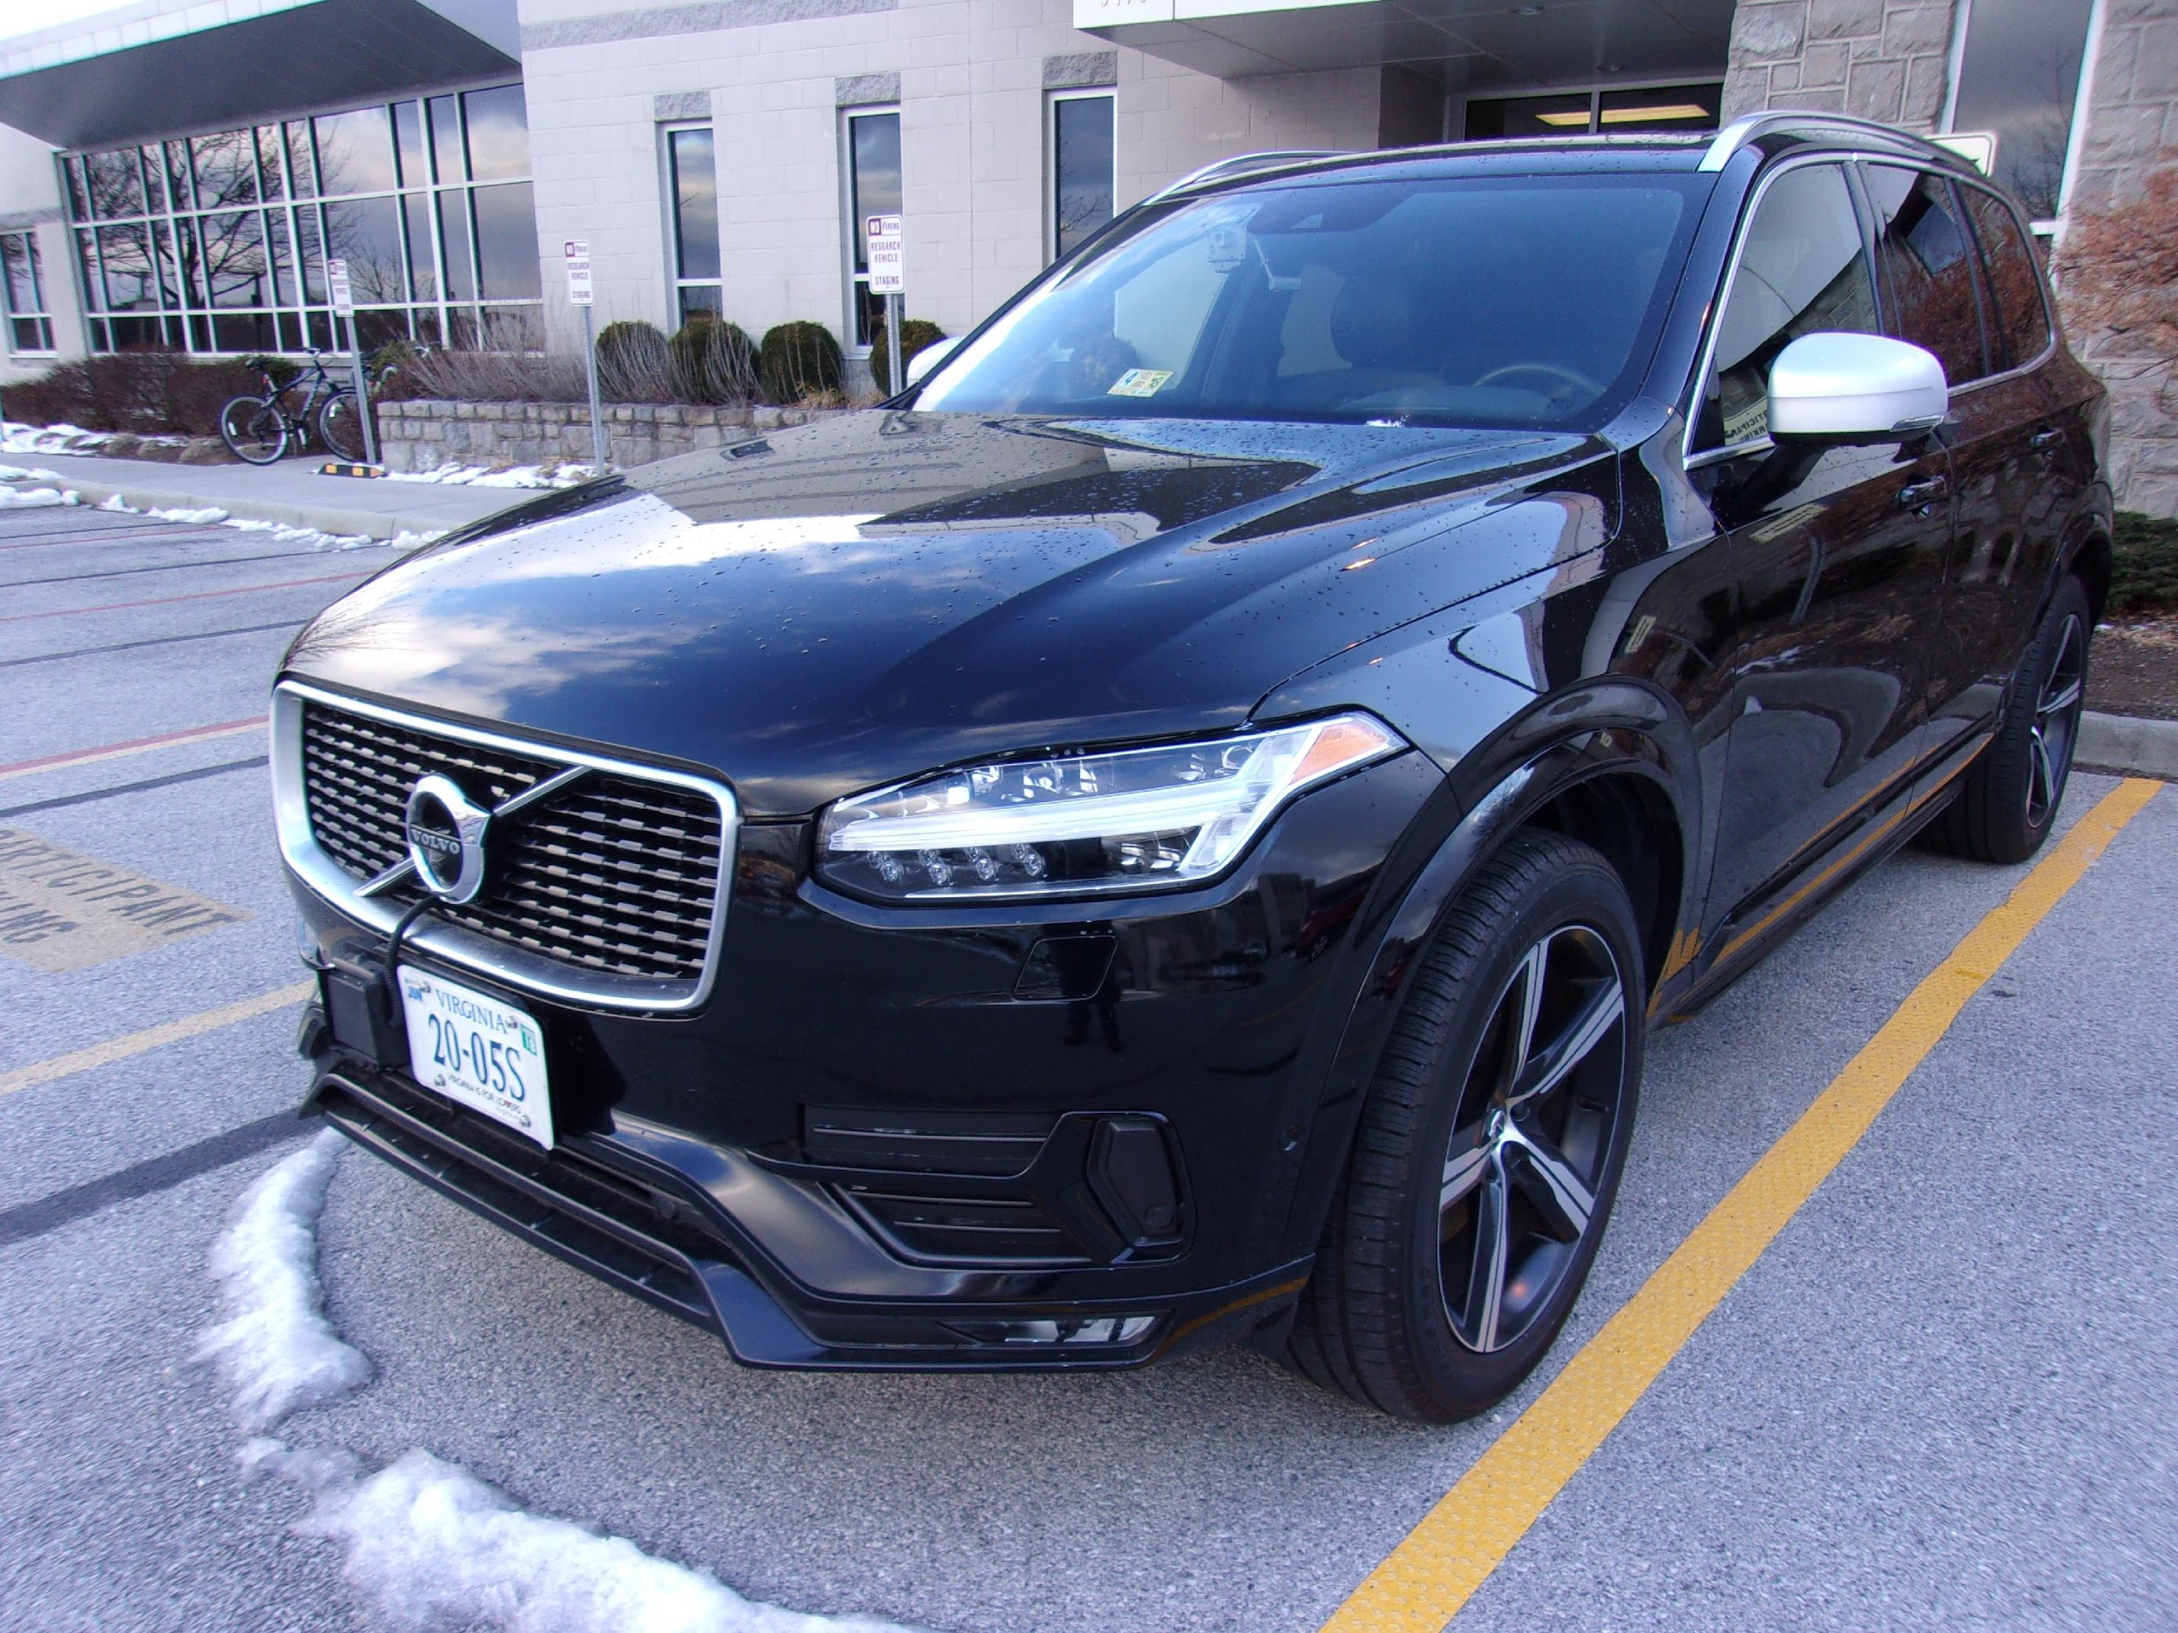
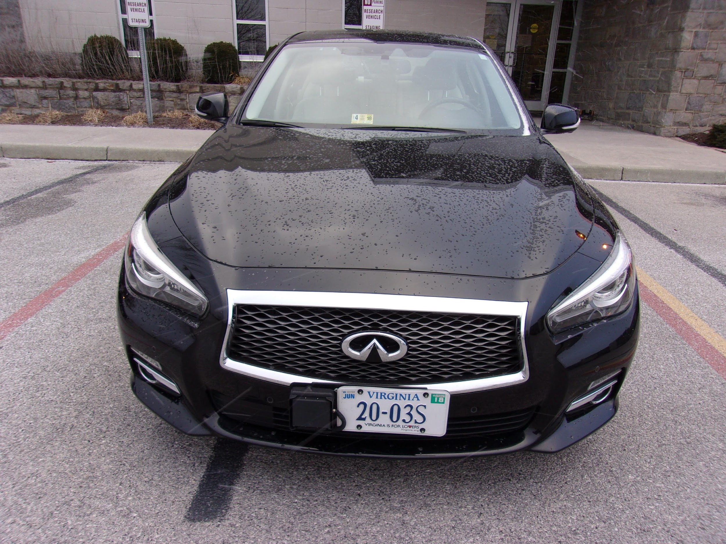
Brands | Vehicle | Blind Spot Warning | Lane Departure Alert | Adaptive Cruise Control | Lane Keep Assist
Audi |  | On automatically, can adjust brightness | Have to activate (40+ mph), steering, visual, and vibration | On automatically with cruise control, also automatic low-speed ACC | Have to activate (40+ mph) - visual, vibration, steering
 |  |  |  |  | On automatically if cruise control is on (37+ mph) -visual, vibration and steering (and directional braking)
Mercedes |  | On automatically | On automatically (37+ mph), visual and vibration
Volvo |  | On automatically | On automatically (30+ mph) |  | On automatically (30+ mph) – visual
 |  |  |  |  | Have to activate- chime, visual and steering input- can be set to high/low intervention
Infinity |  | On automatically, can adjust brightness | On automatically, chimes and visual
Notes:
Operate over 37

Slide 18
Senior Driving Performance with ADAS

Slide 19
Study 1 - Objective
Examine how senior drivers use ADAS in naturalistic driving settings
ADAS might encourage seniors to drive more, thereby improving mobility
ADAS might improve driving performance, thereby improving safety

Slide 20
SMX Study
18 participants (70-79) drove study vehicles with mixed-level automated vehicle systems and equipped with data acquisition system (DAS) for six weeks
Driving behavior recorded by camera
Driving data and vehicle data recorded by sensors
Driving with the loaner vehicle with mixed level automated features and DAS
Pre-study survey on automated features
Vehicle orientation and vehicle training
After-study survey on automated features
Focus group
Weekly phone interview
Initial attitudes towards automated features
Usage and attitudes
towards automated features each week
Experienced attitudes towards automated features
Discussion on attitudes, perception and experience

Slide 21
Comparison between SHRP2 vs SMX
The influence on seniors’ driving was assessed through comparison between the two datasets:
Examining Senior Drivers’ Adaptation on Mixer Automated Vehicle Technologies (SMX)
Seniors recruited at State College, Pennsylvania in the Second Strategic Highway Research Program Naturalistic Driving Study (SHRP 2 NDS)

Slide 22
SHRP2 vs SMX Participants
SHRP2 | SMX
N=Over 3500 | N=18
Location: Bloomington, IN; State College, PA; Tampa Bay, FL; Buffalo, NY; Durham, NC; Seattle, WA | Location: Blacksburg, VA
Participated in study 1-2 years | Participated in study 6 weeks
Age 16-98 | Age 70-79
Participant’s provided his/her owned vehicle as study vehicle | VTTI provided study vehicle and loaned to participants

Slide 23
Selection of SHRP 2 Data Subset
State College, PA and Blacksburg, VA share similar demographics
Dominated by students, employees and retirees from Pennsylvania State University and Virginia Tech
Economic activities mainly caters college life.
 | State College, PA | Blacksburg, VA
Population | 42,352 | 44,678
Percentage of persons 65 years and over | 5.5% | 5.5%
Number of households | 12,523 | 13,436
Bachelor’s degree or higher, percentage of persons age 25 years and over | 70.4% | 70.9%
Mean travel time to work (minutes), workers age 16 + | 15.4 | 14.6
Top employer | PSU | VT

Slide 24
Final Comparison Samples
Table. SHRP 2_PENN and SMX Data Subsets
 | SHRP 2 _PENN | SMX
Participant Subsets | N=30 (Male=16, Female=14) | N=18 (Male=9, Female=9)
Age Groups | Range=70–79, Mean=74.43, SD=3.45 | Range=70–79, Mean=74.00, SD=2.85
Recruitment Sites | State College, Pennsylvania | Blacksburg, Virginia
Total Trips Available for Analysis | 43,314 39,542 after removing invalid trips* | 2,118 1,983 after removing invalid trips
Study Duration per Participant | Mean=88.57 weeks, SD= 35.32, range=16.99 to 140.14 weeks | 6 weeks
Kilometers Traveled | 376,292.98 | 23,026.35
* Invalid trip: the trips with mean speed in km/h = 0 / NA, distance in km = 0 / NA, or start hour = NA.

Slide 25
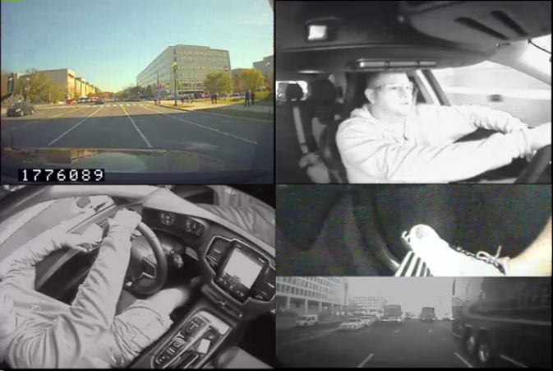
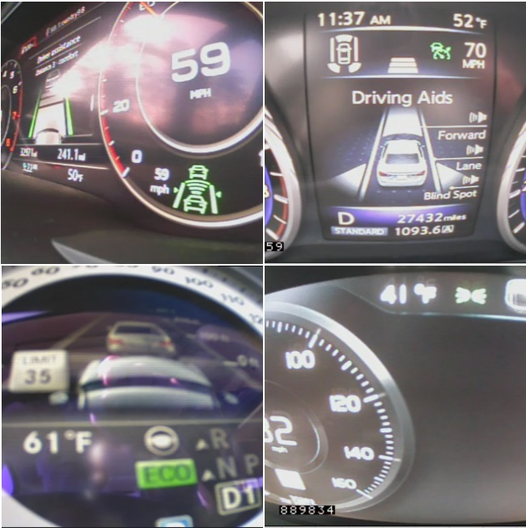
SMX and SHRP 2 –Data
Vehicle Data
Acceleration data (3 axis)
Rate sensors (3 axis)
Turn signals
GPS: latitude longitudinal, elevation, time, velocity
Vehicle network data
Accelerator, Brake pedal activation, Gear position, Steering wheel angle, etc.
Forward view (upper left), the driver’s face (upper right), downward view of the instrument panel and the driver (lower left), foot on the brake (lower left), and rear view (lower left)
Dashboard views of Audi( upper left), Infinity (upper right), Mercedes (lower left) and Volvo (lower right)

Slide 26
Mobility Analysis
How does driving with an ADAS-equipped vehicle influence the types of trips driven by seniors (e.g., when they drive, how long they drive)?
Mobility was evaluated by comparisons between SHRP2 vs SMX in terms of:
Overall driving exposure, and
Driving patterns to answer the research question:
Driving exposure | Driving pattern
Number of trips per week Distance driven per week | Percentage of trips during nighttime Percentage of trips during rush hour traffic Percentage of long-distance trips Percentage of trips on high-speed roads

Slide 27
Mobility Results
Mobility Analysis Statistical Results (Sample Size: 30 for SHRP 2_PENN, 18 for SMX)
Measure | Test Statistics | Degrees of Freedom | P-Value
Number of trips/week | T = −0.23 | 44 | 0.59
Distance driven (km)/week | T = 1.34 | 38 | 0.09
Percentage of trips during rush hours | T = 0.98 | 29 | 0.17
Percentage of night trips | U = 351.50 | - | 0.97
Percentage of long-distance trips | U = 440.00 | - | 0.51
Percentage of trips on high-speed roads | T = 0.98 | 37 | 0.17
Note: T = Welch’s t-test; U = Mann-Whitney-Wilcoxon test
Mobility of the two populations driving two different types of cars showed no significant differences.

Slide 28
Mobility
Mobility of the two populations driving two different types of cars showed no significant differences.
New technology requires adaptation time
Commuting and traveling patterns cannot change either by choice or circumstances (e.g., economy, work, etc…)
Seniors who participated in the both groups were healthy and capable of driving, with no restrictions voluntarily being added.

Slide 29
Driving Performance Analysis
How does driving with an ADAS-equipped vehicle influence seniors’ driving performance?
Comparisons also made between trips using and not using ACC within SMX study
Driving performance was evaluated by comparisons between SHRP2 vs SMX, or within SMX in terms of:
Lateral acceleration events and magnitudes
Longitudinal acceleration events and magnitudes
Lateral acceleration | Lateral acceleration
Number of lateral events/km Variance in acceleration magnitudes across lateral events | Number of longitudinal acceleration events/km Number of longitudinal deceleration events/km Variance in acceleration/deceleration magnitudes across longitudinal events

Slide 30
Driving Performance Results
Driving Performance: SHRP 2_PENN vs. SMX (Sample Size: 30 for SHRP 2_PENN, 18 for SMX)
Measure | Test Statistics | Degrees of Freedom | P-Value
Number of lateral events/km | T = −1.74 | 28.88 | 0.09
Variance in acceleration magnitudes across lateral events | T = 24.49 | 32.15 | <.001
Number of longitudinal acceleration events/km | U = 106 | - | <.001
Number of longitudinal deceleration events/km | U = 412 | - | 0.002
Variance in acceleration/deceleration magnitudes across longitudinal events | T = 4.19 | 29.80 | <.001
T = Welch’s t-test; U = Mann-Whitney-Wilcoxon test

Slide 31
Performance Results
Variance in acceleration magnitudes across lateral events (left) and number of longitudinal acceleration events/km (right) of SHRP 2_PENN and SMX.

Slide 32
Performance Results
Number of longitudinal deceleration events/km (left) and variance in acceleration/deceleration magnitudes across longitudinal events (right) of SHRP 2_PENN and SMX.

Slide 33
Driving Performance
Smaller variance in acceleration magnitudes across lateral events - More stability and better lateral control performance for seniors driving the ADAS-equipped vehicles.
Smaller variance in acceleration/deceleration magnitude across longitudinal events - ADAS may help seniors better manage their speed, for example, reducing hard braking, which can help with headway management.

Slide 34
Limitations
Extraneous factors - road and traffic environment, traffic volume, weather, traffic laws at the data collection sites (nature of naturalistic driving study)
Study vehicles – participants drove new and unfamiliar cars (SMX) vs. their own cars (SHRP2)
Representativeness – participants were healthy and active drivers, considering that they actively participated in the driving study

Slide 35
Senior Attitudes on ADAS

Slide 36
Study 2 – Objective
Examine how senior drivers change their attitudes towards automated features based on actual use
Acceptance of seniors is necessary to realize benefits of these technologies
Seniors found to accept new technologies differently and may take longer to adapt to new technologies

Slide 37
SMX Study
18 participants (70-79) drove study vehicles with mixed-level automated vehicle systems and equipped with data acquisition system (DAS) for six weeks
Driving behavior recorded by camera
Driving data and vehicle data recorded by sensors
Driving with the loaner vehicle with mixed level automated features and DAS
Pre-study survey on automated features
Vehicle orientation and vehicle training
After-study survey on automated features
Focus group
Weekly phone interview
Initial attitudes towards automated features
Usage and attitudes
towards automated features each week
Experienced attitudes towards automated features
Discussion on attitudes, perception and experience

Slide 38
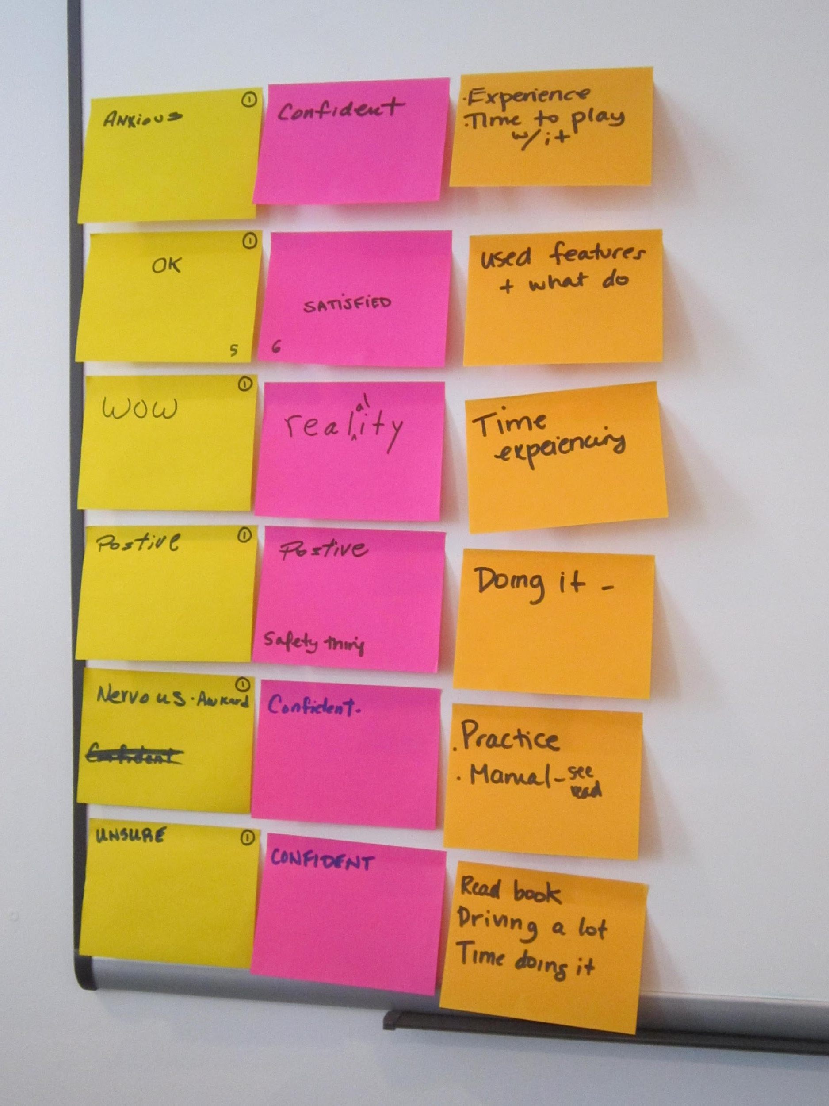
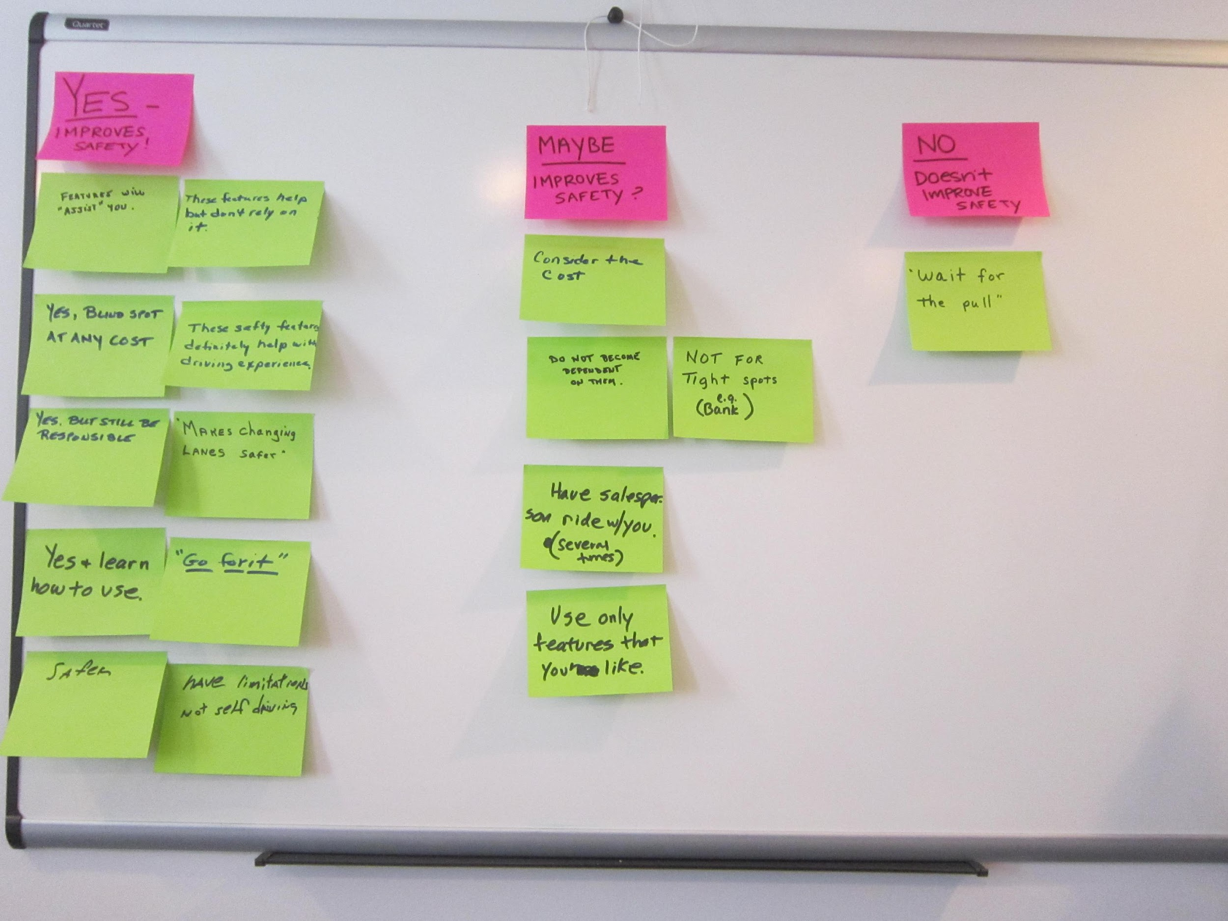
Focus Group
Location: Virginia Tech Transportation Institute, Blacksburg, VA
Length: 90-minute session
Experimenters: One facilitator, two observers
Participants: Six participants per session
(total of 3 sessions)
Notes:
6 per session

Slide 39
Focus Group Probe Topics & Questions
Topics |  | Probe Questions
Attitudes | Q1. | What one word describes how you felt about the advanced features in your vehicle when you began the study? What one word describes how you feel about the advanced features in your vehicle now, at the end of the study?
 | Q2. | What caused your feelings to change or remain the same?
Perception | Q3. | What would make you feel more comfortable with these features?
Feature Likes/Dislikes | Q4. | What is one thing you liked best about these features? What is one thing you liked least about the features?
Safety | Q5. | Suppose a friend is considering purchasing a car with these features and they ask you if you think if they improve driving safety or not. What would you say?

Slide 40
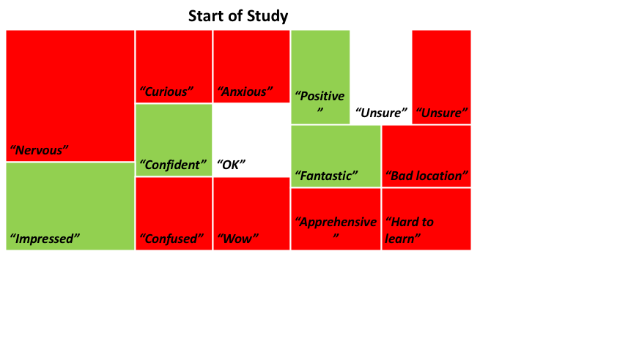
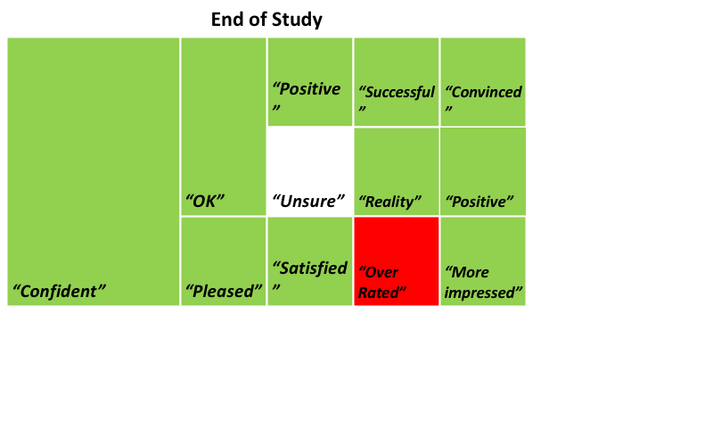
Shift in Attitude (Valence)
Negative initial attitudes towards the advanced features
e.g. “Nervous”, “confused” and “anxious”
Positive post attitudes towards the advanced features
e.g. “Positive” and “Confident”
Attitudes Change
Notes:
start of study

Slide 41
Design
More intuitive control
Intuitive placement of the control
“I think the display could be much more intuitive”
Touchscreen
“So the screen was not a dedicated screen to control”
“when you were touching the screen, it didn’t always recognize you were touching the screen”

Slide 42
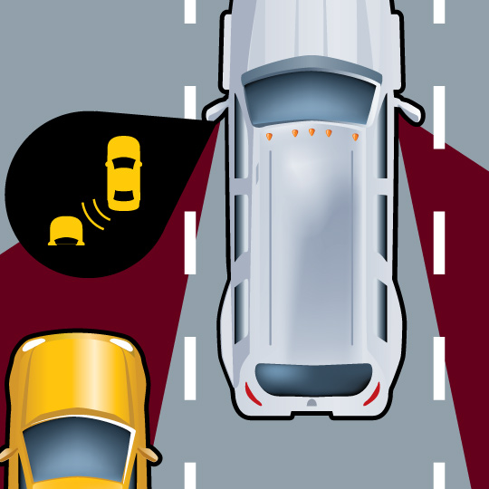
Most Liked Feature – Blind Spot Alert
Improves visibility
“that mirror (blind spot alert) told you there was something there you need to see”
Increases confidence
“It did increase my confidence in driving. In traffic, I’d like to have that.”
Least intrusive
“It is the least intrusive on everything else. It’s there, it doesn’t hurt anything.”

Slide 43
Least Liked Feature – Lane Keeping Assist
Lack of trust
“I felt like I couldn’t trust it” “Cause sometimes worked, sometimes didn’t”
Too many limitations
“It didn’t work well in bad weather”
“The limitations of that system made it something that I wouldn’t want to have”
“if it doesn’t have that painted line, it won’t see anything”

Slide 44
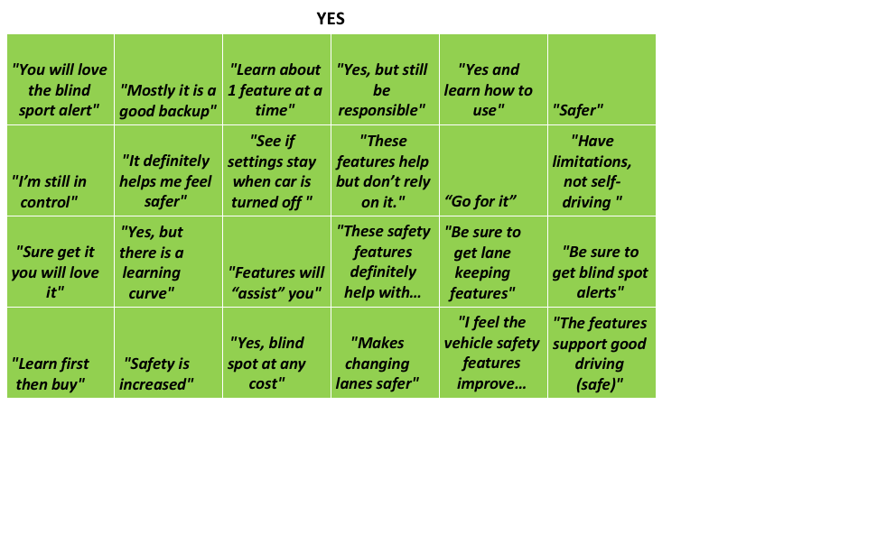
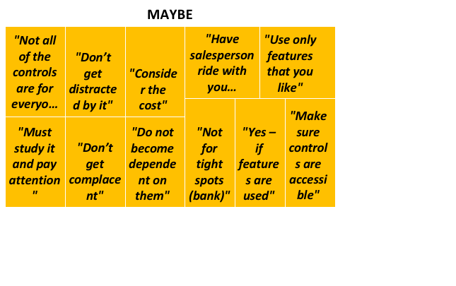
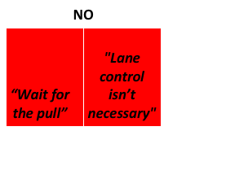
Safety Concerns
Most agreed that the features improve safety
Learning how to use first: “Learn first then buy”
Do not become over dependent on them: “Don’t get complacent”

Slide 45
Training and Experience
Usage improved attitude
“I think practice made the awkward just go away”
Reading manual improved attitude
“The manual I have outlined the limitations very clearly, so all of that made me feel … better about the system”
Better training
Content: include operations of non-safety features (radio, GPS)
Trainer: car dealers, family members, and/or friends
Method: Re-orientation session after week or two into driving

Slide 46
Summary of Focus Group Findings
 | Findings | Sample Response
1 | Negative initial attitudes towards the advanced features | “Anxious” “Nervous” “Unsure”
2 | Positive post attitudes towards the advanced features | “Confident” “Satisfied” “Convinced”
3 | Usage experience improved attitude | “I think practice made the awkward just go away”
4 | Reading manual improved attitude | “The manual I have outlined the limitations very clearly, so all of that made me feel … better about the system”
5 | Expected better training | “I would appreciate being able to go back and have somebody to ride with me, not just explain it, see how I am using it to the best advantage of how I drive”

Slide 47
Summary of Focus Group Findings
 | Findings | Sample Response
6 | Expected more intuitive control | -Placement of the control “I think display could be much more intuitive” -Touchscreen “So the screen was not a dedicated screen to control”
7 | Liked best blind spot alert | “It did increase my confidence in driving, in traffic. I’d like to have that”
8 | Like least lane keeping assist | “I couldn’t trust it” “Sometimes worked, sometimes didn’t”
9 | Agreed that the features improve the safety | -Learning how to use first “Yes, there is a learning curve” -Do not become over dependent on them “Don’t get complacent”

Slide 48
Thank you!

