Slide 1
Evaluation of E-scooter Interaction With Road Users
Virginia Tech Transportation Institute
Robin Hong
Dr. Charlie Klauer

Slide 2
Micro-transit options, such as e-scooters, are becoming more widely available in many urban and university communities around the country.
Currently, several companies have deployed e-scooters on college campuses across America.
In order to address the research gap in the new field of e-scooters , Virginia Tech Transportation Institute (VTTI) has been collaborating with State Farm™ to conduct a safety study of e-scooters as they have been deployed on Virginia Tech campus by Spin™.
As part of this safety study, continuous video data at fixed camera locations around the VT campus was collected by VTTI to assess e-scooter interactions with other road users, including pedestrians.
Project Background Information

Slide 3
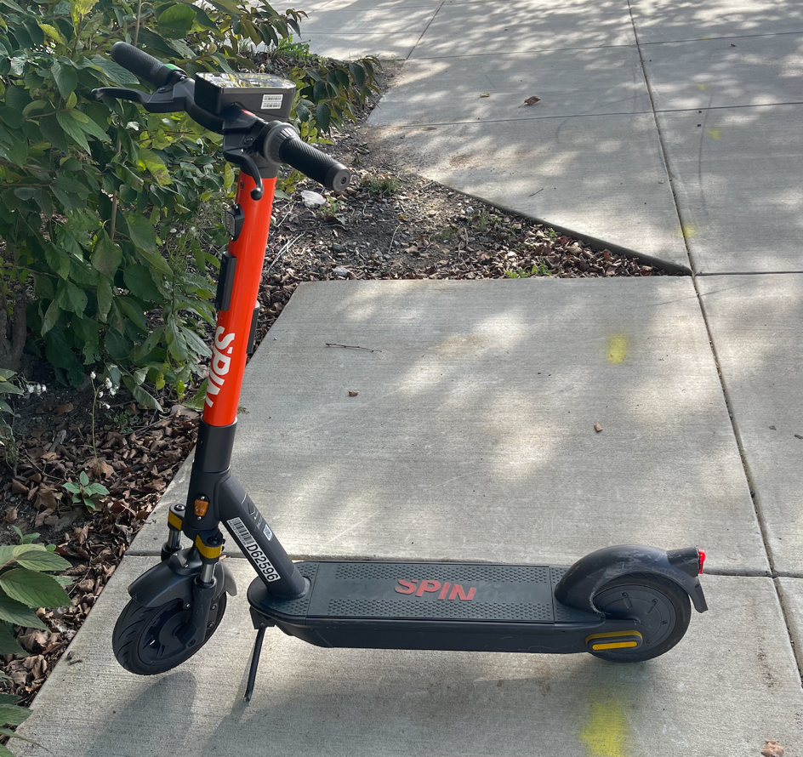
E-scooter Information
Each Spin scooter is approximately 31 pounds in weight, has 40 miles of range on a single charge and a maximum speed of 15 miles per hour.
The scooters are geo-fenced, thus are operational only on university grounds and during daytime (sunrise/sunset)
The scooters are also not available during raining or snowy weather or during large sporting events that would significantly increase pedestrian traffic on campus.

Slide 4
Research Objectives
Investigate safety device implementation during E-scooter riding
Understand E-scooter behavior at different riding locations
Understand the mode and safety limits of E-scooter interactions with other road users, with a special emphasis on motorized vehicles

Slide 5
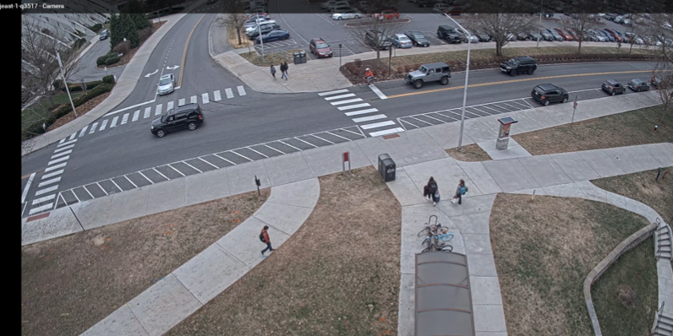
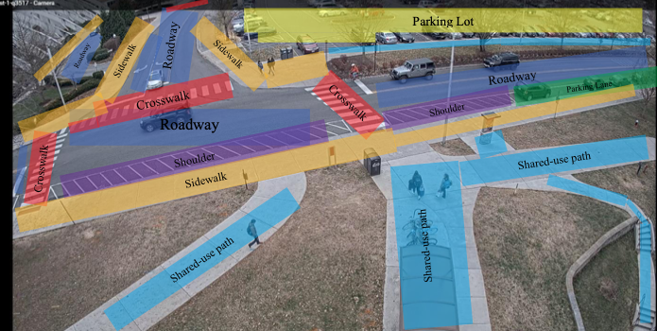
Location and Sample Selection Methods
A total of 14 fixed camera locations were selected to be equipped with fixed cameras for this study. These locations were selected based on infrastructure elements present.
Out of these 14 locations, 7 locations were selected for analysis based on the number of trips recorded by the fixed cameras along with the roadway configuration at the location.
The camera locations are spread across a college campus
The locations are selected to capture all e-scooter riding environments and have a focus on roadway environments

Slide 6
Location and Sample Selection Methods
Since fixed camera locations are selected based on their characteristics, the samples selected does not have a true random baseline
All trips by e-scooters between the time of 10 a.m. to 4 p.m. were coded
The time frame is based on a frequency analysis, this is a representative of the most used hours for e-scooter, which is anticipated since the deployment is on a college campus
For the purpose of this study, a total of 492 e-scooter trips were selected and 473 of those were reduced due to loss of data and visibility of the video. Among the 473 trips that went through video coding protocols, 72 interactions were identified, and 0 conflicts (safety critical events) were present.

Slide 7
Coding Procedure
The coding consisted of three main scenario protocols: control baseline scenarios, interaction scenarios, and conflict scenarios.
Control baseline scenarios were determined to be 10 seconds long
Interaction scenarios were coded when another road user or traffic element comes within a certain radius of the referenced e-scooter rider
Traffic Element | Interaction Radius
Motorized road users (Vehicles, motorcycles, etc.) | 4 ft radius
Unmotorized road users type A (Potentially higher speed users such as bicycles, e-scooters, e-skateboards, etc.) | 3 ft radius
Unmotorized road users type B (Low speed users such as pedestrians, push skateboards, etc.) | 2 ft radius
Permanent road/infrastructure elements (Road sign, bike rack, post, pothole, curb, etc.) | Physical contact
Moveable road/infrastructure elements | Physical contact

Slide 8
Rider Helmet Use
The majority of riders did not wear a helmet while riding, despite it being provided by the manufacture.

Slide 9
Road User Type during Interaction
A total number of 72 interactions between e-scooters and other road users were identified. Among these interactions, pedestrians are the most common road user present (n=51). Motorized vehicles are the second most common road user interaction; however, interactions with pedestrians are 4 times more frequent than interactions with motorized vehicles (n=13). Since data collection took place on a college campus with a lot of sidewalks and a large number of pedestrian traffic, this result was expected.

Slide 10
E-scooter Speed by Interaction Partners
When e-scooters are interacting with pedestrians they are faster than the pedestrian (n=29). This is also true for interaction between e-scooter and motorized vehicles as well, showing that e-scooters interact with motorized vehicles mostly when they are parked or stopped in traffic (n=7).

Slide 11
Limitations of the Project
Since all fixed camera locations were selected based on their infrastructure elements present, the data set gathered does not have a truly random baseline.
The strategy of following one e-scooter rider during the total sample time may have limited the number of samples that were collected. The research team under sampled (N=492) due to lack of valid scooter trips.
Due to the clarity of the camera, sometimes it is hard for the coders to determine details like the gender of the rider, whether the rider is wearing electronics, bags, or helmets.
The traffic environment the study was conducted in (college campus with speed limits of 25 mph or less) makes it hard to generalize the results of this study to roadways with higher speed limits.

Slide 12
Conclusion and Future Work
E-scooters, when not ridden properly, can become a threat to other road users, especially pedestrians.
They are generally faster than pedestrians and when ridden on the sidewalk they can come dangerously close to pedestrians as well.
E-scooters riders have the ability to adjust the operation rules they follow when traveling on different roadways.
Due to this nature of the e-scooters the researchers at VTTI would recommend that it is safer for e-scooters when they are ridden on designated lanes, bike lanes or roadways with speed limit of 25 mph or less .
Future researches that can be conducted to further investigate the limitations and safe operation of E-scooters can include the influence of rider posture and stance, rider gender differences, limitations under different traffic environments, helmet use of riders, and safety awareness by the riders.

Slide 13
Any Questions or Comments?

