Slide 1
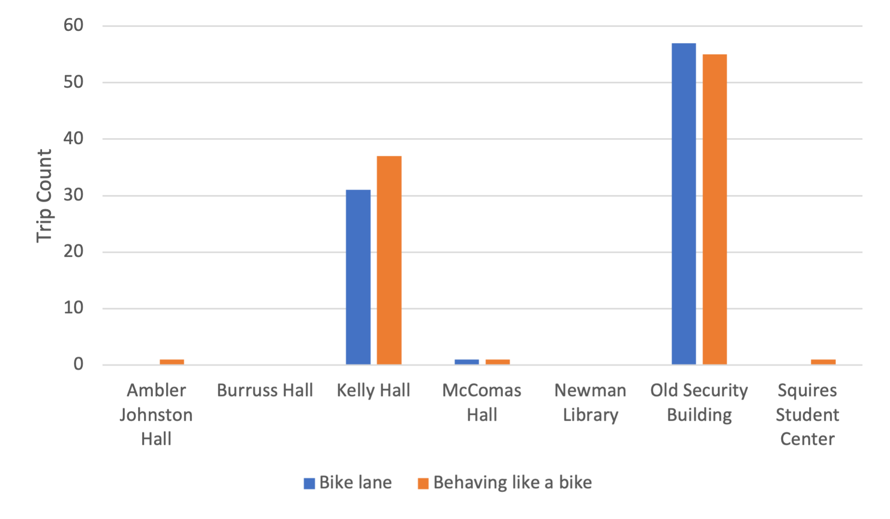
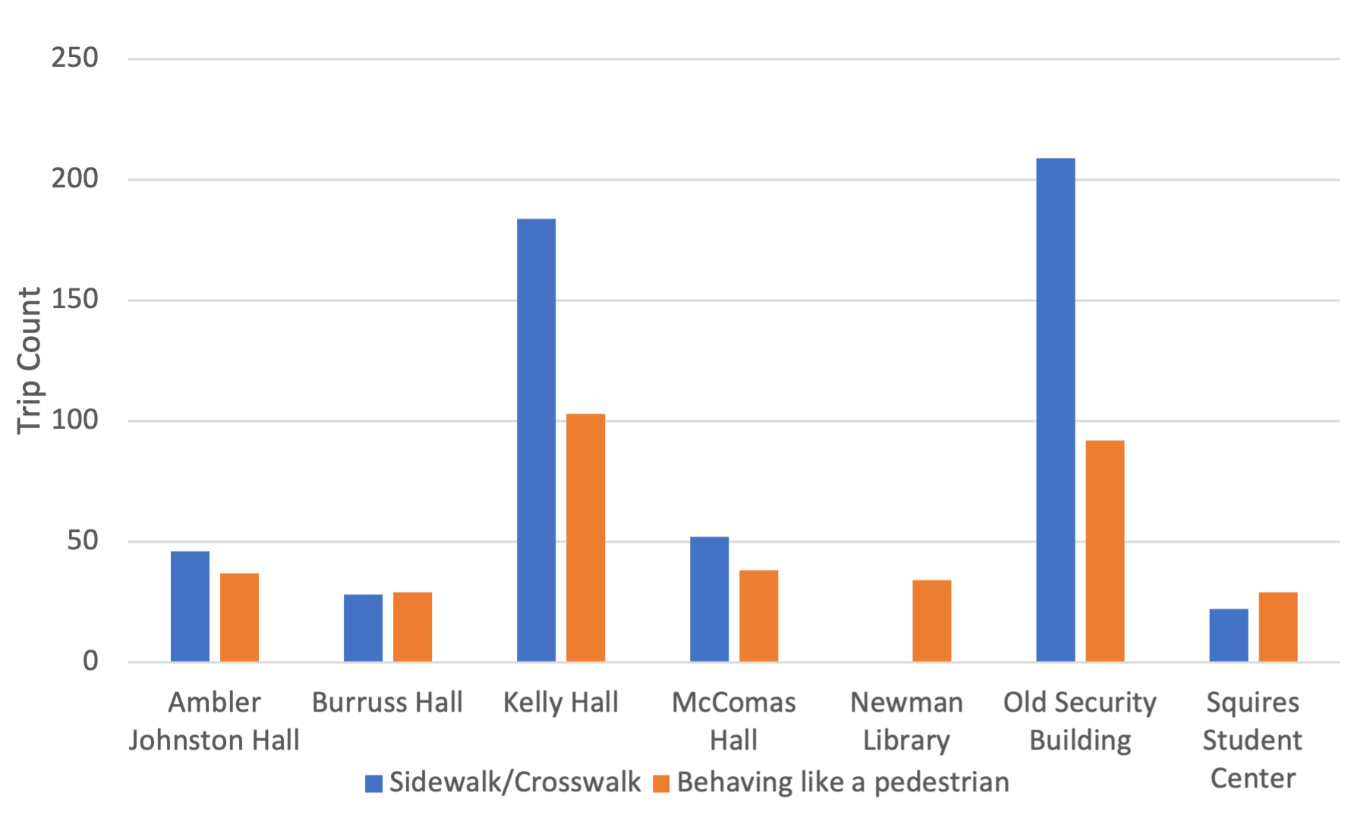
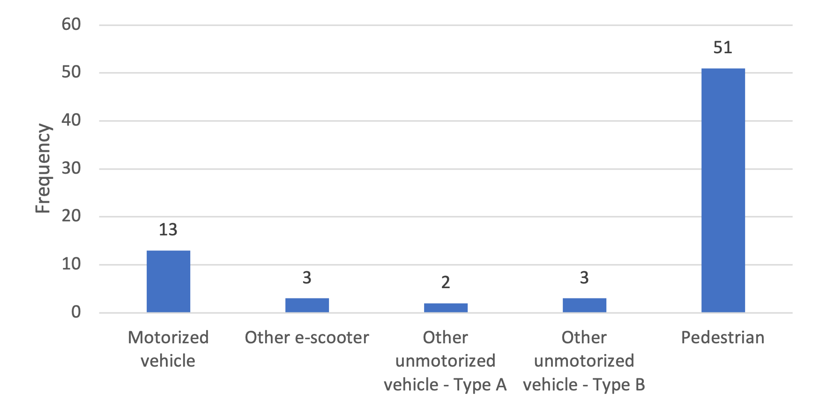
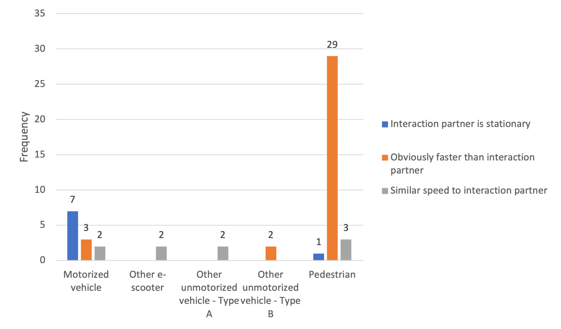
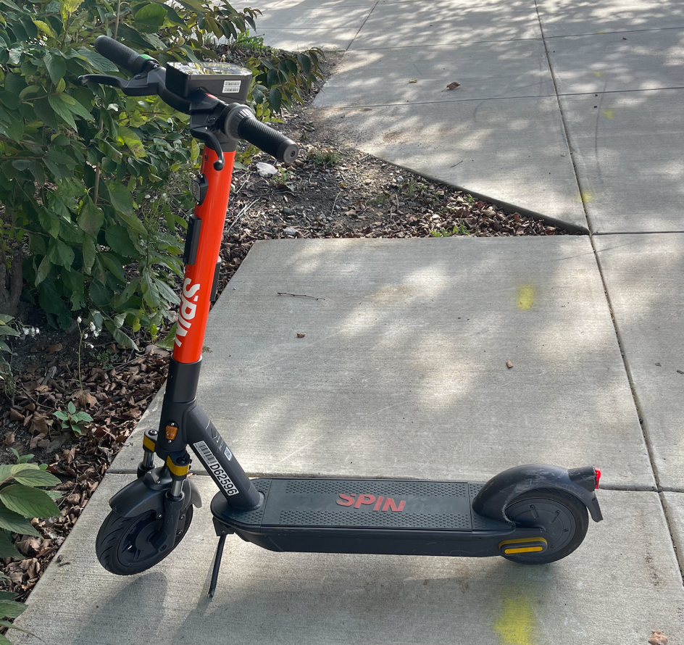
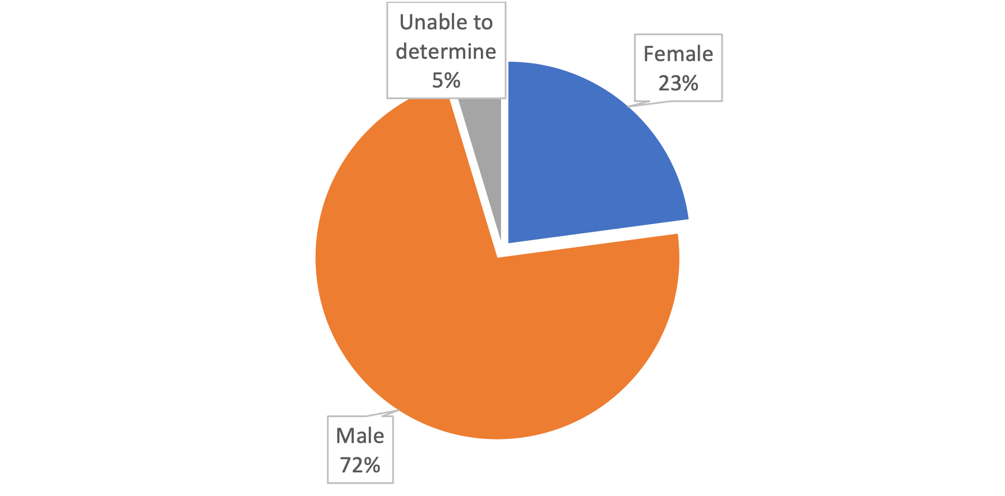
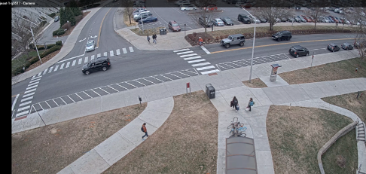
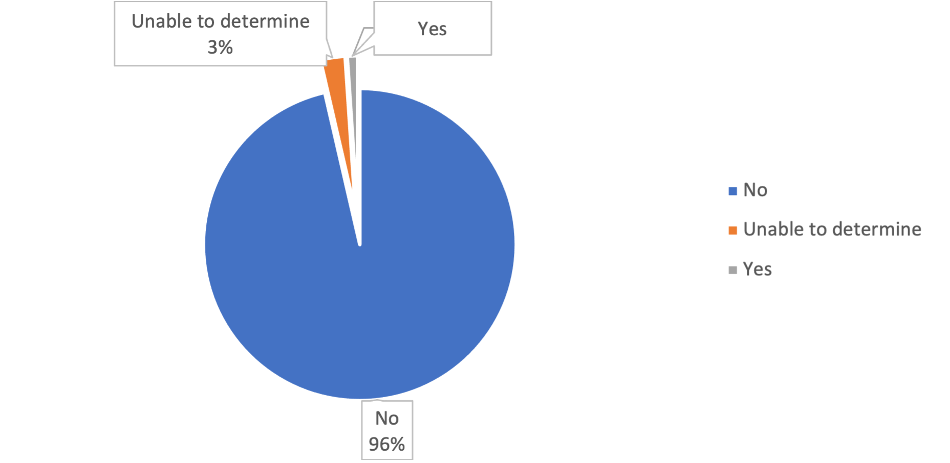
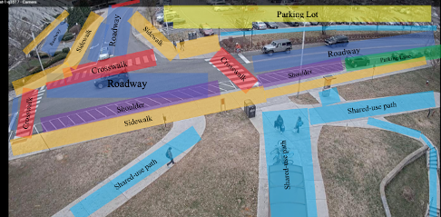
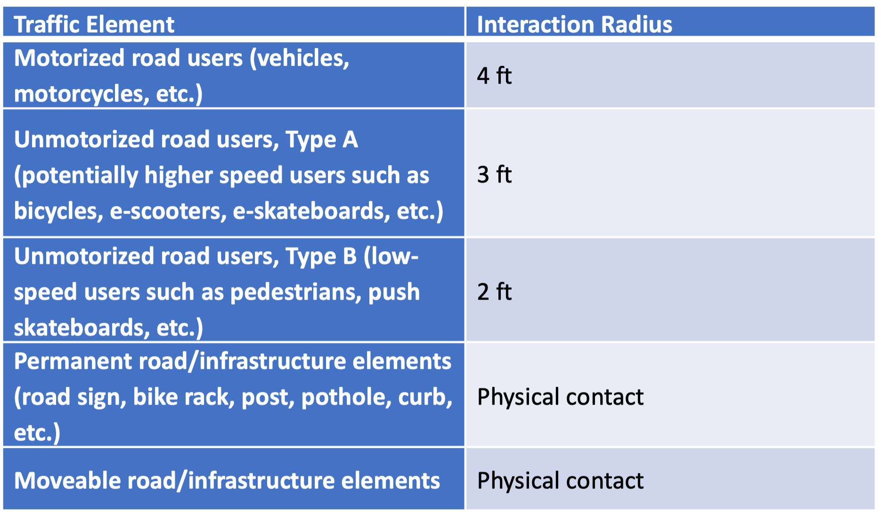
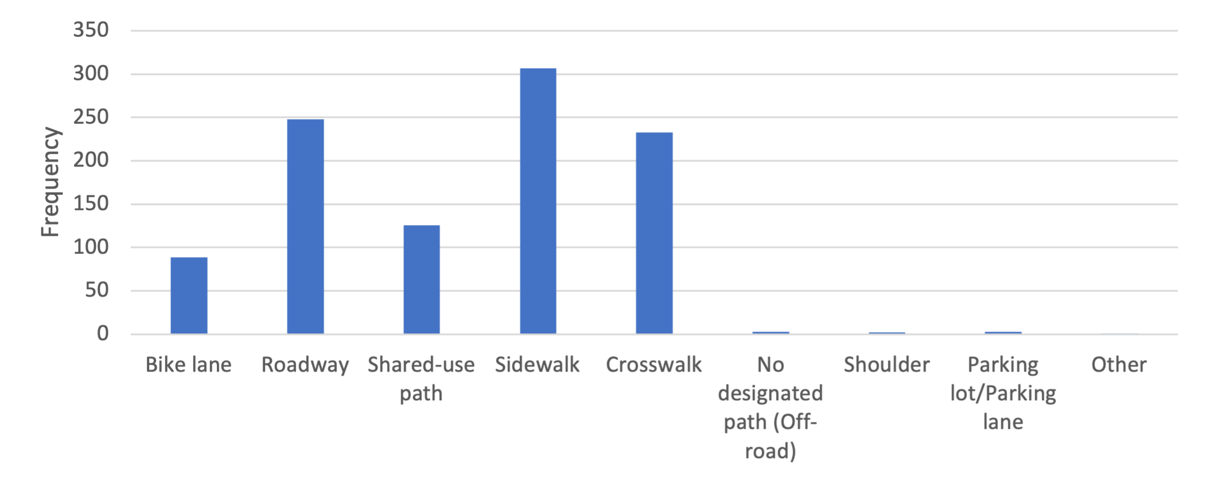
An evaluation of road user interactions with e-scooters
Yubin Hong, Melissa Miles, Charlie Klauer, Ph.D. Department of Industrial Systems Engineering, College of Engineering, Virginia Polytechnic Institute and State University
Abstract
Electric scooters (e-scooters) are gaining in popularity due to their availability, accessibility, and low cost.
There has been little research on how e-scooters behave on the road and interact with other road users.
The Virginia Tech Transportation Institute, teaming with State Farm, conducted an observational study on the Virginia Tech campus.
A total of 492 e-scooter trips were recorded, and 473 of those were analyzed.
The analysis showed that in conflicts e-scooters pose the most threat to pedestrians due to their higher speed and the greater vulnerability of pedestrians.
The results also showed that the e-scooter riders adjusted their operation rules based on the traffic environment.
These results suggest that it might be safer for e-scooters to be operated on designated lanes, bike lanes, or roadways with a speed limit of 25 mph or less.
Additional countermeasures to separate e-scooter traffic from vehicles may be required on roadways with faster speed limits.
METHOD
Seven locations were selected for analysis based on the number of trips recorded by the fixed cameras along with the roadway configuration at the location.
Video data were gathered through instrumented fixed cameras located at various intersections and high-volume pedestrian areas.
The analysis focused on times with a high volume of e-scooter riders, which was the period from 10:00 a.m. to 4:00 p.m., since the deployment was on a college campus.
The time frame was based on a frequency analysis and is representative of the hours e-scooters were most used.
The coding consisted of three main scenario protocols: control baseline scenarios, interaction scenarios, and conflict scenarios.
Control baseline scenarios were determined to be 10-seconds long.
Interaction scenarios were coded when another road user or traffic element came within a certain radius of the referenced e-scooter rider.
For the purpose of this study, a total of 492 e-scooter trips were selected and 473 of those were reduced due to loss of data and visibility of the video. Among the 473 trips that went through video coding protocols, 72 interactions were identified, and 0 conflicts (safety-critical events) were present.
RESULTS
Seventy-two percent of the riders were male and 23% were female, making the majority of the riders male.
Most riders (96%) did not wear a helmet while riding, despite it being provided by the manufacturer.
The most common unsafe behavior recorded was aggressive riding. Sign/signal violation and trick riding are listed as second and third among unsafe riding behaviors.
E-scooter riding occurred most on crosswalks and sidewalks, which is consistent with the high frequency of interaction with pedestrians.
When e-scooter riders traversed sidewalks, crosswalks, access ramps, bike lanes, parking lanes, or shoulders, and were traveling in the same direction as cars, they generally exhibited behavior that followed the rules of the location of travel.
A total number of 72 interactions between e-scooters and other road users were identified.
Pedestrians were the most common road user present during an interaction (n=51). Interactions with pedestrians were 4 times more frequent than interactions with motorized vehicles (n=13).
When e-scooters interacted with pedestrians, they were faster than the pedestrian (n=29).
RESULTS
Trend comparison by camera location between rider behaving like a cyclist and riding in bike lanes.
Trend comparison by camera location between rider behaving like a pedestrian and riding on the sidewalk.
E-scooter rider interaction actor frequency count.
E-scooter speed during interaction frequency count by interaction actor type.
Gender distribution among e-scooter riders.
SPIN Electric scooter from actual deployment on VT campus
Camera view at Ambler Johnston Hall East-Wing location.
Helmet use behavior among e-scooter riders.
CONCLUSIONS
E-scooters, when not appropriately ridden, can become a threat to other road users, especially pedestrians.
E-scooter riders have the ability to adjust the operation rules they follow when traveling on different roadways.
These results suggest that it might be safer for e-scooters to be operated on designated lanes, bike lanes, or roadways with a speed limit of 25 mph or less.
On roadways with faster speed limits, additional countermeasures to separate e-scooter traffic from vehicles may be required.
Color-coded infrastructure elements at camera location Ambler Johnston Hall East-Wing.
AIM
The purpose of this research project was to investigate the severity and distribution of safety-critical interactions between the e-scooter and other road users, along with the prevalence of safety behaviors for e-scooter riders. The primary interests were:
investigating safety equipment implementation during e-scooter riding;
understanding e-scooter behavior at different riding locations; and
understanding the mode and safety limits of e-scooter interactions with other road users, with a special emphasis on motorized vehicles.
E-scooter rider unsafe riding behavior frequency counts.
ACKNOWLEDGMENTS
This project was funded by State Farm™ and the Safety through Disruption (Safe-D) National University Transportation Center, a grant from the U.S. Department of Transportation.
E-scooter rider riding location frequency count.
Interaction Radius Definition

