Slide 1
How to Conduct Research
Using Theory to Increase Sustainable Transportation

Slide 2
14,200
Parking Spaces
36,000 People

Slide 3
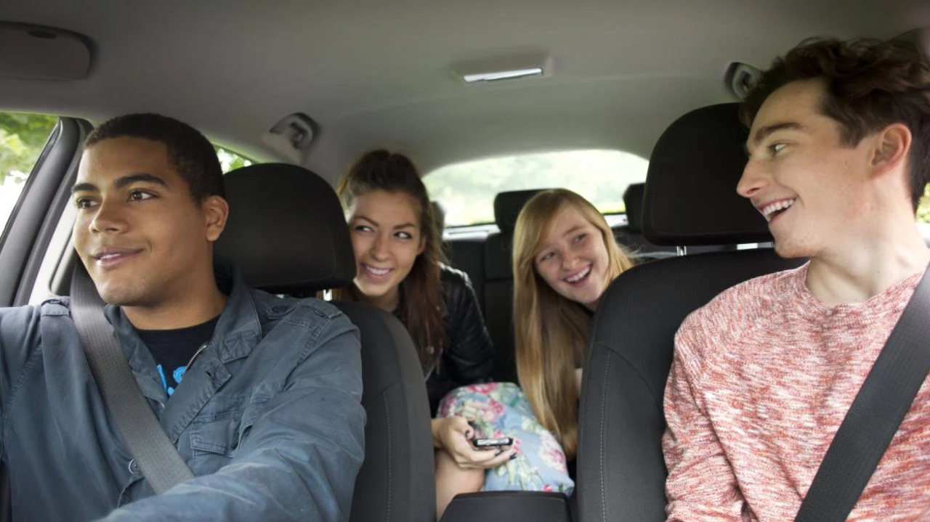
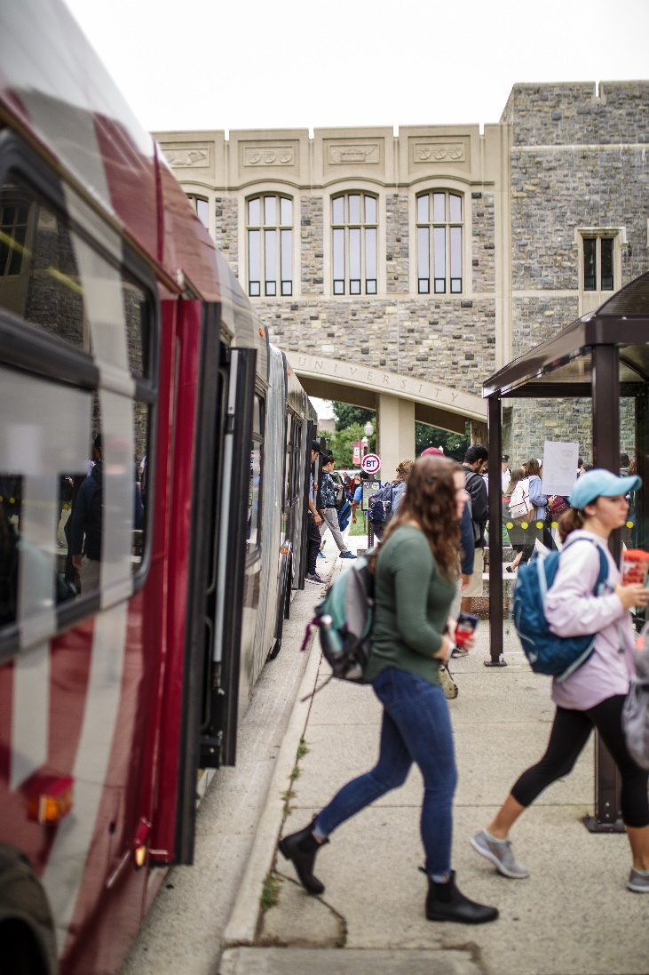
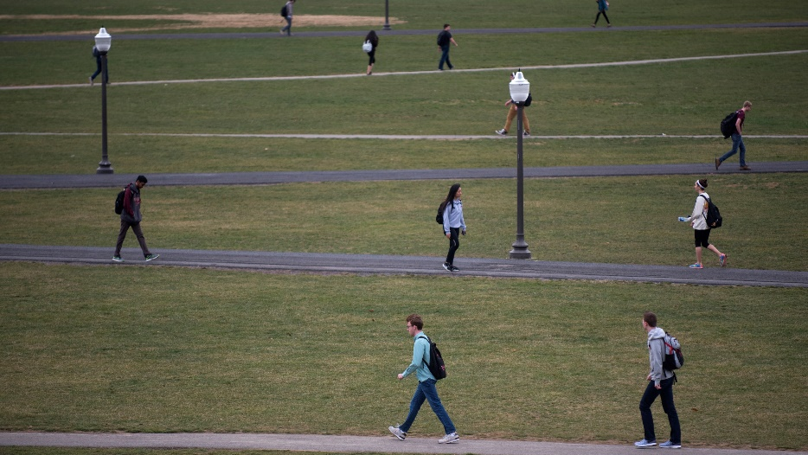
What other Ways can people get to campus?

Slide 4
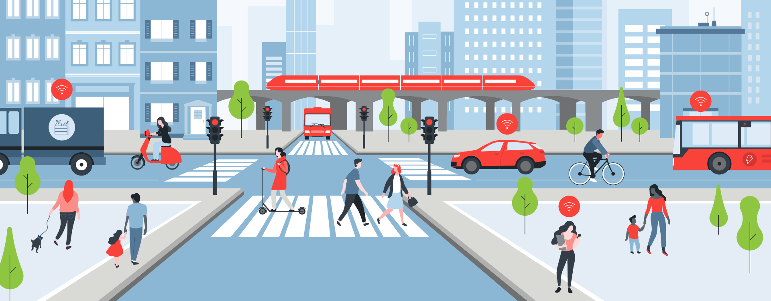
Sustainable Transportation

Slide 5
How do we improve this on campus?
Transportation Institute
Sustainable Transportation Department
Public Health Department

Slide 6
Focus Group

Slide 7
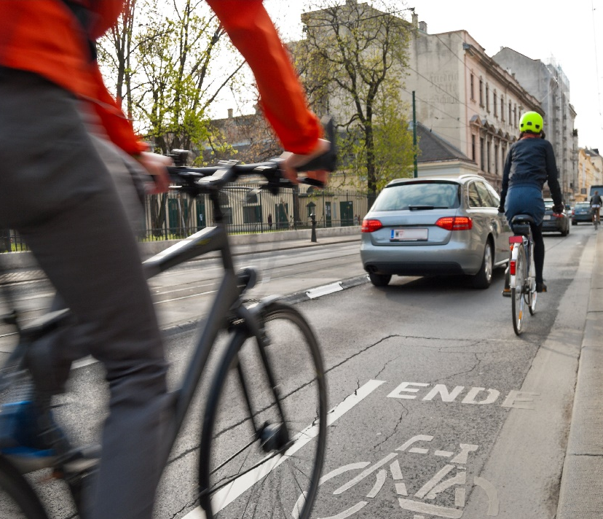
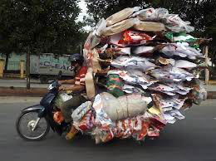
Why Drive versus bike?

Slide 8
Created Modules

Slide 9
Hokie bird Video

Slide 10
GoalS??
Work together
Create safer environment for sustainable transportation
Get everyone to where they need armed with knowledge!

