Slide 1
San Diego State University College of Engineering Department of Civil, Construction, and Environmental Engineering
CON E 652 – Work zone Safety with Wearable Sensors
Dr. Reza Akhavian

Slide 2
Introduction
Work zone construction workers are exposed to both internal and external safety risks.
Internal risks refer to potential injuries as a result of ergonomic hazards, whereas external risks concern the possibility of accidents with oncoming vehicles.
Injuries due to improper or prolonged use of hand tools are examples of internal or ergonomic risks and motor vehicles speeding towards or near work zones illustrate possible external risks.
Notes:
Queue: delay

Slide 3
Introduction
Informed by the statistics of workers’ safety issues in work zones and inspired by recent advancements in pervasive sensing devices and computing powers, this project aimed at developing a holistic approach to recognize a hazard and inform workers to respond in time.
Toward this goal, a smartphone application was developed to detect internal and external risks and alert exposed workers.
This is an integrated system that captures signals from the smartphone sensors as well as cameras installed on the road leading to the work zone.
Notes:
Queue: delay

Slide 4
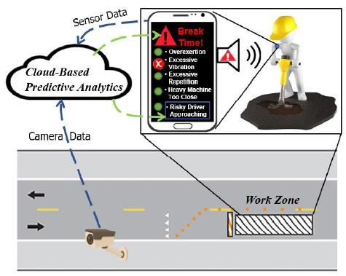
Methodology
Notes:
Queue: delay

Slide 5
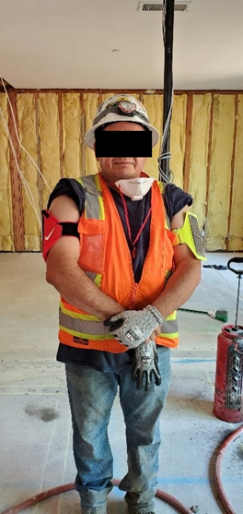
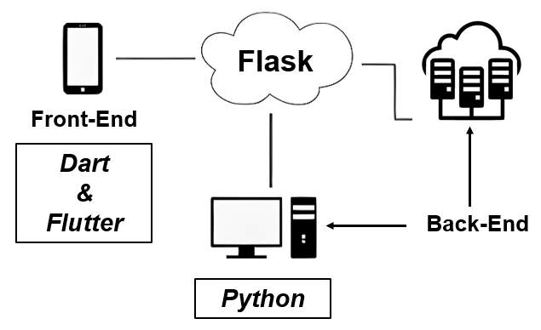
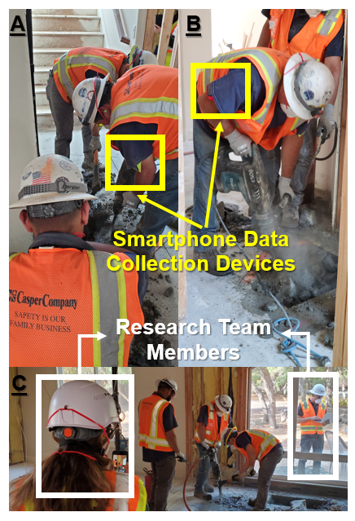
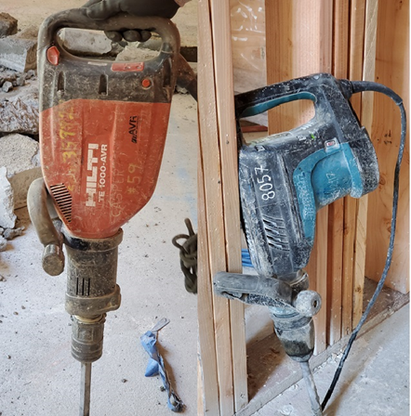
Data Collection
Notes:
Queue: delay

Slide 6
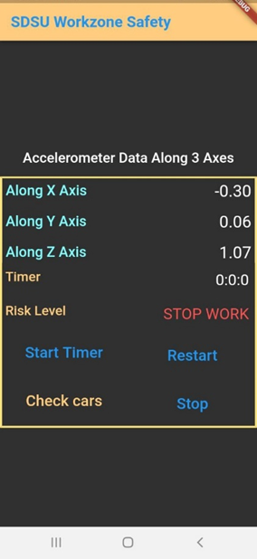
Results
Notes:
Queue: delay

Slide 7
Results
Activity | Tool | Duration (minutes) | $a_{hv(rms)}$ (m/s²)
Break Concrete Slab | TE 1000 AVR | 58 | 5.99
Rest | - | 15 | 0
Break Concrete Slab | TE 1000 AVR | 25 | 5.99
Switching Tool | - | 1 | 0
Break Concrete Slab | HM1203C | 18 | 0.98
Notes:
Queue: delay

