Slide 1
Work Zone Safety Monitoring
CivE 696 Intelligent Transportation Systems
Arash Jahangiri

Slide 2
Introduction
Speeding has been identified as one of the most important factors that could cause crashes on the roadways, and especially where we have active work zones, there is a higher chance of crash occurrence since the road users need to drive slower than usual and be more attentive around these areas.
Assess the existing conditions
Detect and monitor the speed of the vehicles
LIDAR/Video Cameras
Take proactive approaches
Generate warning messages and alert potential users in proximity of the speeding event
Smartphone app/Connected Vehicle Technology

Slide 3
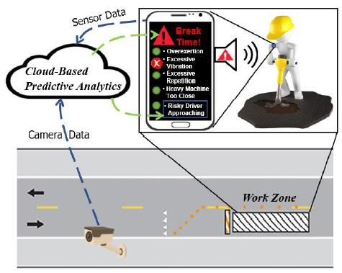
Schematic Framework

Slide 4
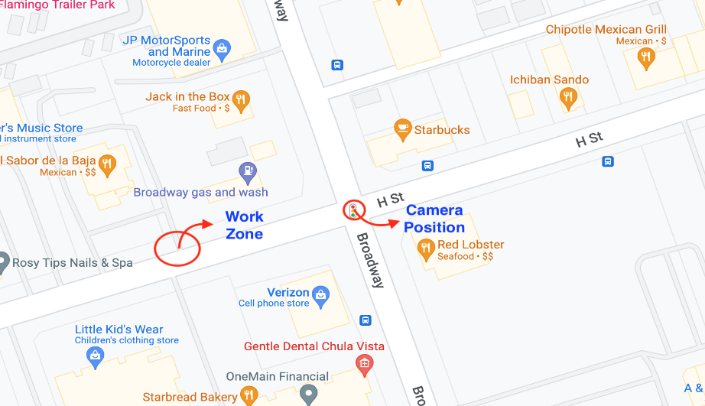
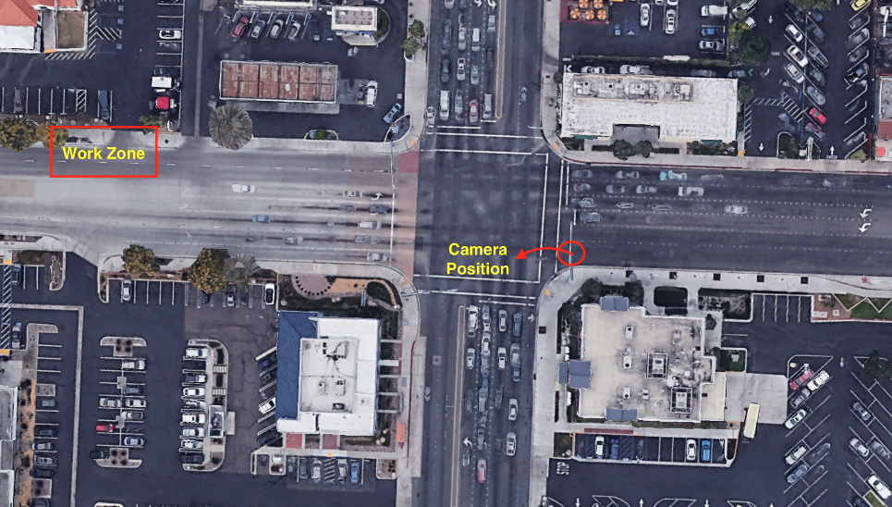
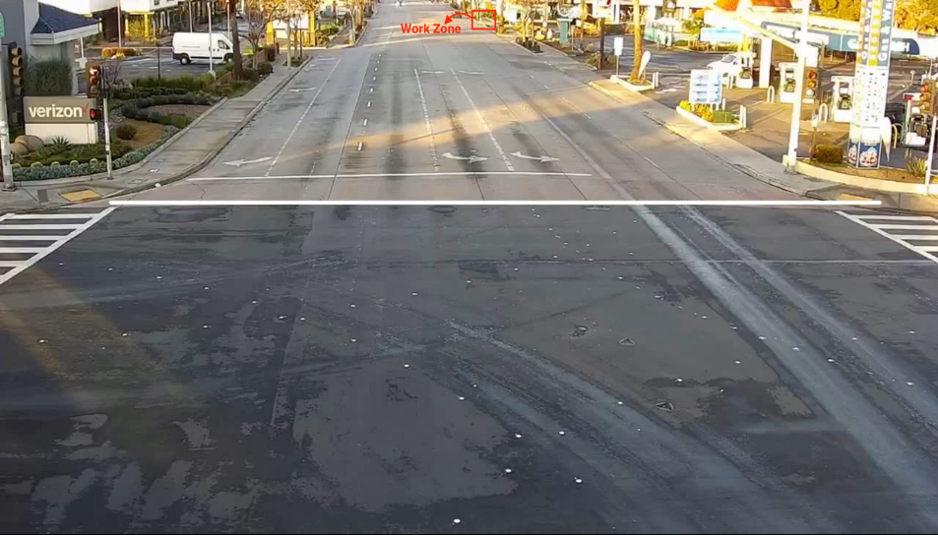
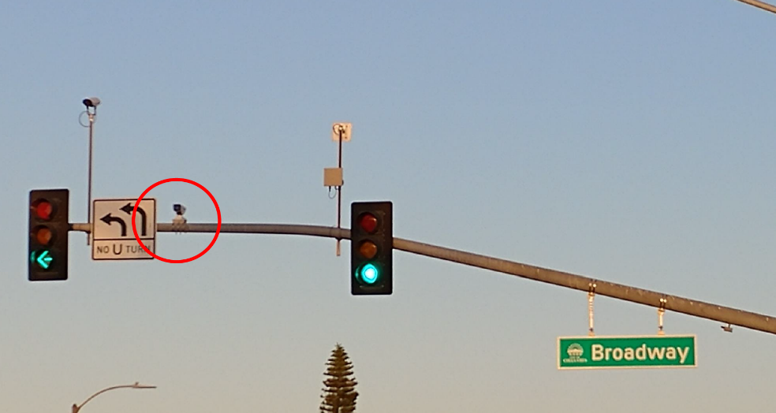
Speeding Detection Site Broadway & F Street, Chula Vista, CA

Slide 5
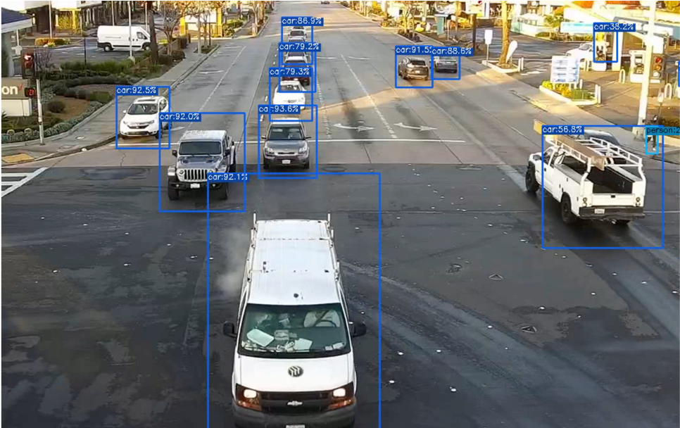
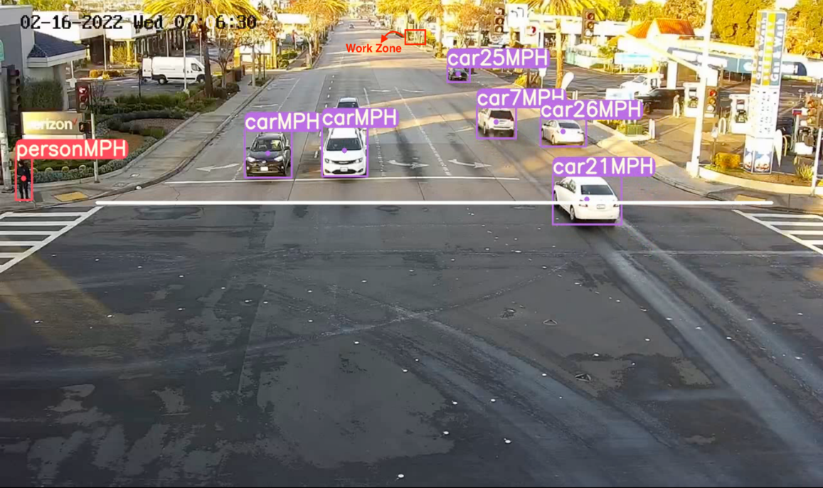
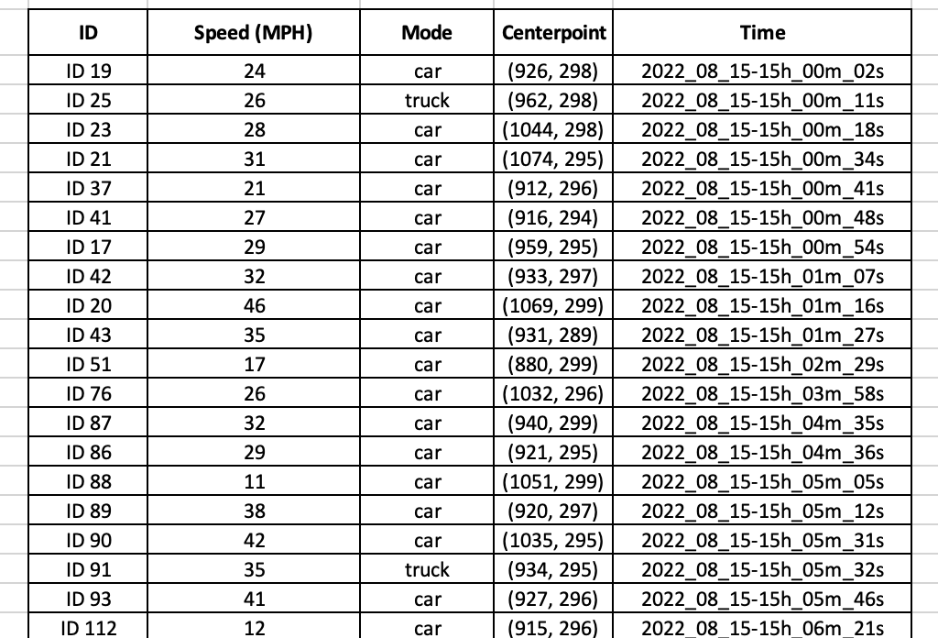
Results
Object detection & tracking
Speeding detection
Speeding: speed > speed limit (35mph)
Speed monitoring

