Slide 1
VTTI-00-033 – Learning Module
6/20/2023
Nick Britten, Jon Hankey

Slide 2
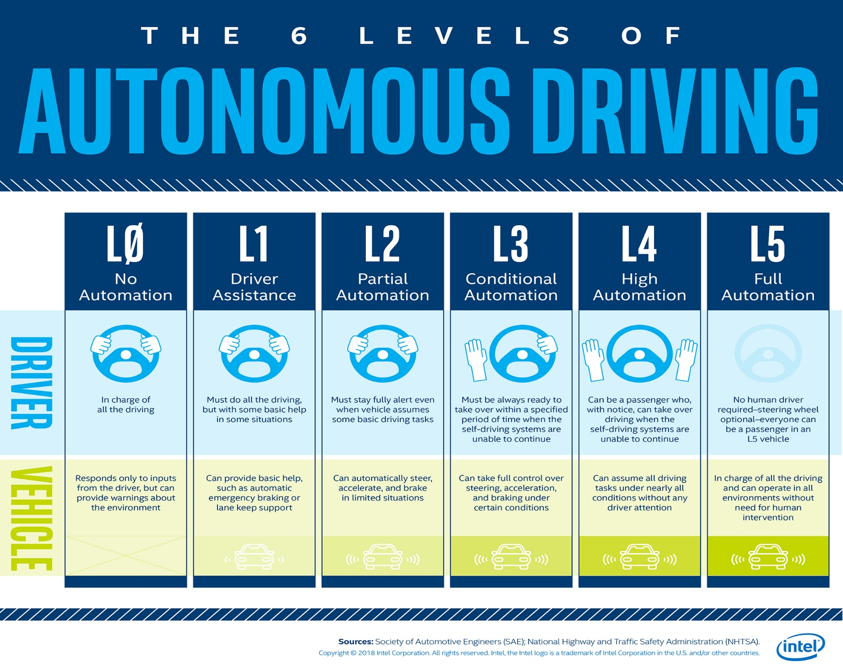
Introduction
The Society of Automotive Engineers (SAE) defines the roles of an automated driving system and its human supervisor during the driving task for each level of automation
Level 2 supports the driver
Level 3 provides longitudinal and lateral control AND doesn’t require the driver to monitor the environment or system
Source: https://newsroom.intel.com/news/autonomous-driving-hands-wheel-no-wheel-all/

Slide 3
Shift in driver role and responsibilities from manual driving to reliable supervised automation (i.e., L2) and unsupervised automation (i.e., L3) is generally associated with reduced situational awareness or entering an “out-of-the-loop” state (Endsley & Kiris, 1995).
Situation awareness = “the perceptions of the elements in the environment within a volume of space and time, the comprehension of their meaning, and the projection of their status in the near future” (Endsley, 1988)
Three levels of situation awareness are:
1 = Perception
2 = Comprehension
3 = Projection
Out of the loop = “Not in physical control of the vehicle, and not monitoring the driving situation, OR in physical control of the vehicle but not monitoring the driving situation.” (Merat et al., 2019)
In the loop = Being in physical control of the vehicle and monitoring the driving
On the loop = Monitoring the environment but not being in physical control of the vehicle

Slide 4
Evasive Maneuvers
In CAD, the automated system is in control of the vehicle within its ODD. This means that during CAD the vehicle is capable of tactical control of the vehicle and can maneuver evasively by braking or steering to avoid objects on the road.
During these evasive maneuvers, the driver may attempt to intervene during the maneuver and take back control of the vehicle. The interruption of a properly performed evasive maneuver may reduce safety with CAD. Additionally, unexpected inertial forces might also affect driver inputs on the controls.
Additionally, unexpected inertial forces might also affect driver inputs on the controls. The potential safety risk of driver intervention during system-initiated critical events has been demonstrated in driving simulators. Roche et al. (2022) found that drivers tended to unsafely depart the travel lane or collide with an obstacle when intervening during a CAD system-initiated critical lane change. While Roche et al. (2020) found that drivers tended to overreact by either decelerating too strongly or unnecessarily changing lanes when intervening during a CAD system-initiated critical braking maneuver.
Results from studies examining whether drivers would intervene to avoid an object during PAD have generally found that a subset of drivers will not intervene and will subsequently strike the object despite having their eyes on the road and their hands on the wheel (Pipkorn, Victor, Dozza, & Tivesten, 2021; Victor et al., 2018).

Slide 5
Understanding how drivers respond to evasive maneuvers initiated by a CAD vehicle is important to the implementation of these systems and the arbitration of controls between the driver and automation in such situations.
How would you design a study to explore this topic?
What research questions and hypotheses would you have?
What variables would you choose to measure? Why?
How would you analyze your variables to support or reject your hypotheses?

Slide 6
Methods

Slide 7
Research Questions
How will drivers respond to an evasive maneuver scenario when in CAD?
When the event is a swerving maneuver initiated by the system?
When the event is a braking maneuver initiated by the system?
https://unsplash.com/photos/XuDPnpox8tc
https://unsplash.com/photos/wjC2TQ4KFRo

Slide 8
Wizard-of-Oz
Currently, CAD autonomous vehicles are not widely commercially available or accessible to researchers. Thus, in order to study CAD vehicles, researchers are often required to use Wizard-of-Oz (WoZ) platforms to simulate automated driving (Bengler, Omozik, & Scheiter, 2019).
The WoZ method uses a hidden human (i.e., the “wizard”) to simulate the role of a computer system (Fraser & Gilbert, 1991).
Beyond these initial uses, the WoZ method has been adopted in vehicle research to simulate autonomous vehicle and advanced driver assistance systems that are “not yet existent, or whose implementation would be too costly for the purpose of the experiment” (Jarosch, Paradies, Feiner, & Bengler, 2019).
This application of the WoZ method is used both in driving simulators (Schieben, Heesen, Schindler, Kelsch, & Flemisch, 2009) and with real vehicles on test tracks (Pipkorn et al., 2021) and public roads (Jarosch et al., 2019).

Slide 9
Participants
36 participants (18 females, 18 males) between the ages of 30 – 75 years old were recruited from the New River Valley area.
Participants will be required to meet the following criteria:
Hold a valid U.S. driver’s license
Have at least two years of driving experience
Gender | n | Age
 |  | Min | Mean | Max
Male | 18 | 31.0 | 54.7 | 74.0
Female | 18 | 31.0 | 52.8 | 74.0
Total | 36 | 31.0 | 53.8 | 74.0
Notes:
Mean age was in the 50s for both men and women

Slide 10
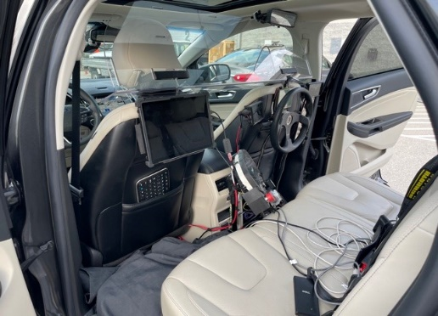
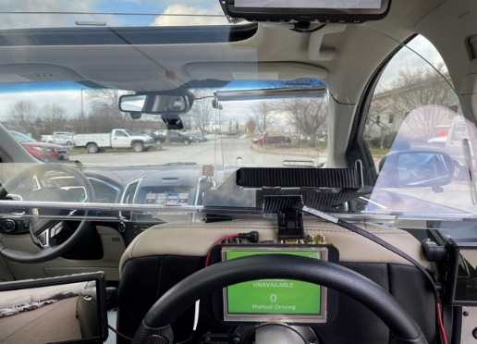
Test Vehicle
2019 Ford Edge
Equipped with rear-seat controls to simulate Assisted Driving and Automated Driving
Vehicle equipped with work station to control the transitions and HMI
Notes:
Click animation 1: These modifications allow the vehicle to be fully controlled from the rear seat in order to simulate CAD automation by steering with ACC active.
Although the vehicle is capable of PAD through the activation of the ACC and LKAS features, PAD will be simulated the same way.
The picture below shows the rear-seat experimenters view while driving, and Click animation the side and Click animation rear-view mirrors.
The vehicle is also equipped with a touchscreen mounted to the driver’s seat that allows the second rear-seat experimenter to control the instrument cluster HMI

Slide 11
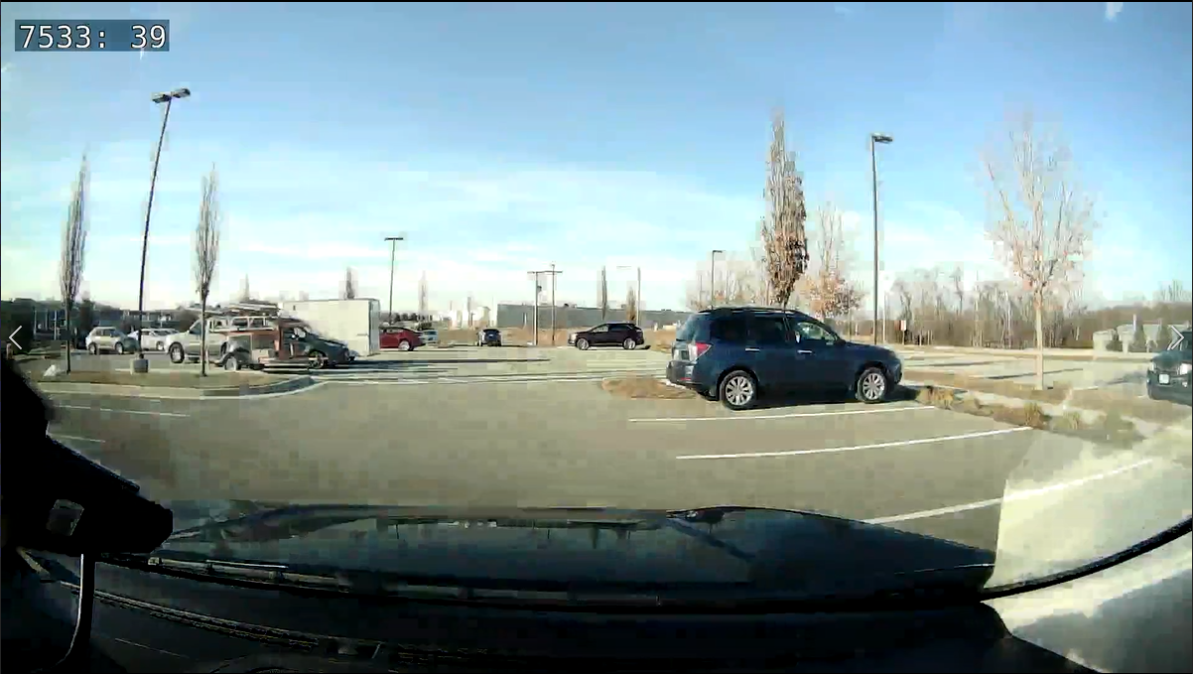
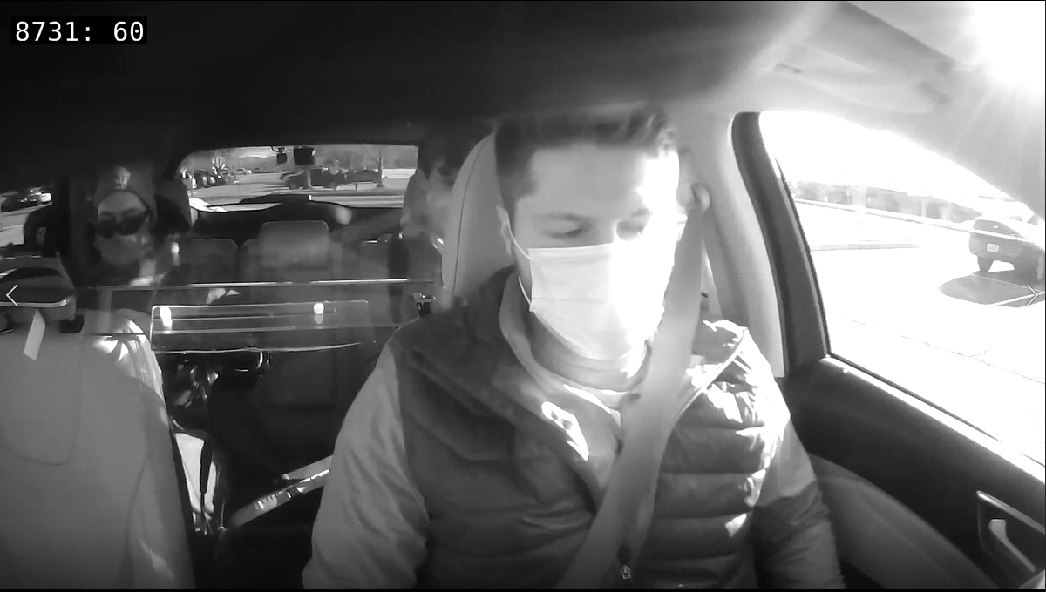
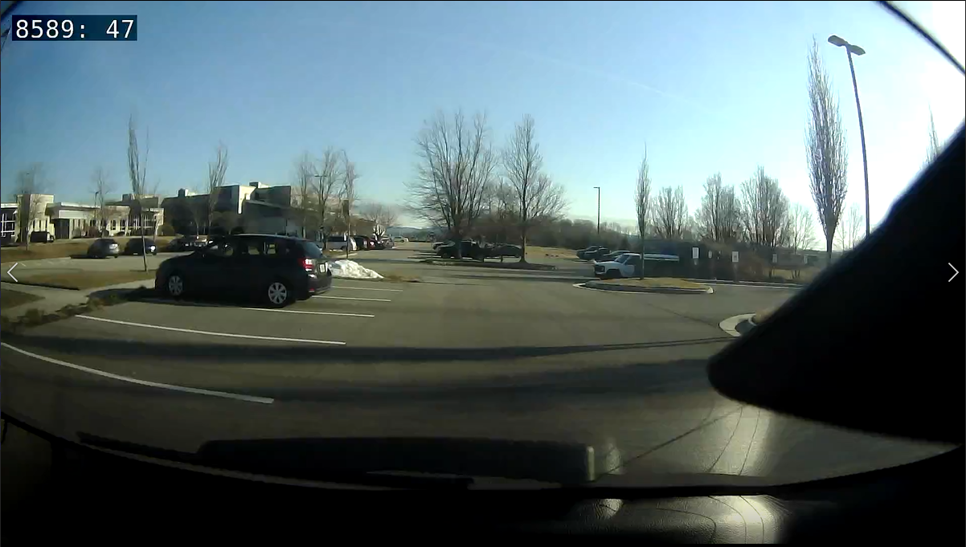
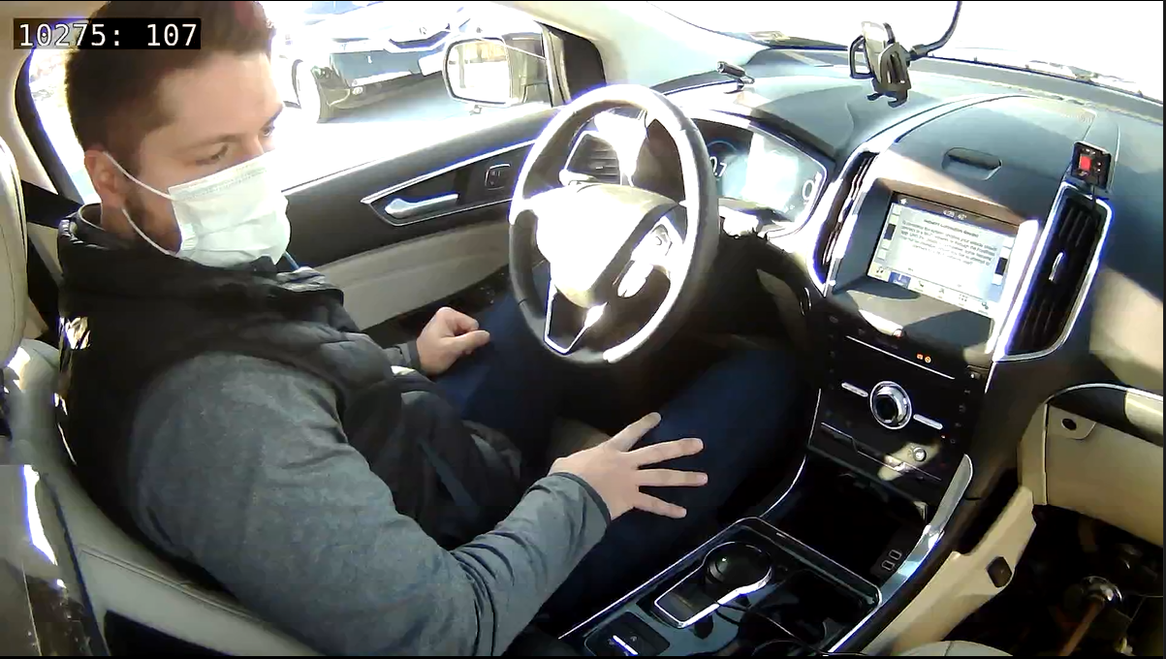
Test Vehicle – Data Acquisition System
Vehicle is instrumented with VTTI’s FlexDAS data acquisition system (DAS)
DAS continuously records:
Vehicle speed
Throttle position
Brake application
Acceleration
GPS position
Steering torque
Automation mode state
Video views

Slide 12
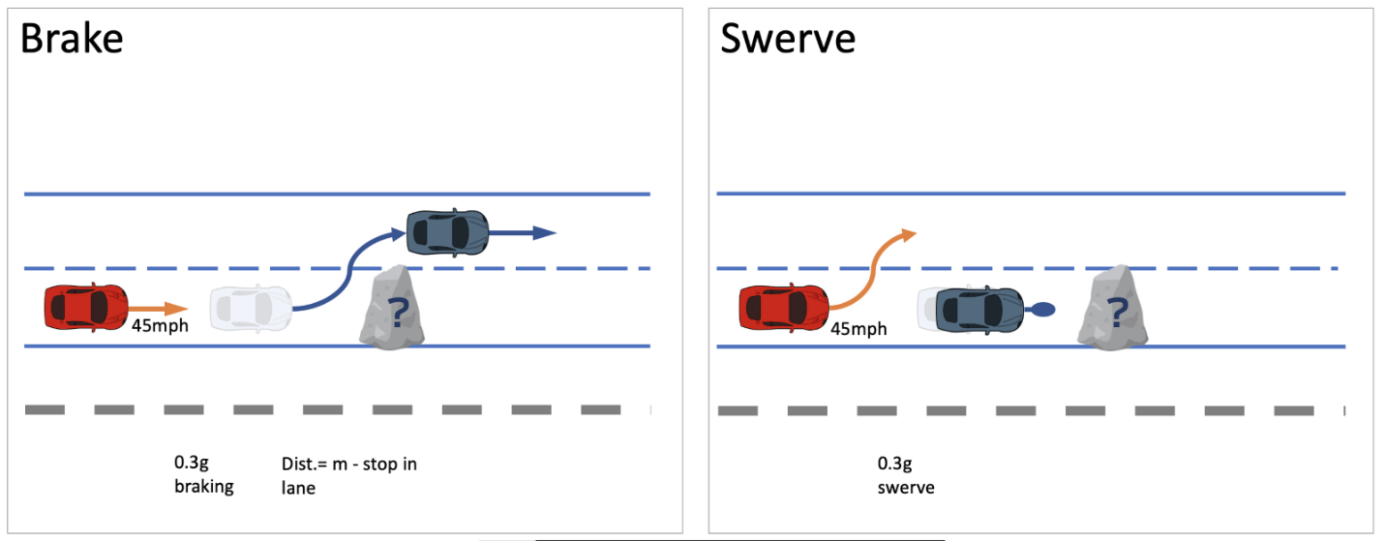
Evasive Maneuver
The evasive maneuver was performed at the end of the study and in a controlled test environment on the Virginia Smart Road.
Once the vehicles reached a pre-determined landmark approximately 30 meters from the box, the rear seat experimenter and lead vehicle initiated opposite evasive maneuvers (e.g., test vehicle brakes and lead vehicle swerves or test vehicle swerves and lead vehicle brakes) in response to a cardboard box in the road
The participant did not need to intervene in any way to avoid the box.
Both vehicles were moving at about 45 mph (20 m/s) prior to the maneuver.

Slide 13
Procedure: Overview
The participant will drive an instrumented 2019 Ford Edge and experience manual driving, PAD, and CAD over the course of single 3 hour session during daylight hours
Session will consist of 6 stages:
1) Pre-arrival screening
2) Participant Arrival
3) Vehicle Orientation
4) Public Road Data Collection
5) Smart Road Data Collection
6) Debrief
Notes:
Pre-Arrival
Potential participants will be provided with study information over the phone.
Those that are interested in participating will be asked for verbal consent prior to administering the eligibility screening.
Interested potential participants will be told that:
Participation will consist of a single session, taking place during daylight hours, and will last approximately 3 hours.
Arrival
Provide an overview of the study.
Review the consent form and answer all questions the participant has.
Fill out tax form.
Conduct an informal hearing test, visual acuity test, and color vision test.
Vehicle Orientation
Participant given orientation to vehicle’s controls and PAD/CAD features
PAD, instructed to keep their eyes and mind on the driving environment but that they do not need to keep their hands on the steering wheel or feet on the pedals.
CAD, instructed that they do not need to keep their eyes and mind on the road, their hands on the wheel, or their feet on the pedals and are free to perform NDRTs on their personal phone
Participants instructed:
If they feel fatigued or feel they need a break, that one will be provided
A non-driving experimenter will be present at rear-seat controls
If they fail to regain control when alerted by HMI, fail to follow instruction, or behave unsafely, then experimenter will end
Must follow all roadway signs and keep seatbelt buckled

Slide 14
Variables
Vehicle Variables
Acceleration, Speed, Orientation, Lat/Long Coordinates
Rear Driver (experimenter) Brake torque, Steering torque, Steering Angle, Throttle Percentage
Front Driver (participant) Brake torque, Steering torque, Steering Angle, Throttle Percentage
Intervention Flag – when the automated system was cancelled with a button or brake
Behavioral Variables
Eye Glance Location - categorized for the glance direction before and after the event using the origin method (ISO 2022)
Hand position – On wheel or off wheel
Foot position – On brake pedal or off brake pedal

Slide 15
Data Analysis

Slide 16
Optional Learning Activity
Students download the metadata and preform their planned data analyses

Slide 17
Results

Slide 18
Interventions
A chi-square test of independence showed that there was no significant association between maneuver type and the number of participants who chose to intervene during the evasive maneuver, χ² (1, N = 34) = 0.007, p = 0.93.
Only two participants chose to intervene and deactivate the system during the evasive maneuver, one participant each in the swerve and brake conditions. Both participants used the brakes to cancel, and moved their hands to the steering wheel when they deactivated the system. Both participants did not have their hands on the wheel prior to the event.

Slide 19
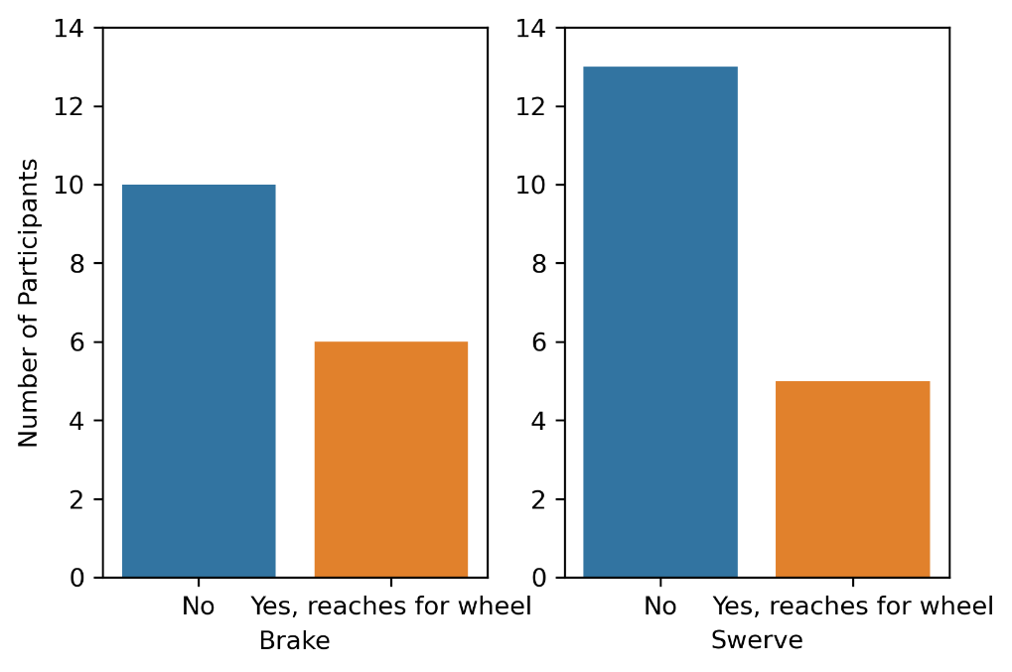
Reaching for Steering Wheel
A chi-square test of independence showed that there was no significant association between maneuver type and the participants reaching toward the steering wheel, χ² (1, N = 34) = 0.37, p = 0.55.

Slide 20
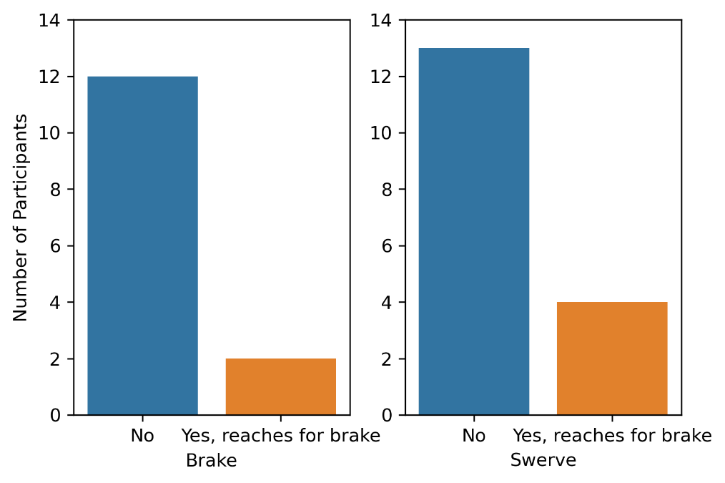
Reaching for Brake Pedal
A chi-square test of independence showed that there was no significant association between maneuver type and the participants reaching their foot toward the brake pedal χ² (1, N = 34) = 0.43, p = 0.51.

Slide 21
Intervention Capability – Brake Maneuver

Slide 22
Intervention Capability – Swerve Maneuver

Slide 23
Glance Data
Participants in both evasive maneuver conditions primarily looked toward the obstacle and the lead vehicle.
This is reflected in the total time spent looking forward in the brake condition (3.6 s; SD = 2.8) and the total time spent looking forward (1.2 s; SD = 1.1) and at the right windshield (1.2 s; SD = 1.4) in the swerving condition.

Slide 24
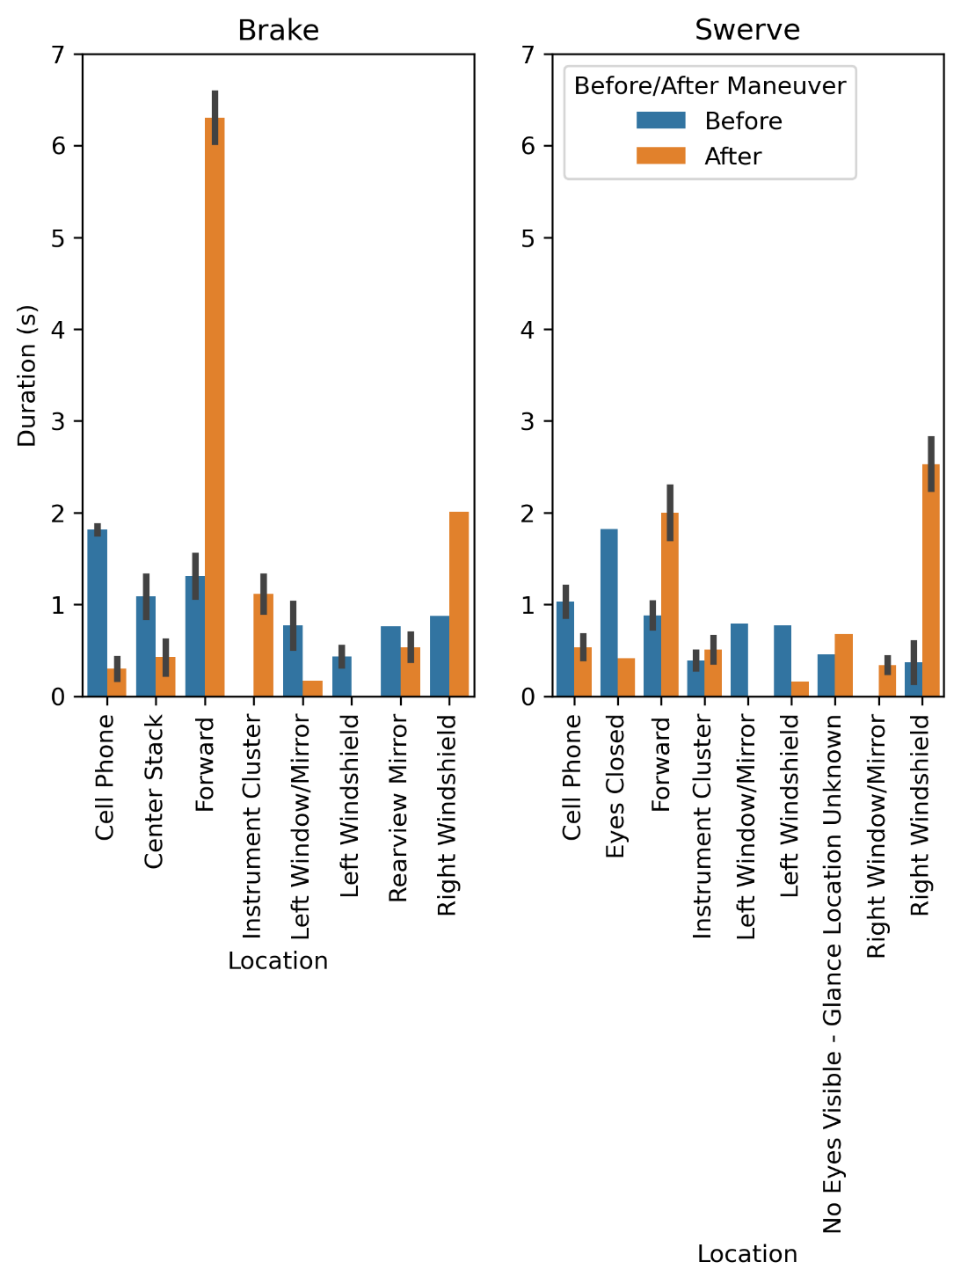
Glance Data - continued
The mean glance duration to the areas of interest before and after the maneuver occurred for each maneuver type.
Participants in the brake condition had a mean increase of 4.9 seconds spent looking to the forward roadway after the maneuver (6.3 s; SD = 1.1 s) compared to before (1.3 s; SD = 0.7).
Participants in the swerve condition had a mean increase of 2.2 seconds spent looking to the right windshield after the maneuver (2.5 s; SD = 1.1) compared to before (0.3 s; SD = 0.3) and 1.1 seconds spent looking to the forward roadway after the maneuver (2.0 s; SD = 1.1) compared to before (0.8 s; SD = 0.4

Slide 25
Optional Learning Activity
After seeing the study data, what conclusions do you think can be drawn?
What study limitations can you identify and what ideas do you have for future research on this topic?

Slide 26
Discussion

Slide 27
Discussion
Overall, the results from this study show that most drivers do not prepare to intervene or intervene in response to a CAD system-initiated evasive maneuver.
Indeed, only 11 participants reached toward the vehicle controls (i.e., prepared to intervene) and, of the few participants that did reach for the controls, only two chose to intervene.
Driver preparation to intervene, as measured by reaching toward the steering wheel, brake pedal, or cancel button, in response to these maneuvers was similar regardless of whether the vehicle braked or swerved to execute the evasive maneuver.
The type of evasive maneuver did not appear to affect the driver’s choice to intervene and take control of the vehicle during CAD system-initiated maneuvers. Importantly, the drivers who intervened did so safely.

Slide 28
Discussion
Interestingly, most drivers were monitoring the roadway (i.e., looking toward the forward roadway, left windshield, or right windshield locations) immediately prior to the beginning of evasive maneuver.
In other words, drivers were looking toward the roadway and elected not to intervene or prepare to intervene. The drivers’ glance behavior also showed that drivers tended to appropriately attend to the evasive maneuver. Specifically, drivers in the brake condition shifted their visual attention to the forward roadway (i.e., the swerving lead vehicle and box in the lane of travel) in response to the maneuver, while drivers in the swerve condition shifted their visual attention to the forward roadway and the right windshield (i.e., toward the braking lead vehicle and box in the lateral lane).
Taken together, these results suggest that after just a couple of hours of driving on public roads, most participants trusted the system enough to not intervene during a maneuver in response to a sudden-reveal road hazard. The participants who did intervene were safe while doing so. It is important to note, though, that the maneuver, while sudden, was conducted at about 0.3 g and not close to the limit of vehicle handling. No differences were found between driver responses in the swerve versus the brake conditions, other than the direction of glances (aimed at the road hazard)

Slide 29
Future Research
Given the ability of CAD-equipped vehicles to operate in PAD and manual modes and the findings from Pipkorn et al. (2021) and Victor et al. (2018) suggesting that drivers do not intervene to avoid obstacles when in PAD, future research should consider the impact of experiencing CAD system-initiated maneuvers on participants’ intervention
Future research should also consider driver fatigue, which has a well-established impact on a driver’s ability to safely drive. Previous research has found that driving automation systems induce drive fatigue faster compared to manual driving (Schömig et al., 2015). In the context of CAD, Vogelpohl et al. (2019) found that fatigue increased driver takeover time and concluded that driver fatigue could be a serious hazard during takeover scenarios. Future research should investigate the impact of driver fatigue on evasive maneuver responses.

Slide 30
Sources

