Slide 2
IN-DEPTH EXAMINATION OF E-SCOOTER SAFETY: A CASE STUDY OF AUSTIN, TEXAS

Slide 3
Introduction & Background

Slide 4
Micromobility: E-Scooters
Introduction & Background
Introduction
E-scooters have rapidly grown across the United States in a few years being part of urban mobility in cities across the country.

Slide 5
E-Scooters As Urban Mobility
Introduction & Background
Background
A critical component of micromobility in urban transportation planning.
A convenient and environmentally friendly alternative to cars for short trips.
Provide first/last mile transportation solutions in urban areas.

Slide 6
E-Scooter Concerns
Introduction & Background
Background
Unpredictable adoption and unmanageable operations in its first years.
Evolved from being an exciting new mobility option to a mode with safety and other concerns.
Compete for space in urban environments with other micromobilities, like bicycles.

Slide 7
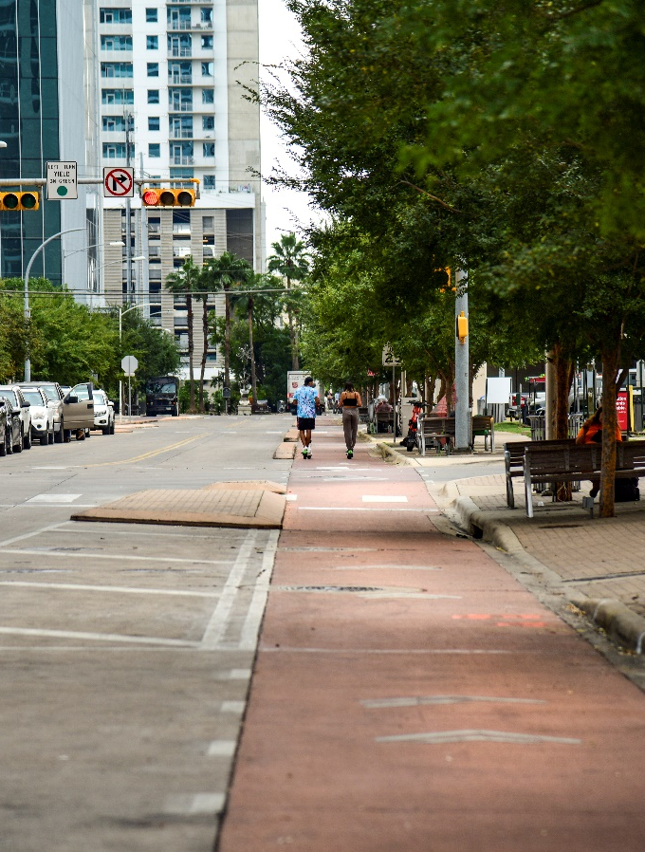
Study Focus
Introduction & Background
Focus
An in-depth examination of e-scooter safety.
A thorough review of the current state of the practice for e-scooter use as well as e-scooter-related injuries, contributing factors to e-scooter incidents, and public perceptions and concerns regarding e-scooters.
An evidence-based multi-level analysis to derive conclusions and informed recommendations for enhancing e-scooter safety.
A case study focusing on:
City of Austin, Texas
Four years of crash data (2018 to 2021)

Slide 8
Data & Methods

Slide 9
Primary Data Sources
Data & Methods
Data
Hospital Data
The hospital emergency room patient records were obtained from Dell Seton Medical Center at the University of Texas.
TxDOT CRIS Data
A total of 2,195 crash records were available for analysis, including crashes involving bicycle, pedestrian, or motorized conveyance.
Field Data
A total of 131 locations from the e-scooter-related CRIS data were examined for the purpose of gathering additional micro-level data on the built environment.
Data were obtained for 369 e-scooter-related patients.
In total, 153 police crash reports were identified as e-scooter related.

Slide 10
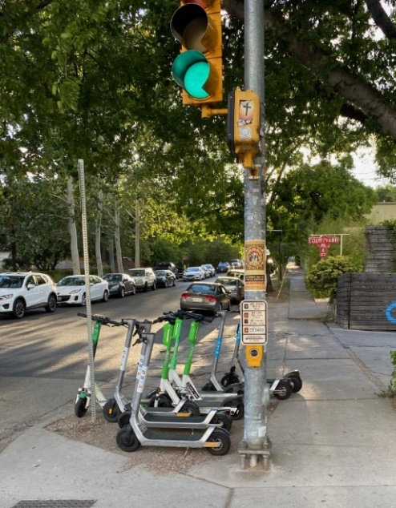
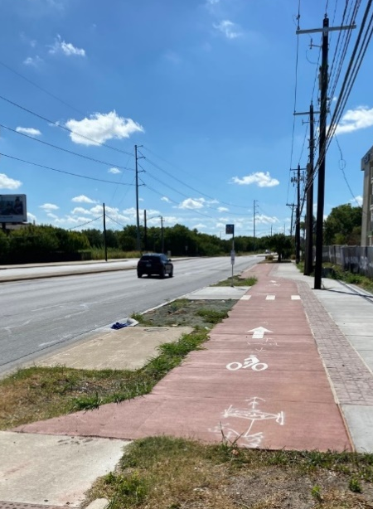
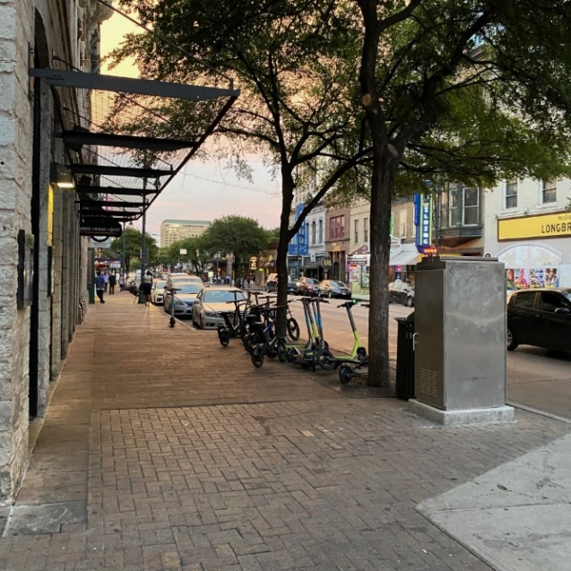
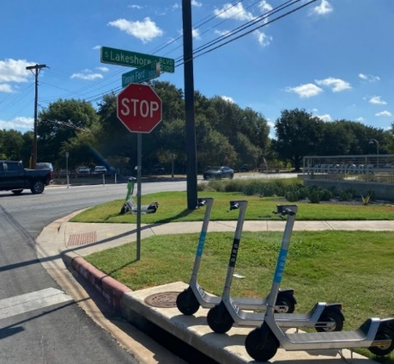
Field Data Collection
Data & Methods
Data

Slide 11
additional Data Sources
Data & Methods
Data
Demographic and Socioeconomic Data
United States Census Bureau’s American Community Survey
Built Environment Data
City of Austin’s data
TxDOT’s roadway inventory
Bicycle facility dataset & Land use dataset
Environmental Protection Agency’s Smart Location Database
Five-year averaged data
Block-group-level

Slide 12
Methodology – Identify & Verify
Data & Methods
Methods
Data Fusion
Various methods were employed to merge hospital data with the CRIS datasets.
Text Mining
Text mining techniques were used to identify and extract e-scooter-related crashes within the crash reports.
Verification
The identified e-scooter-related reports were manually reviewed to identify/correct any errors, and to extract additional information from the descriptive section.
Keywords were searched within the descriptive section of each report.

Slide 13
Methodology – Process & Analyze
Data & Methods
Methods
Topic Modeling
Natural language processing techniques, in specifics topic modeling, were used to generate new features and understand the descriptive sections of crash reports.
Exploratory Analysis
Trends were identified, and cross tables were built to examine potential relationships.
Predictive Modeling
Resampling techniques were utilized to address the imbalanced classification problem.
Statistical tests were conducted to determine the statistical significance of these relationships.
Three models to train the data: logistic regression model, random forest model, and extreme gradient boosting model.

Slide 14
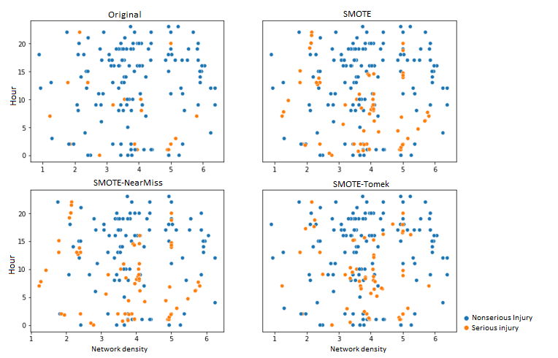
Predictive Modeling Details
Data & Methods
Methods
Treating Imbalance Data
Injury severity data is categorical in nature.
Crashes with severe injury and non-severe injury are disproportionally distributed.
To solve the class imbalance problem, different resampling techniques were used:
Synthetic Minority Over-Sampling Technique (SMOTE)
SMOTE-Tomek
SMOTE-NearMiss

Slide 15
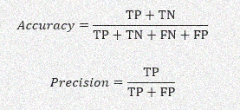
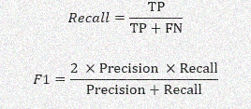
Predictive Modeling Details Cont'd
Data & Methods
Methods
Performance Evaluation
Confusion Matrix | Predicted Positive | Predicted Negative
Actual Positive | True Positive (TP) | False Negative (FN)
Actual Negative | False Positive (FP) | True Negative (TN)
Performance matrices were calculated using the cross-validation technique that uses different portions of the data to test and train a model on different iterations.
The metrics generated from the confusion matrix.

Slide 16
Predictive Modeling Details Cont'd
Data & Methods
Methods
Statistical Models
A widely used classification algorithm that uses a linear combination of input features to predict a binary outcome
Logistic regression model
An ensemble learning method that uses multiple decision trees to make predictions
Random forest model
A widely-used classification algorithm that uses gradient boosting to improve model performance
Extreme Gradient Boosting Model

Slide 17
Predictive Modeling Details Cont'd
Data & Methods
Methods
Variable Selection
Model Interpretation
The Phi_K correlation coefficient was used to identify the most relevant features for model training.
Select additional variables were also included based on the literature review and domain knowledge.
Shapley additive explanations (SHAP) model was used to evaluate the importance of features in the final injury severity prediction model.
A concept from cooperative game theory to determine the contribution of each input feature to the model’s output.

Slide 18
Findings

Slide 19
Comparing Two Datasets
Findings
Comparing Datasets
Variable | Hospital | CRIS
Crashes in 2018 | 14.09% | 19.61%
Crashes in 2019 | 31.71% | 41.18%
Crashes in 2020 | 14.91% | 10.46%
Crashes in 2021 | 39.02% | 28.76%
Crashes in winter | 15.44% | 10.22%
Crashes in spring | 26.28% | 23.36%
Crashes in summer | 20.59% | 29.20%
Crashes in fall | 37.69% | 37.23%
Age-mean | 34 | 31
Age-median | 30 | 28
Female | 34.69% | 34.21%
Male | 65.31% | 65.78%
Age-male (median) | 30 | 28
Age-female (median) | 31 | 29
White (non-Hispanic) | 64.23% | 59.86%
Hispanic | 20.86% | 17.00%
Black | 7.04% | 14.96%

Slide 20
Exploratory Analysis – Hospital Data
Findings
Exploratory Analysis
Most patients were admitted on Fridays and weekends, with the majority on Saturdays.
Injuries sustained during weekends tended to be more severe.
Most injuries were attributed to falls from a height of less than 1 meter.
The neck was the most frequently injured region of the body.
Nearly one-third of the patients had blood alcohol concentration (BAC) above the legal limit.
The BAC levels were significantly higher on weekends.

Slide 21
Exploratory Analysis – Hospital Data Cont'd
Findings
Exploratory Analysis
A higher proportion of patients who exceeded the legal limits for alcohol use and drug consumption experienced severe head injuries (Abbreviated Injury Scale (AIS) > 3).
Contrasting trends were observed regarding substance use among injured patients.
Younger individuals were more commonly intoxicated with alcohol, whereas older individuals were more frequently under the influence of drugs.
Source: https://www.aaam.org/abbreviated-injury-scale-ais/
AIS is an anatomical-based coding system developed by the Association for the Advancement of Automotive Medicine (AAAM) and used to classify and quantify the severity of individual injuries. The AIS score ranges from 1 to 6, where 1 indicates minor injuries, and 6 represents the most severe (maximal) injuries.

Slide 22
Exploratory Analysis – CRIS Data
Findings
Exploratory Analysis
Most patients were admitted on Fridays and weekends, with the majority on Saturdays.
Injuries sustained during weekends tended to be more severe.
The majority of injuries occurred during nighttime hours and on weekends.
More than 90 percent of e-scooter crashes occurred on local roads and streets.

Slide 23
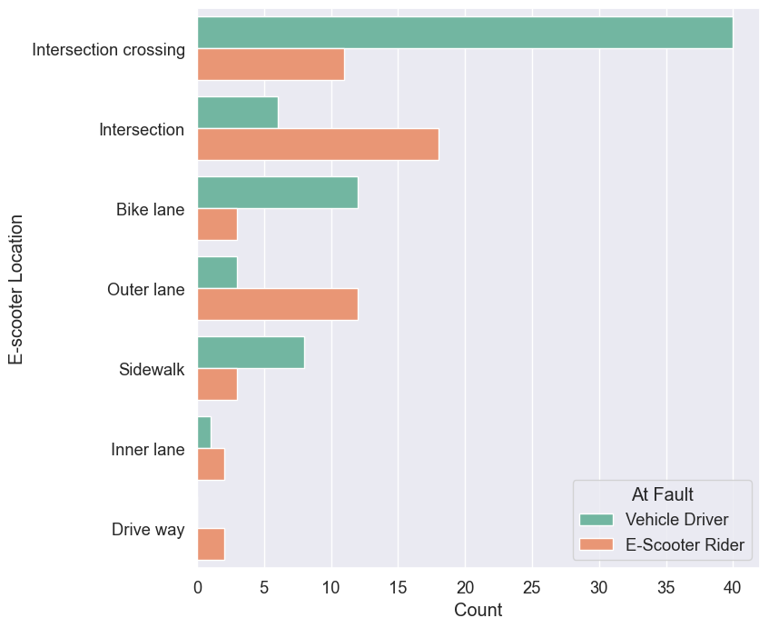
Exploratory Analysis – CRIS Data Cont'd
Findings
Exploratory Analysis
Vehicles exhibited a higher proportion of fault when making right or left turns.
Intersections posed a higher risk for e-scooter crashes, with e-scooters being primarily at fault in these situations.
Field collection data analysis:
Roadways without adequate lighting conditions were associated with a higher occurrence of severe injuries.

Slide 24
Injury Severity Model– Final Model
Findings
Predictive Modeling
The accuracy and precision scores for the random forest model were higher relative to the other model scores.
Comparatively, the XGBoost model had higher recall scores compared to the other models.
This study is more concerned with the recall score given the emphasis on false negatives (i.e., falsely classifying severe injuries as nonsevere injuries) and model interpretability → XGBoost model was chosen as the final.
Performed a subsequent SHAP analysis for the XGBoost model to further understand the variables or features affecting the corresponding model predictions.

Slide 25
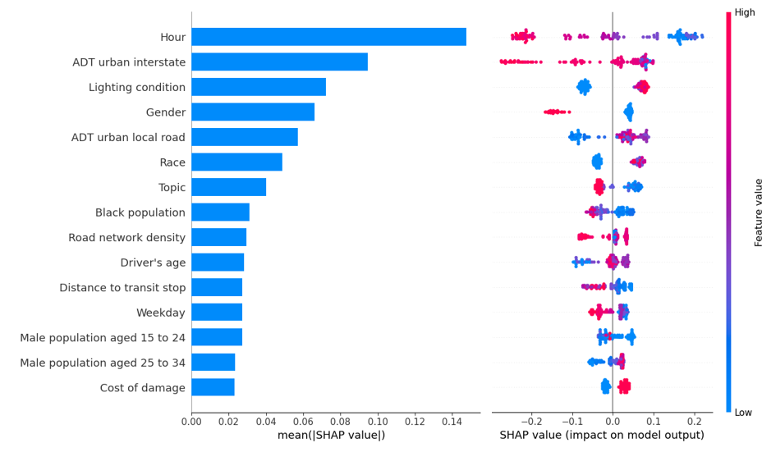
Injury Severity Model– Top Features
Findings
Predictive Modeling
Top Ranked Features based on Mean SHAP Values (left) and Feature’s Relationship with the Target (right) for the XGBoost Model Trained with the E-scooter Crash Dataset

Slide 26
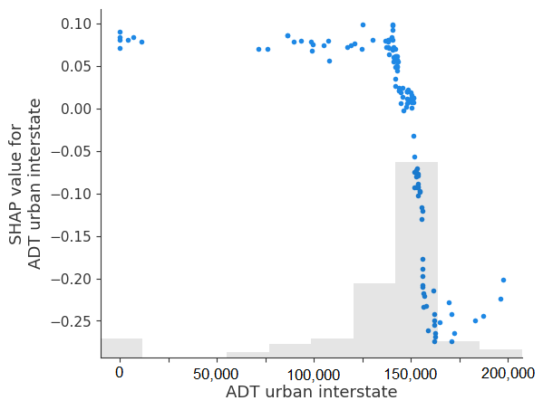
Injury Severity Model – Select Variables
Findings
Predictive Modeling
Average annual daily traffic (ADT)
E-scooter crashes on roads with lower ADT of interstate/freeway were found to be more likely to result in severe injuries.
E-scooter crashes occurring on high ADT or highly congested local roads were more likely to result in severe injuries compared to those occurring on low ADT local roads.

Slide 27
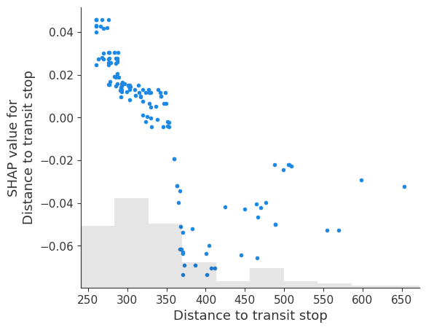
Injury Severity Model – Select Variables Cont'd
Findings
Predictive Modeling
Distance to Transit
More severe injury-related e-scooter crashes tended to occur closer to transit stops—especially for distances less than 300 meters (984 ft.).

Slide 28
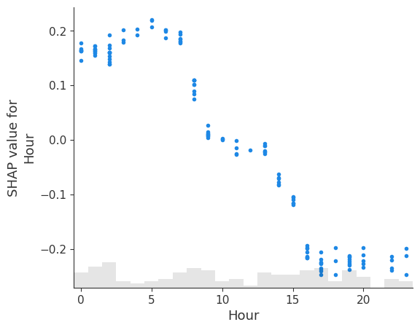
Injury Severity Model – Select Variables Cont'd
Findings
Predictive Modeling
Time of day
E-scooter crashes occurring at late hours, especially after midnight, were most likely to result in severe injuries.

Slide 29
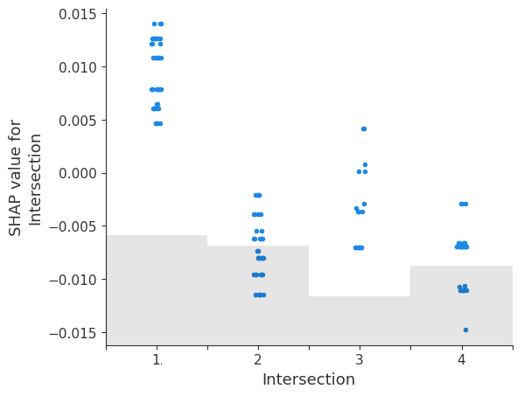
Injury Severity Model – Select Variables Cont'd
Findings
Predictive Modeling
Type of bicycle facility
1=Intersection 2=Intersection-related 3=Driveway access 4=Nonintersection
The type of bicycle facility had a very small effect on injury severity for e-scooter crashes.
Intersections were found to be influential in e-scooter crash injury classification.

Slide 30
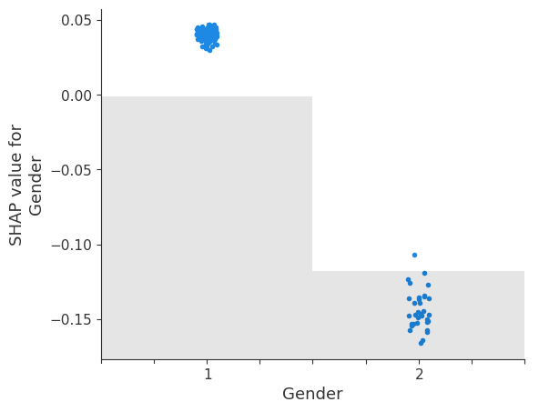
Injury Severity Model – Select Variables Cont'd
Findings
Predictive Modeling
Demographics
Male riders were more prone to experiencing severe injuries in e-scooter crashes as compared to their female counterparts.
The results also indicated disproportionate use and disproportionate risk among e-scooter users with respect to the race of the rider.
1=Male 2=Female

Slide 31
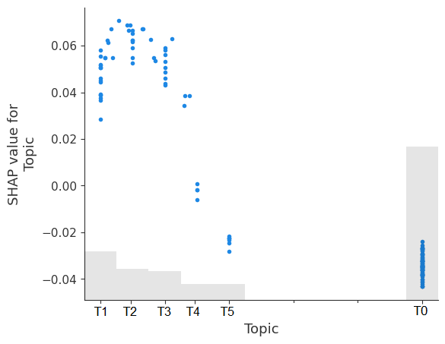
Injury Severity Model – Select Variables Cont'd
Findings
Predictive Modeling
Topic
Topic variable was found to be influential on injury severity classification in e-scooter crashes.
Crashes related to intersections, where the fault lies in not following traffic signs properly while crossing, had a higher impact on classifying the crash as severe.

Slide 32
Final Remarks
Final Remarks

Slide 33
Summary
Final Remarks
Summary
Contributes to our understanding of the characteristics of e-scooter riders and individuals involved in e-scooter-related crashes.
A multi-level analysis, spanning a period of four years of data (2018 to 2021).
A rich, unique set of data compiled through an array of techniques.
Provided valuable insights into implementing effective strategies for e-scooter safety and promoting a safer transportation environment for e-scooter riders and other road users.
Revealed the importance of enhancing the consistency in injury and incident reporting as well as developing and integrating data from different sources.

Slide 34
Potential Strategies
Final Remarks
Strategies
Targeted safety education tailored to specific factors (e.g., gender, age, and ethnicity), promoting safe e-scooter use and enhanced awareness.
Interventions aimed at addressing alcohol and drug use, such as new laws, educational campaigns, and targeted advertisements.
Better infrastructure planning for enhanced e-scooter safety, such as enhancements in the design of micromobility-friendly intersections, improvements in visibility, traffic calming measures, and time/location-specific measures.

Slide 35
IN-DEPTH EXAMINATION OF E-SCOOTER SAFETY: A CASE STUDY OF AUSTIN, TEXAS
Project Team:
Ipek Nese Sener Research Scientist, TTI (Principal Investigator)
Pranik Koirala Graduate Student, TTI/TAMU
Yunlong Zhang Professor, TAMU
For more information:
Ipek N. Sener, Ph.D.
Research Scientist
i-sener@tti.tamu.edu
https://safed.vtti.vt.edu/projects/delving-into-safety-considerations-of-e-scooters-a-case-study-of-austin-texas/

